Slide 1
Is the United States Still a Land of Opportunity?
Recent Trends in Intergenerational Mobility
Raj Chetty, Harvard
Nathaniel Hendren, Harvard
Patrick Kline, UC-Berkeley
Emmanuel Saez, UC-Berkeley
Nicholas Turner, Office of Tax Analysis
The opinions expressed in this paper are those of the authors alone and do not necessarily reflect the views of the Internal Revenue Service or the U.S. Treasury Department. This work is a component of a larger project examining the effects of eliminating tax expenditures on the budget deficit and economic activity. Certain results reported here are taken from the SOI Working Paper “The Economic Impacts of Tax Expenditures: Evidence from Spatial Variation across the U.S.,” approved under IRS contract TIRNO-12-P-00374.

Slide 2

Introduction
Growing public perception that intergenerational mobility has declined in the United States
Vast literature has investigated whether this is true empirically
[e.g., Aaronson and Mazumder 2008, Lee and Solon 2009, Auten, Gee, and Turner 2013]
Results debated partly due to limitations in data [Black and Devereux 2011]
Notes:
2

Slide 3
This Paper
We analyze trends in mobility for 1971-1993 birth cohorts using administrative data on more than 50 million children and their parents
Two main empirical results
  Relationship between parent and child percentile ranks (i.e. the copula) is extremely stable
    Chance of moving from bottom to top fifth of income distribution no lower for children entering labor market today than in the 1970s
  Inequality increased in this sample, consistent with prior work
    Consequences of the “birth lottery” – the parents to whom a child is born – are larger today than in the past
Notes:
3

Slide 4
Data
We use de-identified data from federal income tax returns
  Includes non-filers via information forms (e.g. W-2’s)
Notes:
4

Slide 5
Linking Children to Parents
Parent(s) defined as first person(s) who claim child as a dependent
  Can reliably link children to parents up to age 16, after which some children leave the house
We link approximately 90% of children to parents overall
Notes:
5

Slide 6
Two Samples
Population tax records starting in 1996
  Data on children and parents for the 1980-1993 birth cohorts
  40 million children, age 20-31 in 2011
Statistics of Income 0.1% Stratified Random Samples 1987-1997
  Data on children and parents for the 1971-1982 birth cohorts
Notes:
6

Slide 7
Income Definitions
Parent Income: mean pre-tax household income (AGI+SSDI)
Child Income: mean pre-tax household income ages 26 or 29-30
For non-filers, use W-2 wage earnings + SSDI + UI income
  If no 1040 and no W-2, code income as 0
These household level definitions capture total resources in the household
  Results robust to using individual-level income measures
Notes:
7

Slide 8
Measuring Intergenerational Mobility

Slide 9
Measuring Mobility
Previous literature has measured mobility using various statistics
  Log-log intergenerational elasticity
  Rank-rank correlations
  Transition matrices
Each of these could potentially exhibit different time trends
Begin by formalizing how we measure mobility
Notes:
9

Slide 10
Measuring Mobility
We decompose joint distribution of parent and child income into two components
  Joint distribution of parent and child percentile ranks (i.e., copula of distribution)
  Marginal distributions of parent and child income
Marginal distributions determine inequality within generations
Copula is the key determinant of mobility across generations
  Rank-rank and transition matrix depend purely on copula
  Log-log IGE combines copula and marginal distributions
Notes:
10

Slide 11
Rank-Rank Specification
We study all three measures, but use a rank-rank specification as our primary measure
  Rank children based on their incomes relative to other children in same birth cohort
  Rank parents of these children based on their incomes relative to other parents in this sample
In our companion paper on geography of mobility, we show that rank-rank has statistical advantages over other measures
Notes:
11

Slide 12
Mean Child Percentile Rank vs. Parent Percentile Rank
70
60
50
Mean Child Income Rank
40
30
Rank-Rank Slope (U.S) = 0.341
(0.0003)
20
0
10
20
30
40
50
60
70
80
90
100
Parent Income Rank

Slide 13
Lifecycle and Attenuation Bias
Literature has emphasized two sources of potential bias in estimates of intergenerational elasticities
  Lifecycle bias: measuring earnings too early or too late
  Attenuation bias: measuring transitory rather than permanent income
Notes:
13

Slide 14
Lifecycle Bias: Intergenerational Income Correlation
by Age at Which Child’s Income is Measured
0.4
0.3
Rank-Rank Slope
0.2
0.1
0
22
25
28
31
34
37
40
Age at which Child’s Income is Measured
Population

Slide 15
Lifecycle Bias: Intergenerational Income Correlation
by Age at Which Child’s Income is Measured
0.4
0.3
Rank-Rank Slope
0.2
0.1
0
22
25
28
31
34
37
40
Age at which Child’s Income is Measured
Population
SOI 0.1% Random Sample

Slide 16
Attenuation Bias: Rank-Rank Slopes
by Number of Years Used to Measure Parent Income
0.4
0.3
Rank-Rank Slope
0.2
0.1
0
1
4
7
10
13
16
Years Used to Compute Mean Parent Income

Slide 17
Time Trends

Slide 18
Child Income Rank vs. Parent Income Rank by Birth Cohort
70
60
Mean Child Income Rank
50
71-74 Slope = 0.299
(0.009)
40
30
0
20
40
60
80
100
Parent Income Rank
1971-74

Slide 19
Child Income Rank vs. Parent Income Rank by Birth Cohort
70
60
Mean Child Income Rank
50
71-74 Slope = 0.299
(0.009)
40
75-78 Slope = 0.291
(0.007)
30
0
20
40
60
80
100
Parent Income Rank
1971-74
1975-78

Slide 20
Child Income Rank vs. Parent Income Rank by Birth Cohort
70
60
Mean Child Income Rank
50
71-74 Slope = 0.299
(0.009)
40
75-78 Slope = 0.291
(0.007)
79-82 Slope = 0.313
30
(0.008)
0
20
40
60
80
100
Parent Income Rank
1971-74
1975-78
1979-82

Slide 21
Intergenerational Mobility Estimates for the 1971-1993 Birth Cohorts
0.8
0.6
0.4
Rank-Rank Slope
0.2
0
1971
1974
1977
1980
1983
1986
1989
1992
Child's Birth Cohort
Income Rank-Rank
(Child Age 30)

Slide 22
Intergenerational Mobility Estimates for the 1971-1993 Birth Cohorts
0.8
0.6
0.4
Rank-Rank Slope
0.2
0
1971
1974
1977
1980
1983
1986
1989
1992
Child's Birth Cohort
Income Rank-Rank
(Child Age 30; SOI Sample)
Income Rank-Rank
(Child Age 26; Pop. Sample)

Slide 23
College Gradient
For younger cohorts, it is too early to measure earnings
But we can measure college attendance, which is a strong predictor of earnings
Moreover, college-income gradient is highly correlated with income rank-rank slope across areas of the U.S. [Chetty et al. 2014]
Define college attendance as attending when age 19
  Results similar if attendance measured at later ages
Notes:
23

Slide 24
College Attendance Rates vs. Parent Income Rank by Cohort
100%
80%
60%
Percent in College at 19
84-87 Slope = 0.745
40%
(0.008)
20%
0
20
40
60
80
100
Parent Income Rank
1984-87

Slide 25
College Attendance Rates vs. Parent Income Rank by Cohort
100%
80%
60%
Percent in College at 19
84-87 Slope = 0.745
40%
(0.008)
88-90 Slope = 0.742
(0.010)
20%
0
20
40
60
80
100
Parent Income Rank
1984-87
1988-90

Slide 26
College Attendance Rates vs. Parent Income Rank by Cohort
100%
80%
60%
Percent in College at 19
84-87 Slope = 0.745
40%
(0.008)
88-90 Slope = 0.742
(0.010)
20%
91-93 Slope = 0.705
(0.013)
0
20
40
60
80
100
Parent Income Rank
1984-87
1988-90
1991-93

Slide 27
Intergenerational Mobility Estimates for the 1971-1993 Birth Cohorts
0.8
0.6
0.4
Rank-Rank Slope
0.2
0
1971
1974
1977
1980
1983
1986
1989
1992
Child's Birth Cohort
Income Rank-Rank
(Child Age 30; SOI Sample)
Income Rank-Rank
(Child Age 26; Pop. Sample)
College-Income Gradient
(Child Age 19; Pop. Sample)

Slide 28
Intergenerational Mobility Estimates for the 1971-1993 Birth Cohorts
0.8
0.6
0.4
Rank-Rank Slope
0.2
0
1971
1974
1977
1980
1983
1986
1989
1992
Child's Birth Cohort
Income Rank-Rank
(Child Age 30; SOI Sample)
Forecast Based on Age 26
Income and College Attendance
Income Rank-Rank
(Child Age 26; Pop. Sample)
College-Income Gradient
(Child Age 19; Pop. Sample)

Slide 29
College Quality
Can obtain a richer prediction of earnings by using information on which college student attended
Define “college quality” as mean earnings at age 31 of children born in 1979-80 based on the college they attended at age 20
Notes:
29

Slide 30
College Quality Rank vs. Parent Income Rank by Cohort
80
70
60
Mean College Quality Rank
50
40
84-87 Coll. Qual Gradient (P75-P25) = 0.191
88-90 Coll. Qual Gradient (P75-P25) = 0.192
30
91-93 Coll. Qual Gradient (P75-P25) = 0.181
0
20
40
60
80
100
Parent Income Rank
1984-87
1988-90
1991-93

Slide 31
Trends in College Attendance vs. College Quality Gradients
.2
.8
.15
.6
College Attendance Gradient
.1
.4
College Quality Gradient (P75-P25)
.05
.2
0
0
1984
1986
1988
1990
1992
1994
Child’s Birth Cohort
College Quality
College Attendance

Slide 32
Quintile Transition Probabilities
Mobility also stable using other statistics
  Ex: fraction of children who reach the top quintile
Notes:
32

Slide 33
Probability of Reaching Top Quintile by Birth Cohort
40%
30%
Probability Child in Top Fifth of Income Distribution
20%
10%
0%
1971
1974
1977
1980
1983
1986
Child's Birth Cohort
Parent Quintile
Q1
Q3
Q5

Slide 34
Regional Heterogeneity
Substantial heterogeneity in mobility across areas
[Chetty, Hendren, Kline, Saez 2014]
Do these differences persist over time?
Notes:
34

Slide 35
Intergenerational Mobility Estimates by Parent’s Census Division
0.8
College Attendance
0.6
Rank-Rank Slope
0.4
Age 26 Income Rank
0.2
0
1980
1982
1984
1986
1988
1990
1992
Child's Birth Cohort
Pacific
Mountain
New England
East South Central

Slide 36
Discussion
Rank-based mobility is not declining in the U.S. as a whole
  Combined with evidence from Lee and Solon (2009), mobility appears to be roughly stable over past half century
But mobility is (and has consistently been) low in the U.S. relative to most other developed countries (Corak 2013)
Increased inequality → consequences of the “birth lottery” larger
    Low mobility matters more today than in the past
Notes:
36

Slide 37
Discussion
Results may be surprising given negative correlation between mobility and inequality in cross-section [Corak 2013]
  Based on “Great Gatsby Curve,” one would predict that mobility should have fallen by 20% [Krueger 2012]
One explanation: much of the increase in inequality is driven by extreme upper tail (top 1%)
  But top 1% income shares are not strongly correlated with mobility across countries or across areas within the U.S. [Chetty et al. 2014]
  Predicted increase in rank-rank slope based on bottom 99% Gini coefficient (“middle class inequality”) is only 0.3 to 0.32
Notes:
37

Slide 38
Future Research
Key open question: why do some parts of the U.S. have persistently low rates of intergenerational mobility?
  Mobility statistics by birth cohort by commuting zone available on project website (www.equality-of-opportunity.org)
Notes:
38

Slide 39
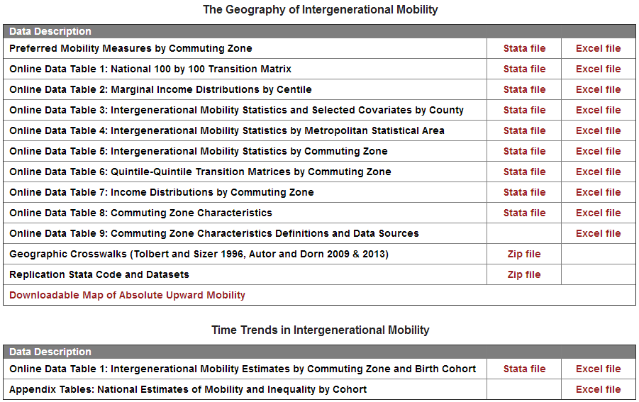
Download Data on Social Mobility
www.equality-of-opportunity.org/data

Slide 40
Appendix Figures

Slide 41
Slope of College Attendance Gradient by
Age of Child when Parent Income is Measured
0.8
0.6
0.4
College Attendance Gradient
0.2
0
3
6
9
12
15
18
Age of Child when Parent Income is Measured

Slide 42
Attenuation Bias: Rank-Rank Slopes by
Number of Years Used to Measure Child Income
0.4
0.3
Rank-Rank Slope
0.2
0.1
0
1
2
3
4
5
Years Used to Compute Mean Child Income

Slide 43
Rank-Rank Slope by Age at which Parent Income is Measured
0.4
0.3
Rank-Rank Slope
0.2
0.1
0
41
43
45
47
49
51
53
55
Age at which Parent Income is Measured

Slide 44
Robustness of College Attendance Gradient by
Age at which College Attendance is Measured
0.8
0.6
0.4
Slope of Coll. Attendance by Par. Income Gradient
0.2
0
1981
1983
1985
1987
1989
1991
1993
Child’s Birth Cohort
Before Age 19
Before Age 20
Before Age 22
Before Age 25

