Slide 1
The Long-Term Impacts of Teachers:
Teacher Value-Added and Students’ Outcomes in Adulthood
Raj Chetty, Harvard
John N. Friedman, Harvard
Jonah Rockoff, Columbia
March 2014
Notes:
1

Slide 2

How can we measure and improve the quality of teaching in elementary schools?
One approach: “value-added” (VA) measures [Hanushek 1971, Murnane 1975, Rockoff 2004, Rivkin et al. 2005, Aaronson et al. 2007]
  Rate teachers based on their students’ test score gains
School districts have started to use VA to evaluate teachers, leading to considerable debate
  Ex: Washington D.C. lays off teachers and offers bonuses using a metric that puts 50% weight on VA measures
  Lawsuit in LA based on VA measures
Introduction: Teacher Value-Added
Notes:
2

Slide 3
Debate About Teacher Value-Added
Debate stems primarily from two intellectual issues:
    If VA estimates are biased, they will incorrectly reward or penalize teachers for the mix of students they get
  Lack of evidence on teachers’ long-term impacts
    Do teachers who raise test scores improve students’ long-term outcomes or are they simply better at teaching to the test?
  Disagreement about whether VA measures are biased
  [Kane and Staiger 2008, Rothstein 2010]
    Do differences in test-score gains across teachers capture causal impacts of teachers or are they driven by student sorting?
Notes:
3

Slide 4
This study answers these two questions by tracking one million children from childhood to early adulthood
  Develop new quasi-experimental tests for bias in VA estimates
  Test whether children who get high VA teachers have better outcomes in adulthood
Results also shed light on broader issues in the economics of education
  What are the long-run returns to investments in better teaching?
  Are impacts on scores a good proxy for long-term impacts of educational interventions?
Objectives of This Project
Notes:
4

Slide 5
Data
Construction of Value-Added Estimates with Drift
Evaluating Bias in Value-Added Estimates
Long-Term Impacts
Policy Implications
Outline
Notes:
5

Slide 6
Dataset 1: School District Data
Teacher and class assignments from 1991-2009 for 2.5 million children
Test scores from 1989-2009
  Scaled scores standardized by grade and subject (math/reading)
  18 million test scores, grades 3-8
Exclude students in special ed. schools and classrooms (6% of obs.)
Notes:
6

Slide 7
Dataset 2: United States Tax Data
Selected data from U.S. federal income tax returns from 1996-2010
  Includes non-filers via information forms (e.g. W-2’s)
Student outcomes: earnings, college, teenage birth, neighborhood quality
Parent characteristics: household income, 401k savings, home ownership, marital status, age at child birth
  Omitted variables from standard VA models
Approximately 90% of student records matched to tax data
  Data were analyzed as part of a broader project on tax policy
  Research based purely on statistics aggregating over thousands of individuals, not on individual data
Notes:
7

Slide 8
Data Structure
Student | Subject | Year | Grade | Class | Teacher | Test Score | Age 28 Earnings
Raj | Math | 1992 | 4 | 1 | Samuelson | 0.5 | $22K
Raj | English | 1992 | 4 | 1 | Samuelson | 1.3 | $22K
Raj | Math | 1993 | 5 | 2 | Solow | 0.9 | $22K
Raj | English | 1993 | 5 | 2 | Solow | 0.1 | $22K
Raj | Math | 1994 | 6 | 3 | Arrow | 1.5 | $22K
Raj | English | 1994 | 6 | 4 | Stigler | 0.5 | $22K
One observation per student-subject-year

Slide 9
Summary Statistics
Variable | Mean | S.D.
 | (1) | (2)
Student Data:
Class size (not student-weighted) | 28.2 | 5.8
Test score (SD) | 0.12 | 0.91
Female | 50.4%
Age (years) | 11.7 | 1.6
Free lunch eligible (1999-2009) | 77.1%
Minority (Black or Hispanic) | 72.1%
English language learner | 4.9%
Special education | 3.1%
Repeating grade | 2.7%
Number of subject-school years per student | 6.25 | 3.18
Student match rate to adult outcomes | 89.2%
Student match rate to parent chars. | 94.8%

Slide 10
Summary Statistics
Variable | Mean | S.D.
 | (1) | (2)
Adult Outcomes:
Annual wage earnings at age 20 | 5,670 | 7,773
Annual wage earnings at age 25 | 17,194 | 19,889
Annual wage earnings at age 28 | 20,885 | 24,297
In college at age 20 | 35.6%
In college at age 25 | 16.5%
College Quality at age 20 | 26,408 | 13,461
Contribute to a 401(k) at age 25 | 19.1%
ZIP code % college graduates at age 25 | 13.7%
Had a child while a teenager (for women) | 14.3%
Parent Characteristics:
Household income (child age 19-21) | 40,808 | 34,515
Ever owned a house (child age 19-21) | 34.8%
Contributed to a 401k (child age 19-21) | 31.3%
Ever married (child age 19-21) | 42.2%
Age at child birth | 28.3 | 7.8
Predicted Score | 0.17 | 0.26

Slide 11
Simplest case: teachers teach one class per year with N students
All teachers have test score data available for t previous years
Objective: predict test scores for students taught by teacher j in year t+1 using test score data from previous t years
Constructing Value-Added Estimates
Notes:
11

Slide 12
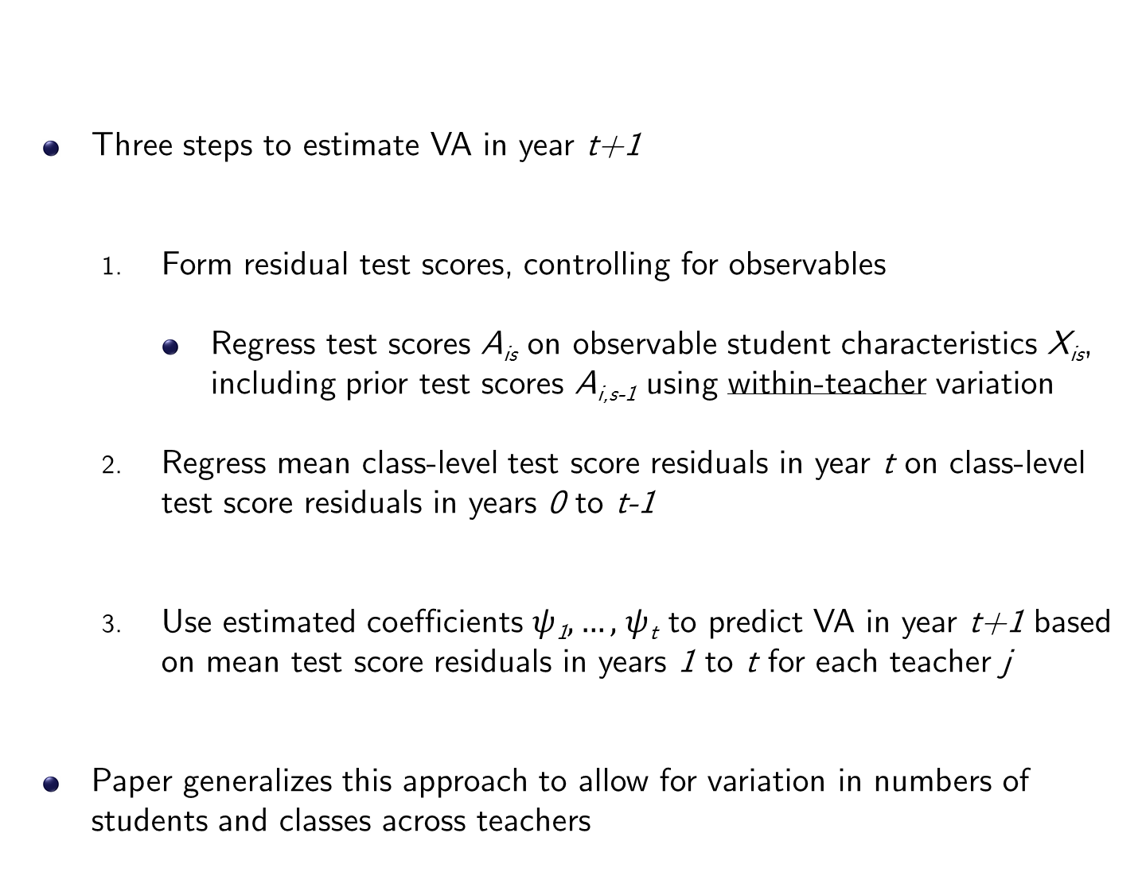
Three steps to estimate VA in year t+1
  Form residual test scores, controlling for observables
    Regress test scores A_{is} on observable student characteristics X_{is}, including prior test scores A_{i,s-1} using within-teacher variation
  Regress mean class-level test score residuals in year t on class-level test score residuals in years 0 to t-1
  Use estimated coefficients $ψ$₁$,…,$ $ψ$_{t} to predict VA in year t+1 based on mean test score residuals in years 1 to t for each teacher j
Paper generalizes this approach to allow for variation in numbers of students and classes across teachers
Constructing Value-Added Estimates
Notes:
12

Slide 13
Practical complications: number of students varies across classes, number of years varies across teachers, multiple classes per year in middle school
Generalize regression approach by estimating an autocorrelation vector and assume stationarity of teacher VA process
Then form a prediction for VA in each teacher-year using data from all other years using autocorrelation vector
STATA ado file to implement this procedure on the web
Constructing Value-Added Estimates
Notes:
13

Slide 14
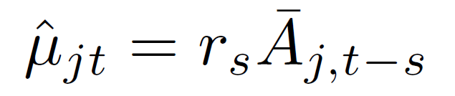

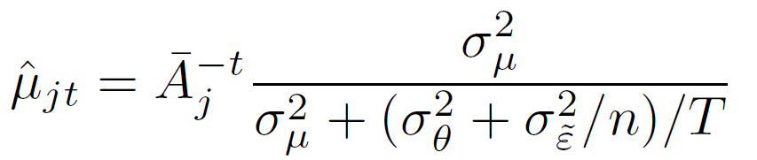
Constructing Value-Added: Special Cases
Two special cases:
  Forecast VA in year t using data from only year t-s:
where
  Without drift, put equal weight on all prior scores. Formula collapses to standard shrinkage estimator [e.g., Kane and Staiger 2008]
Notes:
14

Slide 15
Autocorrelation Vector in Elementary School for English and Math Scores
0.5
0.4
0.3
Correlation (r_{s})
0.2
0.1
0
0
2
4
6
8
10
Years Between Classes
English
Math

Slide 16
Empirical Distribution of Estimated Teacher Effects in Elementary School
6
SD for English = 0.080
SD for Math = 0.116
4
Density
2
0
-0.3
-0.2
-0.1
0
0.1
0.2
0.3
Teacher Value-Added
English
Math

Slide 17
Autocorrelation Vector in Middle School for English and Math Scores
0.5
0.4
0.3
Correlation
0.2
0.1
0
0
2
4
6
8
10
Years Between Classes
English
Math

Slide 18
Empirical Distribution of Estimated Teacher Effects in Middle School
10
SD for English = 0.042
SD for Math = 0.092
8
6
Density
4
2
0
-0.3
-0.2
-0.1
0
0.1
0.2
0.3
Teacher Value-Added
English
Math

Slide 19
Test Scores vs. Teacher Value-Added
0.2
0.1
Score in Year t
0
-0.1
Coef. = 0.998
(0.006)
-0.2
-0.2
-0.1
0
0.1
0.2
Estimated Teacher Value-Added in Year t

Slide 20
Part I: Bias in VA Estimates
Notes:
20

Slide 21
Question 1: Are VA Estimates Unbiased?
Teachers’ estimated VA may reflect unobserved differences in type of students they get rather than causal impact of teacher
We evaluate whether VA measures provided unbiased forecasts of teachers’ causal impacts in two ways
First test: are observable characteristics excluded from VA model are correlated with VA estimates?
    Ex: parent income is a strong predictor of test scores even conditional on control vector used to estimate VA
    Do high VA teachers have students from higher-income families?
    Combine parental background characteristics into a single predicted score using a cross-sectional regression
Notes:
21

Slide 22
Predicted Scores based on Parent Chars. vs. Teacher Value-Added
0.2
0.1
Predicted Score in Year t
0
Coef. = 0.002
(0.000)
-0.1
-0.2
-0.2
-0.1
0
0.1
0.2
Teacher Value-Added
Predicted Score
Actual Score

Slide 23
Predicted Score Based on Twice-Lagged Score vs. Current Teacher VA
0.2
0.1
Predicted Score in Year t
0
Coef. = 0.022
(0.002)
-0.1
-0.2
-0.2
-0.1
0
0.1
0.2
Teacher Value-Added
Year t-2
Year t

Slide 24
Estimates of Forecast Bias Using Parent Characteristics and Lagged Scores
 | Score in Year t | Pred. Score using Parent Chars. | Score in Year t | Pred. Score using Year t-2 Score
Dep. Var.:
 | (1) | (2) | (3) | (4)
Teacher VA | 0.998 | 0.002 | 0.996 | 0.022
 | (0.0057) | (0.0003) | (0.0057) | (0.0019)
Parent Chars. Controls |  |  | X
Observations | 6,942,979 | 6,942,979 | 6,942,979 | 5,096,518

Slide 25
Quasi-Experimental Validation: Teacher Switchers
VA measures orthogonal to predictors of scores such as parent income
But selection on unobservables could still be a problem (Rothstein 2010)
Ideal test: out-of-sample forecasts in experiments (Kane and Staiger 2008)
  Does a student who is randomly assigned to a teacher previously estimated to be high VA have higher test score gains?
We use teacher switching as a quasi-experimental analog
Notes:
25

Slide 26
Teacher Switchers in School-Grade-Subject-Year Level Data
School | Grade | Subject | Year | Teachers | Mean Score | Mean Age 28 Earnings
1 | 5 | math | 1992 | Smith, Farber, … | -.09 | $15K
1 | 5 | math | 1993 | Smith, Farber, … | -.04 | $17K
1 | 5 | math | 1994 | Smith, Farber, … | -.05 | $16K
1 | 5 | math | 1995 | Mas, Farber, … | 0.01 | $18K
1 | 5 | math | 1996 | Mas, Farber, … | 0.04 | $17K
1 | 5 | math | 1997 | Mas, Farber, … | 0.02 | $18K
Smith switches to a different school in 1995; Mas replaces him

Slide 27
Impact of High Value-Added Teacher Entry on Cohort Test Scores
.06
.04
School-Grade-Cohort Mean Test Score
.02
0
-3
-2
-1
0
1
2
Year Relative to Entry of High Value-Added Teacher
Score in Current Grade

Slide 28
Impact of High Value-Added Teacher Entry on Cohort Test Scores
.06
.04
School-Grade-Cohort Mean Test Score
.02
0
-3
-2
-1
0
1
2
Year Relative to Entry of High Value-Added Teacher
Score in Current Grade
Score in Previous Grade

Slide 29
Impact of High Value-Added Teacher Entry on Cohort Test Scores
.06
∆ Score = 0.035
(0.008)
∆ TVA = 0.042
(0.002)
.04
p [∆ score = 0] < 0.001
p [∆ score = ∆ TVA] = 0.34
School-Grade-Cohort Mean Test Score
Number of Events = 1135
.02
0
-3
-2
-1
0
1
2
Year Relative to Entry of High Value-Added Teacher
Score in Current Grade
Score in Previous Grade

Slide 30
Impact of High Value-Added Teacher Exit on Cohort Test Scores
.15
∆ Score = -0.045
(0.008)
∆ TVA = -0.042
(0.002)
.1
p [∆ score = 0] < 0.001
p [∆ score = ∆ TVA] = 0.66
School-Grade-Cohort Mean Test Score
Number of Events = 1115
.05
0
-3
-2
-1
0
1
2
Year Relative to Departure of High Value-Added Teacher
Score in Current Grade
Score in Previous Grade

Slide 31
Impact of Low Value-Added Teacher Entry on Cohort Test Scores
0
-.01
-.02
School-Grade-Cohort Mean Test Score
-.03
∆ Score = -0.021
(0.007)
∆ TVA = -0.033
(0.002)
-.04
p [∆ score = 0] < 0.01
p [∆ score = ∆ TVA] = 0.09
-.05
Number of Events = 1148
-3
-2
-1
0
1
2
Year Relative to Entry of Low Value-Added Teacher
Score in Current Grade
Score in Previous Grade

Slide 32
Impact of Low Value-Added Teacher Exit on Cohort Test Scores
.02
.01
0
School-Grade-Cohort Mean Test Score
-.01
∆ Score = 0.034
(0.008)
-.02
∆ TVA = 0.034
(0.002)
-.03
p [∆ score = 0] < 0.001
p [∆ score = ∆ TVA] = 0.99
Number of Events = 1089
-3
-2
-1
0
1
2
Year Relative to Departure of Low Value-Added Teacher
Score in Current Grade
Score in Previous Grade

Slide 33
Teacher Switchers Design: Changes in Scores vs. Changes in Mean Teacher VA
0.1
0.05
Changes in Scores
0
-0.05
Coef. = 0.974
(0.033)
-0.1
-0.1
-0.05
0
0.05
0.1
Changes in Mean Teacher Value-Added

Slide 34
Changes in Predicted Scores vs. Changes in Mean Teacher VA
0.1
0.05
0
Changes in Predicted Scores
Coef. = 0.004
(0.005)
-0.05
-0.1
-0.1
-0.05
0
0.05
0.1
Changes in Mean Teacher Value-Added
Predicted Score
Score

Slide 35
Changes in Other-Subject Scores vs. Changes in Mean Teacher VA
Middle Schools Only
0.1
0.05
0
Changes in Other-Subject Scores
-0.05
Coef. = 0.038
(0.083)
-0.1
-0.1
-0.05
0
0.05
0.1
Changes in Mean Teacher Value-Added

Slide 36
Changes in Other-Subject Scores vs. Changes in Mean Teacher VA
Elementary Schools Only
0.1
0.05
0
Changes in Other-Subject Scores
-0.05
Coef. = 0.237
(0.028)
-0.1
-0.1
-0.05
0
0.05
0.1
Changes in Mean Teacher Value-Added

Slide 37
Estimates of Forecast Bias with Alternative Control Vectors
Control Vector | Quasi-Experimental Estimate of Bias (%)
Baseline | 2.58
 | (3.34)
Student-level lagged scores | 4.83
 | (3.29)
Non-score controls only | 45.39
 | (2.26)
No controls | 65.58
 | (3.73)

Slide 38
Relation to Rothstein (2010) Findings on Sorting
Rothstein result 1: Students are sorted into classrooms based on pre-determined variables such as grade g-2 test scores
  We confirm this result in our data
Rothstein result 2: Selection on observables is minimal conditional on grade g-1 controls
  Controlling for grade g-2 score does not affect VA estimates
  Consistent with our findings that VA does not predict g-2 score
→ Rothstein notes that his findings do not imply bias in VA estimates
  But they raise concerns about potential selection on unobservables
  Our quasi-experimental teacher switcher tests indicate that selection on unobservables turns out to be modest in practice
Notes:
38

Slide 39
Part II: Long-Term Impacts
Notes:
39

Slide 40
Fade-Out of Teachers’ Impacts on Test Scores in Subsequent Grades
1
0.8
0.6
Impact of Current Teacher VA on Test Scores
0.4
0.2
0
0
1
2
3
4
Years After Current School Year
Point Estimate
95% CI

Slide 41
Impacts on Outcomes in Adulthood
Do teachers who raise test scores also improve long-term outcomes?
Regress residualized long-term outcomes on teacher-level VA estimates
Then validate OLS estimates using cross-cohort switchers design
Interpretation of these reduced-form coefficients [Todd and Wolpin 2003]
  Impact of having better teacher, as measured by VA, for a single year during grades 4-8 on earnings
  Includes benefit of better teachers, peers, etc. in later grades via tracking, as well as any complementarity with future teacher quality
$$Y_{it}=α+ κ{\hat{m}}_{jt }+ η_{it}^{′}$$
Notes:
41

Slide 42

College Attendance at Age 20 vs. Teacher Value-Added
38
37.5
Percent in College at Age 20
37
36.5
Coef. = 0.82%
(0.07)
36
-1.5
-1
-0.5
0
0.5
1
1.5
Normalized Teacher Value Added ($\hat{m}$_{jt})

Slide 43
Change in College Attendance Across Cohorts vs. Change in Mean Teacher VA
0.8
0.6
0.4
Change in College Attendance Rate Across Cohorts (%)
0.2
0
Coef. = 0.86%
(0.23)
-0.2
-0.5
0
0.5
Change in Mean Normalized Teacher VA Across Cohorts

Slide 44
Event Study of Coefficients on College Attendance
1
Coef. at 0 = 1.0
(0.3)
Coef. at +1 equals Coef. at 0: p=0.009
Coef. at -1 equals Coef. at 0: p=0.050
0.5
Impact of 1 SD Change in Leads or Lags of Mean VA (%)
0
-0.5
-4
-3
-2
-1
0
1
2
3
4
Lead or Lag of Change in Mean VA

Slide 45
Impacts of Teacher Value-Added on College Attendance
 |  |  |  | College | College | College | High
Dependent | College at | College at | College at | Quality at | Quality at | Quality at | Quality
Variable: | Age 20 | Age 20 | Age 20 | Age 20 | Age 20 | Age 20 | College
 | (%) | (%) | (%) | ($) | ($) | ($) | (%)
 | (1) | (2) | (3) | (4) | (5) | (6) | (7)
Value-Added | 0.82 | 0.71 | 0.74 | 298.63 | 265.82 | 266.17 | 0.72
 | (0.07) | (0.06) | (0.09) | (20.74) | (18.31) | (26.03) | (0.05)
Mean of Dep. Var. | 37.22 | 37.22 | 37.09 | 26,837 | 26,837 | 26,798 | 13.41
Baseline Controls | X | X | X | X | X | X | X
Parent Chars. Controls |  | X |  |  | X
Lagged Score Controls |  |  | X |  |  | X
Observations | 4,170,905 | 4,170,905 | 3,130,855 | 4,167,571 | 4,167,571 | 3,128,478 | 4,167,571

Slide 46
College Quality (Projected Earnings) at Age 20 vs. Teacher Value-Added
27200
27000
College Quality at Age 20 ($)
26800
26600
Coef. = $299
26400
(21)
-1.5
-1
-0.5
0
0.5
1
1.5
Normalized Teacher Value Added ($\hat{m}$_{jt})

Slide 47
Earnings at Age 28 vs. Teacher Value-Added
22000
21500
Earnings at Age 28 ($)
21000
Coef. = $350
(92)
20500
-1.5
-1
-0.5
0
0.5
1
1.5
Normalized Teacher Value Added ($\hat{m}$_{jt})

Slide 48
Impact of Teacher Value-Added on Earnings by Age
3
2
Impact of 1 SD of VA on Earnings (%)
1
0
-1
20
22
24
26
28
Age of Earnings Measurement
Point Estimate
95% CI

Slide 49
Impacts of Teacher Value-Added on Earnings
Dependent | Earnings at | Earnings at | Earnings at | Working at | Total Income | Wage growth
Variable: | Age 28 | Age 28 | Age 28 | Age 28 | at Age 28 | Ages 22-28
 | ($) | ($) | ($) | (%) | ($) | ($)
 | (1) | (2) | (3) | (4) | (5) | (6)
Teacher VA | 349.84 | 285.55 | 308.98 | 0.38 | 353.83 | 286.20
 | (91.92) | (87.64) | (110.17) | (0.16) | (88.62) | (81.86)
Mean of Dep. Var. | 21,256 | 21,256 | 21,468 | 68.09 | 22,108 | 11,454
Baseline Controls | X | X | X | X | X | X
Parent Chars. Controls |  | X |  |  | X
Lagged Score Controls |  |  | X
Observations | 650,965 | 650,965 | 510,309 | 650,965 | 650,965 | 650,943
Notes:
49

Slide 50
Women with Teenage Births vs. Teacher Value-Added
14.5
Coef. = -0.61%
(0.06)
14
Percent of Women with Teenage Births
13.5
13
12.5
-1.5
-1
-0.5
0
0.5
1
1.5
Normalized Teacher Value Added ($\hat{m}$_{jt})

Slide 51
Neighborhood Quality at Age 28 vs. Teacher Value-Added
14.2
14
Percent College Graduates in ZIP at Age 28
13.8
13.6
Coef. = 0.25%
(0.04)
13.4
-1.5
-1
-0.5
0
0.5
1
1.5
Normalized Teacher Value Added ($\hat{m}$_{jt})

Slide 52
Retirement Savings at Age 28 vs. Teacher Value-Added
20.5
20
Percent Saving for Retirement at Age 28
19.5
19
Coef. = 0.55%
(0.16)
-1.5
-1
-0.5
0
0.5
1
1.5
Normalized Teacher Value Added ($\hat{m}$_{jt})

Slide 53
Heterogeneity in Impacts of 1 SD of Teacher VA by Demographic Group
Dependent Variable: | College Quality at Age 20 ($)
 | Girls | Boys | Low Income | High Income | Minority | Non-Minority
 | (1) | (2) | (3) | (4) | (5) | (6)
Value-Added | 290.65 | 237.93 | 190.24 | 379.89 | 215.51 | 441.08
 | (23.61) | (21.94) | (19.63) | (27.03) | (17.09) | (42.26)
Mean College Quality | 27,584 | 26,073 | 23,790 | 30,330 | 23,831 | 33,968
Impact as % of Mean | 1.05% | 0.91% | 0.80% | 1.25% | 0.90% | 1.30%

Slide 54
Heterogeneity in Impacts of 1 SD of Teacher VA by Subject
Dependent Variable: | College Quality at Age 20 ($)
 | Elementary School |  |  |  | Middle School
 | (1) | (2) | (3) |  | (4) | (5)
Math Teacher | 207.81 |  | 106.34 |  | 265.59
Value-Added | (21.77) |  | (28.50) |  | (43.03)
English Teacher |  | 258.16 | 189.24 |  |  | 521.61
Value-Added |  | (25.42) | (33.07) |  |  | (63.67)
Control for Average VA in Other Subject |  |  |  |  | X | X

Slide 55
Reduced-form impacts of having better teachers in each grade include tracking to better teachers in future grades
We can net-out the impact of tracking from the reduced-form coefficients by estimating tracking process
  Estimate impact of current teacher VA on VA of future teachers
  Subtract out impacts of future teachers
Teacher Impacts by Grade
Notes:
55

Slide 56
Effect of Value-Added on Earnings by Grade
800
600
Impact of 1 SD of VA on College Quality ($)
400
200
0
4
5
6
7
8
Grade
Reduced-Form Coefficients
Net of Teacher Tracking
95% CI for Reduced-Form

Slide 57
Policy Implications
Policy Proposal 1: Deselection of Low VA Teachers
What are the gains from replacing teachers with VA in bottom
5% with teachers of median quality (Hanushek 2009)?
Notes:
57

Slide 58
Use estimates to evaluate gains from improving teacher quality
Measure impact of teacher VA on present value of lifetime earnings
Assumptions
  Ignore general equilibrium effects and non-monetary gains
  [Oreopoulos and Salvanes 2011, Heckman 2000]
  Constant percentage impact on earnings over life
  Life-cycle earnings follows cross-sectional life-cycle path in 2010
  2% wage growth with 5% discount rate back to age 12
    Undiscounted lifetime earnings gains are roughly 5 times larger
Policy Calculations
Notes:
58

Slide 59
Consider replacing teachers in the bottom 5% of VA distribution with teachers of average quality (Hanushek 2009)
Select on true VA → NPV gain for a class of average size: $407,000
In practice, gains are reduced by two factors
  Estimation error in VA
  Drift in VA over time
Policy Calculations
Notes:
59

Slide 60
Deselecting Teachers on the Basis of Value-Added
0.04
0.03
Density
0.02
0.01
0
0
-0.3
-0.2
-0.1
0
0.1
0.2
0.3
Teacher Effect on Test Scores
Population
Observed Below 5th Percentile After 3 Years

Slide 61
Deselecting Teachers on the Basis of Value-Added
0.04
0.03
Only 3% of teachers deselected
using estimated VA with three
years of data are above average
in true VA
Density
0.02
0.01
0
0
-0.3
-0.2
-0.1
0
0.1
0.2
0.3
Teacher Effect on Test Scores
Population
Observed Below 5th Percentile After 3 Years

Slide 62
Earnings Impact in First Year After Deselection Based on Estimated VA
Present Value Gain from Deselection on True VA = $406,988
400
300
Lifetime Earnings Gain Per Class ($1000s)
200
100
0
0
2
4
6
8
10
Number of Years Used to Estimate VA

Slide 63
Deselection Based on Estimated VA After 3 Years:
Earnings Impacts in Subsequent Years
400
300
Lifetime Earnings Gain Per Class ($1000s)
200
100
Average 10 Year Gain = $184,234
0
1
2
3
4
5
6
7
8
9
10
11
12
13
School Years Since Teacher Was Hired

Slide 64
Earnings Impact Over Time
400
300
Lifetime Earnings Gain Per Class ($1000s)
Average 10 Year Gain = $246,744
200
100
Average 10 Year Gain = $184,234
0
1
2
3
4
5
6
7
8
9
10
11
12
13
School Years Since Teacher Was Hired
Deselected on Estimated VA in Year 4
Deselected on True VA in Year 4

Slide 65
Costs vs. Benefits of VA-Based Evaluation
Rothstein (2013) estimates that deselecting bottom 5% of teachers based on VA would require a salary increase of $700 for all teachers
Avg. gain from deselection policy is $184,000 x 5% = $9,250
Gain 10 times as large as cost → VA could be a useful policy tool
Key concern: gains may be eroded when VA is actually used
  Using VA in high-stakes evaluation could lead to teaching to the test or cheating [Jacob 2005, Neal and Schanzenbach 2010, Barlevy and Neal 2012]
Broader policy lesson: improving teacher quality, whether through VA or other metrics, likely to have very large returns
Notes:
65

Slide 66
Policy Implications
Policy Proposal 2: Retention of High VA Teachers
What are the gains from increasing retention of high value-added teachers by paying salary bonuses?
Notes:
66

Slide 67
Gains from Retaining High VA Teachers
Retaining a teacher whose VA is at the 95th percentile (based on 3 years of data) for an extra year would generate PV earnings gain of $266K
Clotfelter et al. (2008) analyze impacts of bonus payments to teachers
  $1,800 bonus would raise teacher retention by 1.5 percentage points → earnings gain of $3,200
Net return relatively small because most of the bonus payments go to teachers who would not have left anyway
  Have to pay bonuses to 60 teachers to retain 1 teacher on average
Notes:
67

Slide 68
Conclusion
Further work needed to assess value-added as a policy tool
  Using VA measures in high-stakes evaluation could induce negative behavioral responses such as teaching to the test or cheating
  Errors in personnel decisions must be weighed against mean benefits
Results highlight large potential returns from developing policies to improve teacher quality
From a purely financial perspective, parents should be willing to pay about $7,000/year to get a 1 SD higher VA teacher for their child
Notes:
68

Slide 69
Appendix Figures
Notes:
69

Slide 70
Rankings of Colleges Based on Earnings at Ages 23 and 27 vs. Age 32
100
80
60
Percentile Ranking Based on Earnings at Age 23 or 27
40
20
0
0
20
40
60
80
100
Percentile Ranking of College Based on Earnings at Age 32
Age 23
Age 27

Slide 71
Correlation of College Rankings Based on Earnings at Age 32
With Rankings Based on Earnings at Earlier Ages
1
0.9
0.8
Correlation with Ranking Based on Earnings at Age 32
0.7
0.6
0.5
23
25
27
29
31
Age at Which Earnings are Measured

Slide 72
Correlation of Individual Earnings with Earnings 12 Years Later, by Age
.6
.5
.4
Correlation of Earnings at Age x with Earnings at Age x+12
.3
.2
.1
20
30
40
50
60
Age

Slide 73
College Attendance
80%
60%
Percent Attending College at Age 20
40%
20%
0%
-2
-1
0
1
2
Test Score (SD)
No Controls
With Controls

Slide 74
College Quality
45
40
35
College Quality at Age 20 ($1000)
30
25
20
-2
-1
0
1
2
Test Score (SD)
No Controls
With Controls

Slide 75
Earnings
40
30
Earnings at Age 28 ($1000)
20
10
-2
-1
0
1
2
Test Score (SD)
No Controls
With Controls

Slide 76
Teenage Birth
25%
20%
15%
Percent of Females with Teenage Birth
10%
5%
-2
-1
0
1
2
Test Score (SD)
No Controls
With Controls

Slide 77
Jacob and Levitt (2003) Proxy for Test Manipulation vs. Value-Added Estimates
25
20
15
Percentage of Jacob and Levitt (2003) Outliers
10
5
0
0
20
40
60
80
100
Percentile of Teacher Value-Added

