Slide 1
The Effects of Exposure to Better Neighborhoods on Children’s Long-Term Outcomes
Raj Chetty, Nathaniel Hendren, and Lawrence Katz
Harvard University and NBER
May 2015
The opinions expressed in this paper are those of the authors alone and do not necessarily reflect the views of the Internal Revenue Service or the U.S. Treasury Department. This work is a component of a larger project examining the effects of eliminating tax expenditures on the budget deficit and economic activity. Results reported here are contained in the SOI Working Paper “The Economic Impacts of Tax Expenditures: Evidence from Spatial Variation across the U.S.,” approved under IRS contract TIRNO-12-P-00374.

Slide 2

Introduction
Substantial disparities in economic outcomes across low vs. high poverty neighborhoods [e.g., Wilson 1987, Jencks and Mayer 1990, Cutler and Glaeser 1997]
These disparities motivated the HUD Moving to Opportunity (MTO) experiment in the mid 1990’s
  Offered a randomly selected subset of families living in high-poverty housing projects housing vouchers to move to lower-poverty areas
Large literature on MTO has found significant effects on adult health and subjective well-being
But these studies have consistently found that the MTO treatments had no impact on earnings or employment rates of adults and older youth [e.g. Katz, Kling, and Liebman 2001, Oreopoulous 2003, Sanbonmatsu et al. 2011]
Notes:
2

Slide 3
Revisiting MTO
We revisit the MTO experiment and focus on its impacts on children who were young when their families moved to better neighborhoods
Re-analysis motivated by a companion paper that presents quasi-experimental evidence on neighborhood effects [Chetty and Hendren 2015]
  Key finding: childhood exposure effects
  Every year in a better area during childhood → better outcomes in adulthood
  Implies that gains from moving to a better area are larger for children who move when young
Notes:
3

Slide 4
Revisiting MTO
In light of this evidence on childhood exposure effects, we returned to MTO data to examine treatment effects on young children
Link MTO data to tax data to analyze effects of MTO treatments on children’s outcomes in adulthood
Children we study were not old enough to observe outcomes in adulthood at the time of the MTO Final Impacts Evaluation (which used data up to 2008)
Notes:
4

Slide 5
Outline
    Background on MTO Experiment and Data
    Estimates from MTO Experiment
    Quasi-Experimental Estimates of Causal Effects by County
    [Chetty and Hendren 2015]
    Conclusion: Policy Implications

Slide 6
Moving to Opportunity Experiment
HUD Moving to Opportunity Experiment implemented from 1994-1998
4,600 families at 5 sites: Baltimore, Boston, Chicago, LA, New York
Families randomly assigned to one of three groups:
  Experimental: housing vouchers restricted to low-poverty (<10%) Census tracts
  Section 8: conventional housing vouchers, no restrictions
  Control: public housing in high-poverty (50% at baseline) areas

Slide 7
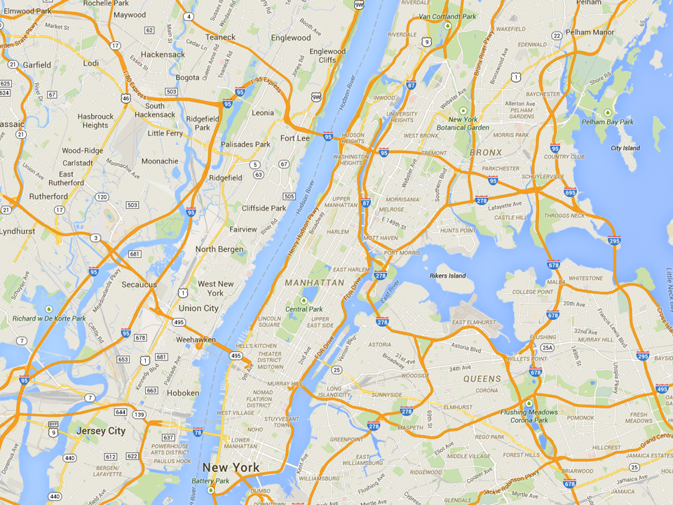
Most Common MTO Residential Locations in New York
Experimental
Wakefield Bronx
Section 8
Soundview Bronx
Control
King Towers
Harlem

Slide 8
Data
MTO data obtained from HUD
  4,604 households and 15,892 individuals
  Primary focus: 8,603 children born in or before 1991
Link MTO data to federal income tax returns from 1996-2012
  Approximately 85% of children matched
  Match rates do not differ significantly across treatment groups
  Baseline covariates balanced across treatment groups in matched data
Notes:
8

Slide 9
Estimating MTO Treatment Effects
In baseline analysis, estimate treatment effects for two groups:
  Young children: below age 13 at random assignment (RA)
  Older children: age 13-18 at random assignment
Average age at move: 8.2 for young children vs. 15.1 for older children
  Younger children had 7 more years of exposure to low-poverty nbhd.
Estimates robust to varying age cutoffs and estimating models that interact age linearly with treatments
Notes:
9

Slide 10
Estimating MTO Treatment Effects
We replicate standard regression specifications used in prior work
[Kling, Katz, Liebman 2007]
These intent-to-treat (ITT) estimates identify effect of being offered a voucher to move through MTO
Estimate treatment-on-treated (TOT) effects using 2SLS, instrumenting for voucher takeup with treatment indicators
  Experimental take-up: 48% for young children, 40% for older children
  Section 8 take-up: 65.8% for young children, 55% for older children
Treatment
Indicators
Site
Indicators
Notes:
10

Slide 11
Treatment Effects on Neighborhood Poverty
Begin with “first stage” effects of MTO experiment on poverty rates
  Measure mean poverty rates from random assignment to age 18 at tract level using Census data
Use poverty rates as an index of nbhd. quality, but note that MTO treatments naturally changed many other features of neighborhoods too
Notes:
11

Slide 12
Impacts of MTO on Children Below Age 13 at Random Assignment
Mean Poverty Rate in Tract (ITT)
Post RA to Age 18
(b) Mean Poverty Rate in Tract (TOT)
Post RA to Age 18
50
50
40
40
30
30
Mean Poverty Rate in Tract post RA to Age 18 (%)
Mean Poverty Rate in Tract post RA to Age 18 (%)
20
20
41.2%
33.2%
30.9%
10
41.2%
29.1%
19.6%
10
p = 0.0001
p = 0.0001
p = 0.0001
p = 0.0001
0
0
Control
Section 8
Experimental
Voucher
Control
Section 8
Experimental
Voucher

Slide 13
Impacts of MTO on Children Age 13-18 at Random Assignment
Mean Poverty Rate in Tract (ITT)
Post RA to Age 18
(b) Mean Poverty Rate in Tract (TOT)
Post RA to Age 18
50
50
40
40
30
30
Mean Poverty Rate in Tract post RA to Age 18 (%)
Mean Poverty Rate in Tract post RA to Age 18 (%)
20
20
47.9%
39.3%
37.9%
10
47.9%
32.5%
23.2%
10
p = 0.0001
p = 0.0001
p = 0.0001
p = 0.0001
0
0
Control
Section 8
Experimental
Voucher
Control
Section 8
Experimental
Voucher

Slide 14
Treatment Effects on Outcomes in Adulthood
Now turn to impacts on outcomes in adulthood
Begin by analyzing effects on children below age 13 at RA
Start with individual earnings (W-2 earnings + self-employment income)
  Includes those who don’t file tax returns through W-2 forms
Measured from 2008-12, restricting to years in which child is 24 or older
  Evaluate impacts at different ages after showing baseline results
Notes:
14

Slide 15
Impacts of MTO on Children Below Age 13 at Random Assignment
(a) Individual Earnings (ITT)
(b) Individual Earnings (TOT)
17000
17000
15000
15000
13000
13000
Individual Income at Age ≥ 24 ($)
Individual Income at Age ≥ 24 ($)
11000
11000
9000
9000
$11,270
$12,380
$12,894
$11,270
$12,994
$14,747
7000
p = 0.101
p = 0.014
7000
p = 0.101
p = 0.014
5000
5000
Control
Section 8
Experimental
Voucher
Control
Section 8
Experimental
Voucher

Slide 16
Impacts of Experimental Voucher by Age of Earnings Measurement
For Children Below Age 13 at Random Assignment
3000
2000
Experimental Vs. Control ITT on Earnings ($)
1000
0
-1000
20
21
22
23
24
25
26
27
28
Age of Income Measurement

Slide 17
Impacts of MTO on Children Below Age 13 at Random Assignment
(a) College Attendance (ITT)
(b) College Quality (ITT)
22000
20
21000
15
College Attendance, Ages 18-20 (%)
Mean College Quality, Ages 18-20 ($)
20000
10
5
16.5%
17.5%
19.0%
19000
$20,915
$21,547
$21,601
p = 0.435
p = 0.028
p = 0.014
p = 0.003
0
18000
Control
Section 8
Experimental
Voucher
Control
Section 8
Experimental
Voucher

Slide 18
Impacts of MTO on Children Below Age 13 at Random Assignment
(a) ZIP Poverty Share in Adulthood (ITT)
(b) Birth with no Father Present (ITT)
Females Only
25
50
23
37.5
21
Zip Poverty Share (%)
Birth with no Father on Birth Certificate (%)
25
19
17
23.8%
22.4%
22.2%
12.5
33.0%
31.7%
28.2%
p = 0.047
p = 0.008
p = 0.610
p = 0.042
15
0
Control
Section 8
Experimental
Voucher
Control
Section 8
Experimental
Voucher

Slide 19
Treatment Effects on Older Children
Next, turn to children who were ages 13-18 at random assignment
  Replicate same analysis as above
Notes:
19

Slide 20
Impacts of MTO on Children Age 13-18 at Random Assignment
(a) Individual Earnings (ITT)
(b) Individual Earnings (TOT)
17000
17000
15000
15000
13000
13000
Individual Income at Age ≥ 24 ($)
Individual Income at Age ≥ 24 ($)
11000
11000
9000
9000
$15,882
$14,749
$14,915
$15,882
$13,830
$13,455
7000
p = 0.219
p = 0.259
7000
p = 0.219
p = 0.259
5000
5000
Control
Section 8
Experimental
Voucher
Control
Section 8
Experimental
Voucher

Slide 21
Impacts of Experimental Voucher by Age of Earnings Measurement
3000
2000
Below 13 at RA
Experimental Vs. Control ITT on Earnings ($)
1000
0
Above 13 at RA
-1000
20
21
22
23
24
25
26
27
28
Age of Income Measurement

Slide 22
Impacts of MTO on Children Age 13-18 at Random Assignment
(a) College Attendance (ITT)
(b) College Quality (ITT)
22000
20
21000
15
College Attendance, Ages 18-20 (%)
Mean College Quality, Ages 18-20 ($)
20000
10
5
11.4%
19000
$21,638
$21,041
15.6%
12.6%
$20,755
p = 0.091
p = 0.013
p = 0.168
p = 0.022
0
18000
Control
Section 8
Experimental
Voucher
Control
Section 8
Experimental
Voucher

Slide 23
Impacts of MTO on Children Age 13-18 at Random Assignment
(a) ZIP Poverty Share in Adulthood (ITT)
(b) Birth with no Father Present (ITT)
Females Only
25
50
23
37.5
21
Zip Poverty Share (%)
Birth No Father Present (%)
25
19
17
23.6%
22.7%
23.1%
12.5
41.4%
40.7%
45.6%
p = 0.184
p = 0.418
p = 0.857
p = 0.242
15
0
Control
Section 8
Experimental
Voucher
Control
Section 8
Experimental
Voucher

Slide 24
Robustness Checks: Varying Age Cutoffs
 | < Age 12 at RA |  |  | < Age 13 at RA |  |  | < Age 14 at RA
 | Exp. vs. Control | Sec. 8 vs. Control |  | Exp. vs. Control | Sec. 8 vs. Control |  | Exp. vs. Control | Sec. 8 vs. Control
 | (1) | (2) |  | (3) | (4) |  | (5) | (6)
Individual Earnings ($) | 1416.3⁺ | 1414.8⁺ |  | 1624.0* | 1109.3 |  | 1034.4⁺ | 216.2
 | (723.7) | (764.8) |  | (662.4) | (676.1) |  | (623.8) | (624.2)
College Quality 18-20 ($) | 697.1** | 587.9* |  | 686.7** | 632.7* |  | 555.5* | 524.5*
 | (244.0) | (274.3) |  | (231.2) | (256.3) |  | (220.5) | (246.7)
Married (%) | 2.217* | 2.686* |  | 1.934* | 2.840** |  | 1.804⁺ | 2.526*
 | (0.911) | (1.087) |  | (0.892) | (1.055) |  | (0.936) | (1.043)
Poverty Share (%) | -1.481* | -1.029 |  | -1.592** | -1.394* |  | -1.624** | -1.129⁺
 | (0.650) | (0.764) |  | (0.602) | (0.699) |  | (0.569) | (0.661)
Income Taxes Paid ($) | 159.4* | 120.2⁺ |  | 183.9** | 109.0* |  | 151.7** | 75.14
 | (73.98) | (66.27) |  | (62.80) | (54.76) |  | (56.05) | (48.95)

Slide 25
Linear Exposure Effect Estimates
Dep. Var.: | Indiv. Earn. 2008-2012 ITT ($) | Household Income 2008-2012 ITT ($) |  | Coll. Qual. 18-20 ITT ($) | Married ITT (%) | ZIP Poverty Share ITT (%)
 | (1) | (2) |  | (3) | (4) | (5)
Experimental × Age at RA | -364.1⁺ | -723.7** |  | -171.0** | -0.582* | 0.261⁺
 | (199.5) | (255.5) |  | (55.16) | (0.290) | (0.139)
Section 8 × Age at RA | -229.5 | -338.0 |  | -117.1⁺ | -0.433 | 0.0109
 | (208.9) | (266.4) |  | (63.95) | (0.316) | (0.156)
Experimental | 4823.3* | 9441.1** |  | 1951.3** | 8.309* | -4.371*
 | (2404.3) | (3035.8) |  | (575.1) | (3.445) | (1.770)
Section 8 | 2759.9 | 4447.7 |  | 1461.1* | 7.193⁺ | -1.237
 | (2506.1) | (3111.3) |  | (673.6) | (3.779) | (2.021)
Number of Observations | 20043 | 20043 |  | 20127 | 20043 | 15798
Control Group Mean | 13807.1 | 16259.9 |  | 21085.1 | 6.6 | 23.7

Slide 26
Heterogeneity
Prior work has analyzed variation in treatment effects across sites, racial groups, and gender
Replicate analysis across these groups for children below age 13 at RA

Slide 27
Impacts of MTO on Individual Earnings (ITT) by Gender
for Children Below Age 13 at Random Assignment
15000
12500
Individual Earnings 2008-12 ($)
10000
7500
5000
Male
Female
Control
Section 8
Experimental

Slide 28
Impacts of MTO on Individual Earnings (ITT) by Race
for Children Below Age 13 at Random Assignment
25000
20000
Individual Earnings 2008-12 ($)
15000
10000
5000
Hispanic
Non-Black Non-Hisp
Black Non-Hisp
Control
Section 8
Experimental

Slide 29
Impacts of MTO on Individual Earnings (ITT) by Site
for Children Below Age 13 at Random Assignment
20000
15000
Individual Earnings 2008-12 ($)
10000
5000
Baltimore
Boston
Chicago
LA
New York
Control
Section 8
Experimental

Slide 30
Multiple Hypothesis Testing
Given extent to which heterogeneity has been explored in MTO data, one should be concerned about multiple hypothesis testing
Our study simply explores one more dimension of heterogeneity: age of child
Any post-hoc analysis will detect “significant” effects (p < 0.05) even under the null of no effects if one examines a sufficiently large number of subgroups
We account for multiple tests by testing omnibus null that treatment effect is zero in all subgroups studied to date (gender, race, site, and age)
  Two approaches: parametric F test and non-parametric permutation test

Slide 31
Multiple Comparisons: F Tests for Subgroup Heterogeneity
 | Indiv. Earnings 2008-12 ($) | Hhold. Inc. 2008-12 ($) | College Attendance 18-20 (%) | College Quality 18-20 ($) | Married (%) | Poverty Share in ZIP 2008-12 (%)
Dep. Var.:
 | (1) | (2) | (3) | (4) | (5) | (6)
Panel A: p-values for Comparisons by Age Group
Exp. vs. Control | 0.0203 | 0.0034 | 0.0035 | 0.0006 | 0.0814 | 0.0265
Sec. 8 vs. Control | 0.0864 | 0.0700 | 0.1517 | 0.0115 | 0.0197 | 0.0742
Exp & Sec. 8 vs. Control | 0.0646 | 0.0161 | 0.0218 | 0.0020 | 0.0434 | 0.0627
Panel B: p-values for Comparisons by Age, Site, Gender, and Race Groups
Exp. vs. Control | 0.1121 | 0.0086 | 0.0167 | 0.0210 | 0.2788 | 0.0170
Sec. 8 vs. Control | 0.0718 | 0.1891 | 0.1995 | 0.0223 | 0.1329 | 0.0136
Exp & Sec. 8 vs. Control | 0.1802 | 0.0446 | 0.0328 | 0.0202 | 0.1987 | 0.0016

Slide 32
Multiple Comparisons: Permutation Tests for Subgroup Heterogeneity
 | Age |  |  | Race |  |  |  | Gender |  |  | Site
p-value | < 13 | >= 13 |  | Black | Hisp | Other |  | M | F |  | Balt | Bos | Chi | LA | NYC |  | Min
Truth | 0.014 | 0.258 |  | 0.698 | 0.529 | 0.923 |  | 0.750 | 0.244 |  | 0.212 | 0.720 | 0.287 | 0.491 | 0.691 |  | 0.014

Slide 33
Multiple Comparisons: Permutation Tests for Subgroup Heterogeneity
 | Age |  |  | Race |  |  |  | Gender |  |  | Site
p-value | < 13 | >= 13 |  | Black | Hisp | Other |  | M | F |  | Balt | Bos | Chi | LA | NYC |  | Min
Truth | 0.014 | 0.258 |  | 0.698 | 0.529 | 0.923 |  | 0.750 | 0.244 |  | 0.212 | 0.720 | 0.287 | 0.491 | 0.691 |  | 0.014
Placebos
1 | 0.197 | 0.653 |  | 0.989 | 0.235 | 0.891 |  | 0.568 | 0.208 |  | 0.764 | 0.698 | 0.187 | 0.588 | 0.122 |  | 0.122
2 | 0.401 | 0.344 |  | 0.667 | 0.544 | 0.190 |  | 0.292 | 0.259 |  | 0.005 | 0.919 | 0.060 | 0.942 | 0.102 |  | 0.005
3 | 0.878 | 0.831 |  | 0.322 | 0.511 | 0.109 |  | 0.817 | 0.791 |  | 0.140 | 0.180 | 0.248 | 0.435 | 0.652 |  | 0.109
4 | 0.871 | 0.939 |  | 0.225 | 0.339 | 0.791 |  | 0.667 | 0.590 |  | 0.753 | 0.750 | 0.123 | 0.882 | 0.303 |  | 0.123
5 | 0.296 | 0.386 |  | 0.299 | 0.067 | 0.377 |  | 0.340 | 0.562 |  | 0.646 | 0.760 | 0.441 | 0.573 | 0.342 |  | 0.067
6 | 0.299 | 0.248 |  | 0.654 | 0.174 | 0.598 |  | 0.127 | 0.832 |  | 0.284 | 0.362 | 0.091 | 0.890 | 0.097 |  | 0.091
7 | 0.362 | 0.558 |  | 0.477 | 0.637 | 0.836 |  | 0.555 | 0.436 |  | 0.093 | 0.809 | 0.767 | 0.422 | 0.736 |  | 0.093
8 | 0.530 | 0.526 |  | 0.662 | 0.588 | 0.238 |  | 0.875 | 0.986 |  | 0.386 | 0.853 | 0.109 | 0.826 | 0.489 |  | 0.109
9 | 0.299 | 0.990 |  | 0.917 | 0.214 | 0.660 |  | 0.322 | 0.048 |  | 0.085 | 0.038 | 0.527 | 0.810 | 0.854 |  | 0.038
10 | 0.683 | 0.805 |  | 0.017 | 0.305 | 0.807 |  | 0.505 | 0.686 |  | 0.356 | 0.795 | 0.676 | 0.472 | 0.523 |  | 0.017
 |  |  |  |  |  |  |  |  |  |  |  | Adjusted p-value (example) |  |  |  |  | 0.100

Slide 34
Multiple Hypothesis Testing
Conduct permutation test for all five outcomes we analyzed above
Calculate fraction of placebos in which p value for all five outcomes in any one of the 12 subgroups is below true p values for <13 group
  Yields a p value for null hypothesis that there is no treatment effect on any of the five outcomes adjusted for multiple testing
  Adjusted p < 0.01 based on 1000 replications
Moreover, recall that we returned to MTO data to test a pre-specified hypothesis that treatment effects would be larger for young children
→ We believe results unlikely to be an artifact of multiple hypothesis testing

Slide 35
Treatment Effects on Adults
Previous work finds no effects on adults’ economic outcomes
[Kling et al. 2007, Sanbonmatsu et al. 2011]
Re-evaluate impacts on adults’ outcomes using tax data
Does exposure time matter for adults’ outcomes as it does for children?
[Clampet-Lundquist and Massey 2008]

Slide 36
Impacts of Experimental Voucher on Adults Exposure to Low-Poverty Neighborhoods
by Years Since Random Assignment
2.5
2
1.5
Exp. Vs. Control ITT on Years of Nbhd Poverty <20%
1
.5
2
4
6
8
10
Years since Random Assignment

Slide 37
Impacts of Experimental Voucher on Adults’ Individual Earnings
by Years Since Random Assignment
4000
3000
2000
1000
Experimental Vs. Control ITT on Income ($)
0
-1000
-2000
-3000
-4000
2
4
6
8
10
Years since Random Assignment

Slide 38
Impacts of Experimental Voucher by Child’s Age at Random Assignment
Household Income, Age ≥ 24 ($)
4000
2000
0
Experimental Vs. Control ITT on Income ($)
-2000
-4000
-6000
10
12
14
16
Age at Random Assignment

Slide 39
MTO: Limitations
MTO experiment shows that neighborhoods matter, but has two limitations:
  Sample size insufficient to determine which ages of childhood matter most
  Does not directly identify which neighborhoods are good or bad
Companion quasi-experimental study addresses these issues
[Chetty and Hendren 2015]

Slide 40
Quasi-Experimental Estimates of Exposure Effects by County

Slide 41
Quasi-Experimental Analysis: Data
Use full population of tax returns from 1996-2012
Focus on children in 1980-1988 birth cohorts
  Approximately 30 million children
  Approximately 5 million families who move
Begin with a descriptive characterization of children’s outcomes across areas [Chetty, Hendren, Kline, Saez QJE 2014]
  Measure mean percentile rank of a child who grows up in a family at 25th percentile of parent income distribution
Notes:
41

Slide 42
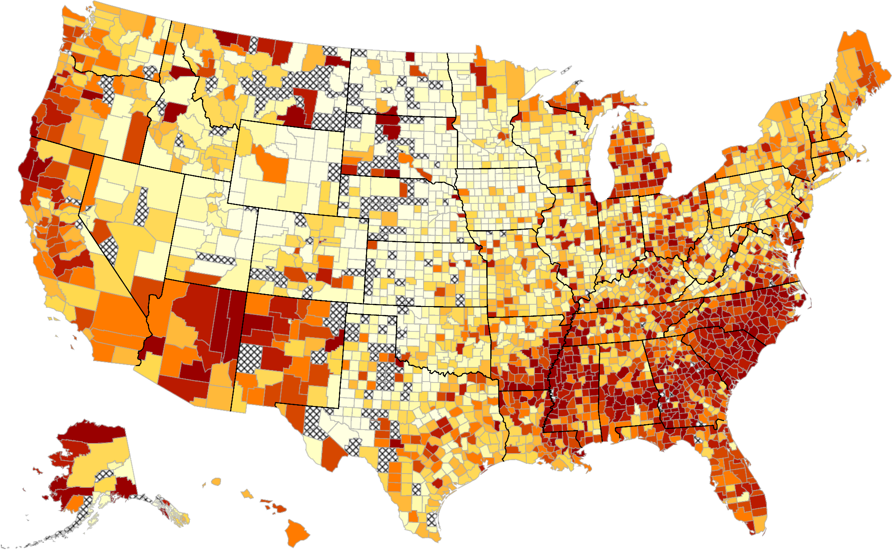
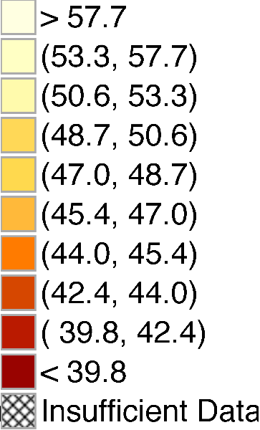
The Geography of Intergenerational Mobility in the United States
Predicted Income Rank at Age 26 for Children with Parents at 25th Percentile

Slide 43
The Geography of Intergenerational Mobility in the United States
Predicted Income Rank at Age 26 for Children with Parents at 25th Percentile
What Fraction of Variance in this Map is Due to Causal Place Effects?

Slide 44
Estimating Exposure Effects in Observational Data
Identify exposure effects by studying families who move across neighborhoods in observational data
  Key idea: identify from differences in timing of moves across families who make the same moves
To begin, consider subset of families who move with a child who is exactly 13 years old
Regress child’s income rank at age 26 y_{i} on predicted outcome of permanent residents in destination:
Include parent decile (q) by origin (o) by birth cohort (s) fixed effects to identify b_{m} purely from differences in destinations

Slide 45
Movers’ Outcomes vs. Predicted Outcomes Based on Residents in Destination
Child Age 13 at Time of Move
4
2
0
Mean (Residual) Child Rank in National Income Distribution
Slope: b₁₃ = 0.628
(0.048)
-2
-4
-6
-4
-2
0
2
4
6
Predicted Diff. in Child Rank Based on Permanent Residents in Dest. vs. Orig.

Slide 46
Movers’ Outcomes vs. Predicted Outcomes Based on Residents in Destination
By Child’s Age at Move, Income Measured at Age $=$ 24
0.8
0.6
Coefficient on Predicted Rank in Destination
b_{m} > 0 for m > 24: Selection Effect (δ)
0.4
b_{m} declining with m Exposure Effects
0.2
10
15
20
25
30
Age of Child when Parents Move

Slide 47
Movers’ Outcomes vs. Predicted Outcomes Based on Residents in Destination
By Child’s Age at Move, Income Measured at Age $=$ 24
0.8
0.6
δ: 0.226
Coefficient on Predicted Rank in Destination
Slope: -0.038
Slope: -0.002
(0.002)
(0.011)
0.4
0.2
10
15
20
25
30
Age of Child when Parents Move

Slide 48
Movers’ Outcomes vs. Predicted Outcomes Based on Residents in Destination
By Child’s Age at Move, Income Measured at Age $=$ 24
0.8
0.6
δ: 0.226
Coefficient on Predicted Rank in Destination
Slope: -0.038
Slope: -0.002
(0.002)
(0.011)
0.4
0.2
Assumption 1: δ_{m} = δ for all m
→ Causal effect of moving at age m is β_{m} = b_{m} – δ
10
15
20
25
30
Age of Child when Parents Move

Slide 49
Family Fixed Effects: Sibling Comparisons
0.8
0.6
0.4
Coefficient on Predicted Rank in Destination (b_{m})
δ (Age > 23): 0.008
Slope (Age ≤ 23): -0.043
Slope (Age > 23): -0.003
(0.003)
(0.013)
0.2
0
10
15
20
25
30
Age of Child when Parents Move (m)

Slide 50
Additional Tests
Family fixed effects do not rule out time-varying unobservables (e.g. wealth shocks) that affect children in proportion to exposure time
Two approaches to evaluate such confounds:
  Outcome-based placebo (overidentification) tests
  Quasi-experimental variation from displacement shocks
Focus on the first here in the interest of time

Slide 51
Outcome-based Placebo Tests
General idea: exploit heterogeneity in place effects across subgroups to obtain overidentification tests of exposure effect model
Ability to implement such tests is a key advantage of defining neighborhood “quality” based on prior residents’ outcomes
  Outcome-based measures yield sharp predictions on how movers’ outcomes should change when they move
  With traditional measures of nbhd. quality such as poverty rates, difficult to disentangle causal effect of nbhd. from contemporaneous shock

Slide 52
Outcome-based Placebo Tests
Start with variation in place effects across birth cohorts
  Some areas are getting better over time, others are getting worse
  Causal effect of neighborhood on a child who moves in to an area should depend on properties of that area while he is growing up
Parents choose neighborhoods based on their preferences and information set at time of move
  Difficult to predict high-frequency differences that are realized 15 years later → hard to sort on this dimension

Slide 53
Estimates of Exposure Effects Based on Cross-Cohort Variation
0.04
0.03
0.02
Exposure Effect Estimate (β)
0.01
0
-0.01
-4
-2
0
2
4
Years Relative to Own Cohort
Separate

Slide 54
Estimates of Exposure Effects Based on Cross-Cohort Variation
0.04
0.03
0.02
Exposure Effect Estimate (β)
0.01
0
-0.01
-4
-2
0
2
4
Years Relative to Own Cohort
Simultaneous
Separate

Slide 55
Distributional Convergence
  Areas differ not just in mean child outcomes but also across distribution
  For example, compare outcomes in Boston and San Francisco for children with parents at 25th percentile
    Mean expected rank is 46th percentile in both cities
    Probability of reaching top 10%: 7.3% in SF vs. 5.9% in Boston
    Probability of being in bottom 10%: 15.5% in SF vs. 11.7% in Boston
  Exposure model predicts convergence to permanent residents’ outcomes not just on means but across entire distribution
    Children who move to SF at younger ages should be more likely to end up in tails than those who move to Boston

Slide 56
Exposure Effects on Upper-Tail and Lower-Tail Outcomes
Comparisons of Impacts at P90 and Non-Employment
 | Dependent Variable
 | Child Rank in top 10% |  |  |  |  |  | Child Employed
 | (1) | (2) |  | (3) |  |  | (4) | (5) | (6)
Distributional Prediction | 0.043 |  |  | 0.040 |  |  | 0.046 |  | 0.045
 | (0.002) |  |  | (0.003) |  |  | (0.003) |  | (0.004)
Mean Rank Prediction |  | 0.022 |  | 0.004 |  |  |  | 0.021 | 0.000
(Placebo) |  | (0.002) |  | (0.003) |  |  |  | (0.002) | (0.003)

Slide 57
Gender Comparisons
  Finally, exploit heterogeneity across genders
  Construct separate predictions of expected income rank conditional on parent income for girls and boys in each CZ
    Correlation of male and female predictions across CZ’s is 0.90
  Low-income boys do worse than girls in areas with:
    Higher rates of crime
    More segregation and inequality
    Lower marriage rates (consistent with Autor and Wasserman 2013)

Slide 58
Exposure Effect Estimates: Gender-Specific Predictions
 | No Family Fixed Effects |  |  |  | Family Fixed Effects
 | (1) | (2) | (3) |  | (4)
Own Gender Prediction | 0.038 |  | 0.031 |  | 0.031
 | (0.002) |  | (0.003) |  | (0.007)
Other Gender Prediction (Placebo) |  | 0.034 | 0.009 |  | 0.012
 |  | (0.002) | (0.003) |  | (0.007)
Sample | Full Sample |  |  |  | 2-Gender HH

Slide 59
Estimating Fixed Effects by County
Apply exposure-time design to estimate causal effects of each area in the U.S. using a fixed effects model
  Focus exclusively on movers, without using data on permanent residents
Intuition: suppose children who move from Manhattan to Queens at younger ages earn more as adults
  Can infer that Queens has positive exposure effects relative to Manhattan
Build on this logic to estimate fixed effects of all counties using five million movers, identifying purely from differences in timing of moves across areas
Use these fixed effects to form unbiased forecasts of each county and CZ’s causal effect

Slide 60
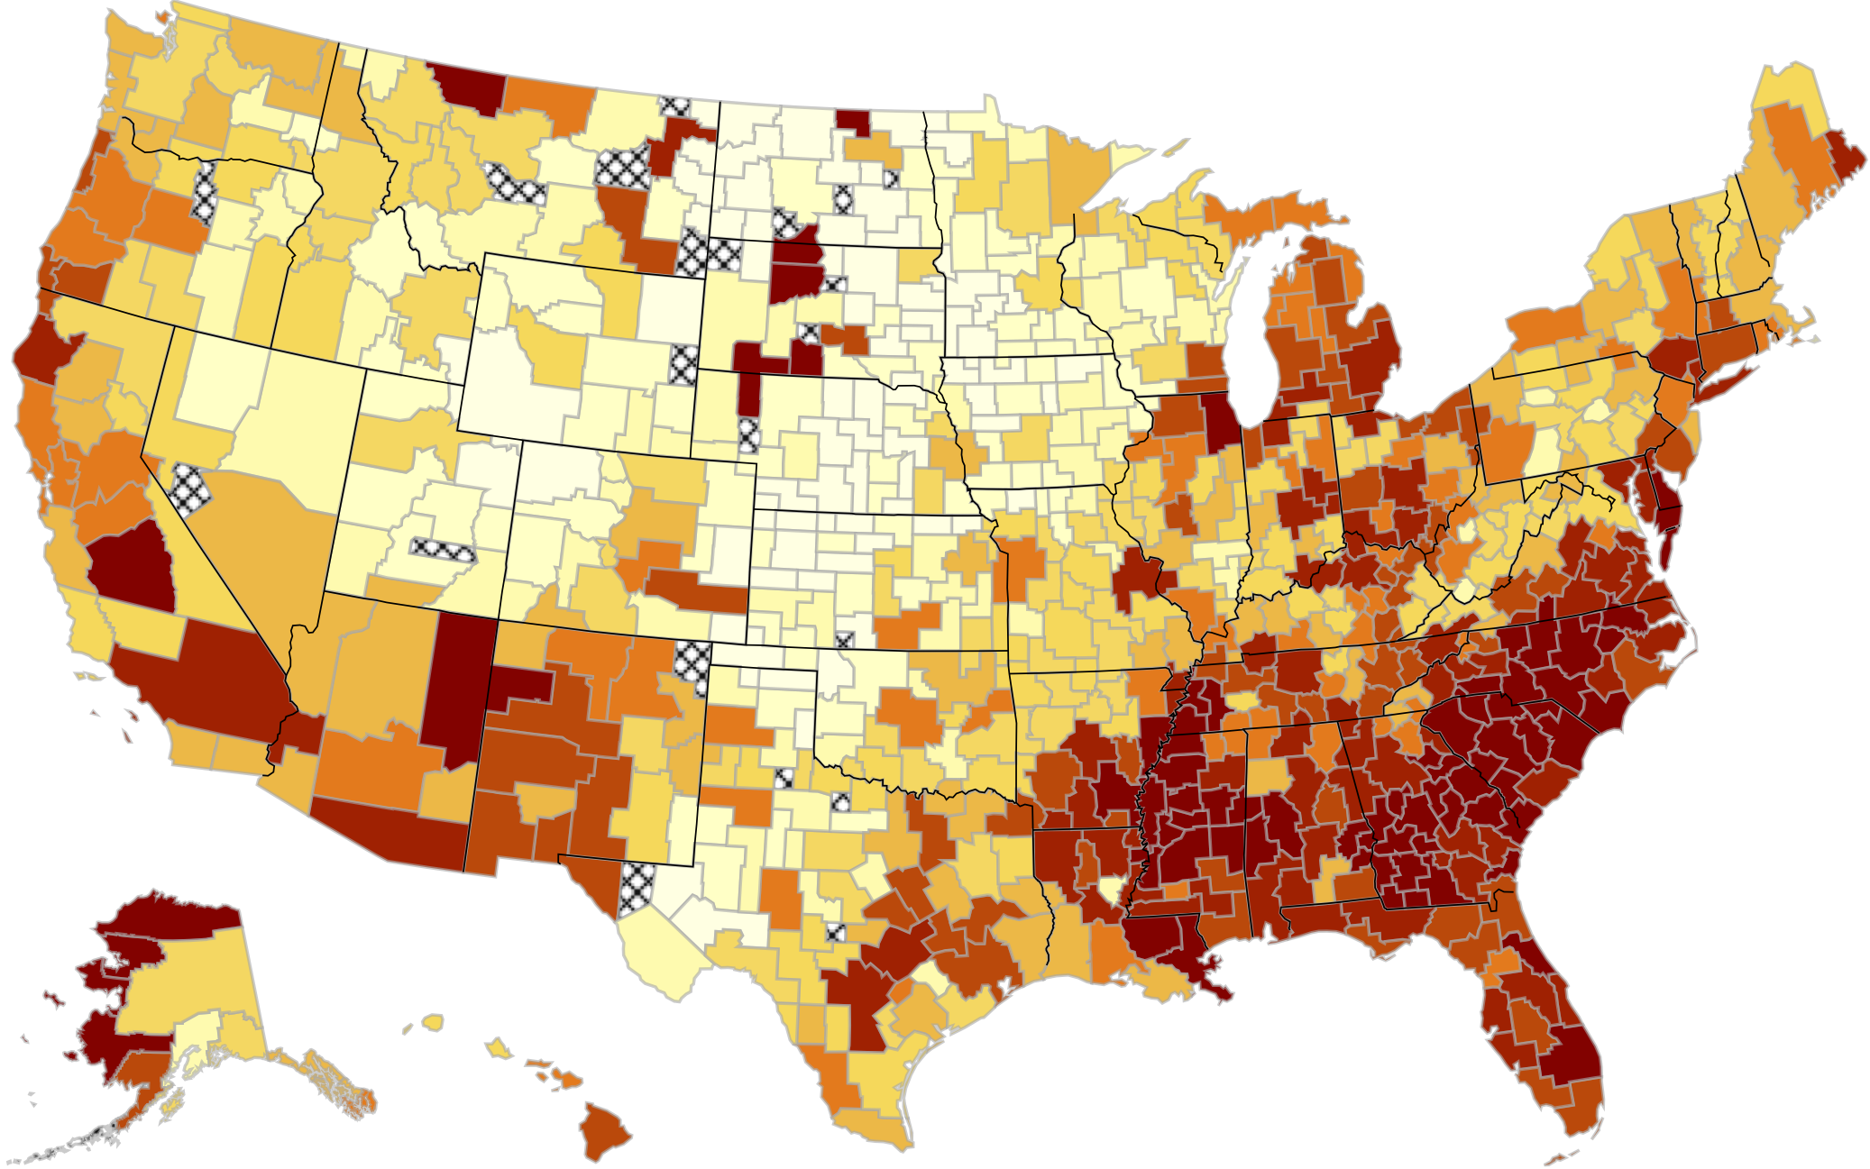
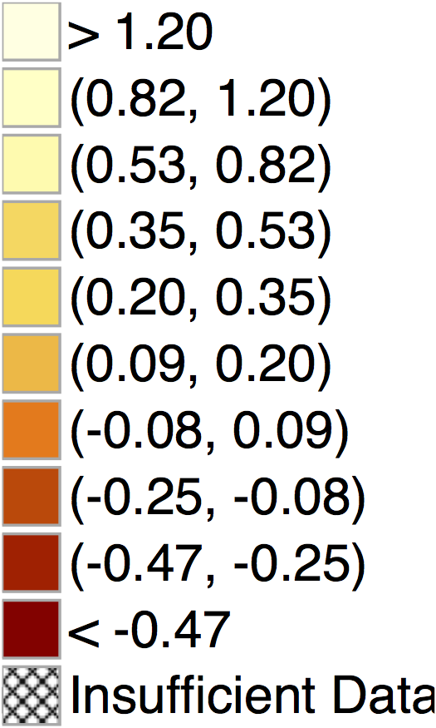
Predicted Exposure Effects on Child’s Income Level at Age 26 by CZ
For Children with Parents at 25th Percentile of Income Distribution
Note: Estimates represent % change in earnings from spending one more year of childhood in CZ

Slide 61
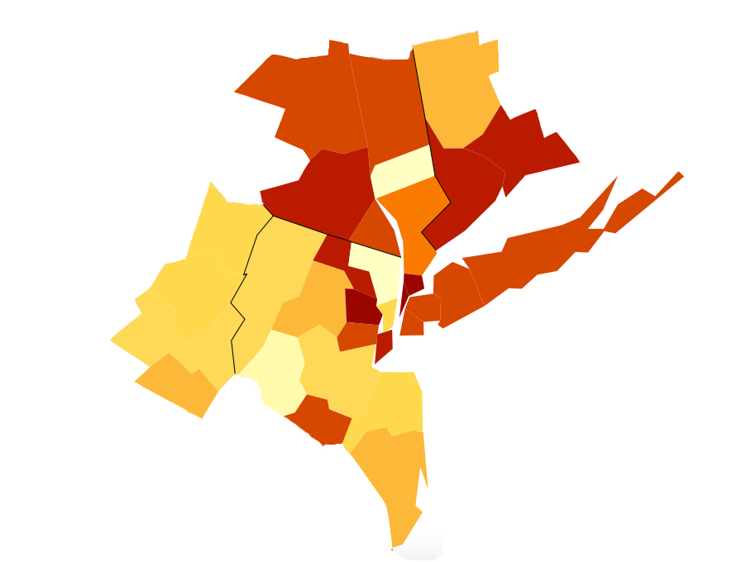
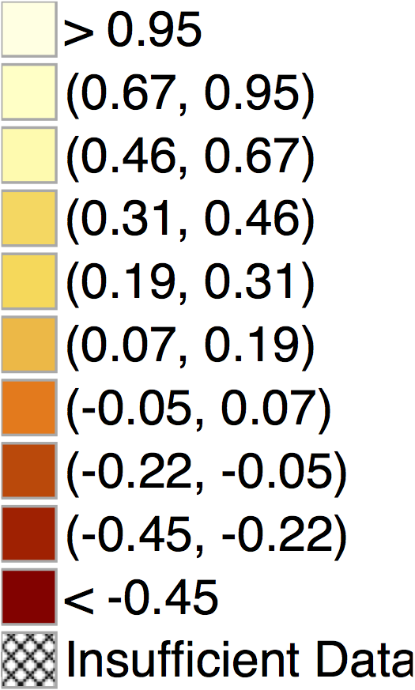
Exposure Effects on Income in the New York CSA
For Children with Parents at 25th Percentile of Income Distribution
Ulster
New Haven
Bergen
Suffolk
Bronx
Monroe
Queens
Brooklyn
Hudson
Ocean
Causal Exposure Effects Per Year:
Bronx NY: - 0.54 %
Bergen NJ: + 0.69 %

Slide 62
Causal Effect Forecasts on Earnings Per Year of Childhood Exposure (p25)
Top 10 and Bottom 10 Among the 100 Largest Counties in the U.S.
Top 10 Counties |  |  |  | Bottom 10 Counties
Rank | County | Annual Exposure Effect (%) |  | Rank | County | Annual Exposure Effect (%)
1 | Dupage, IL | 0.80 |  | 91 | Wayne, MI | -0.57
2 | Fairfax, VA | 0.75 |  | 92 | Orange, FL | -0.61
3 | Snohomish, WA | 0.70 |  | 93 | Cook, IL | -0.64
4 | Bergen, NJ | 0.69 |  | 94 | Palm Beach, FL | -0.65
5 | Bucks, PA | 0.62 |  | 95 | Marion, IN | -0.65
6 | Norfolk, MA | 0.57 |  | 96 | Shelby, TN | -0.66
7 | Montgomery, PA | 0.49 |  | 97 | Fresno, CA | -0.67
8 | Montgomery, MD | 0.47 |  | 98 | Hillsborough, FL | -0.69
9 | King, WA | 0.47 |  | 99 | Baltimore City, MD | -0.70
10 | Middlesex, NJ | 0.46 |  | 100 | Mecklenburg, NC | -0.72
Exposure effects represent % change in adult earnings per year of childhood spent in county

Slide 63
Causal Effect Forecasts on Earnings Per Year of Childhood Exposure (p25)
Male Children
Top 10 Counties |  |  |  | Bottom 10 Counties
Rank | County | Annual Exposure Effect (%) |  | Rank | County | Annual Exposure Effect (%)
1 | Bucks, PA | 0.84 |  | 91 | Milwaukee, WI | -0.74
2 | Bergen, NJ | 0.83 |  | 92 | New Haven, CT | -0.75
3 | Contra Costa, CA | 0.72 |  | 93 | Bronx, NY | -0.76
4 | Snohomish, WA | 0.70 |  | 94 | Hillsborough, FL | -0.81
5 | Norfolk, MA | 0.62 |  | 95 | Palm Beach, FL | -0.82
6 | Dupage, IL | 0.61 |  | 96 | Fresno, CA | -0.84
7 | King, WA | 0.56 |  | 97 | Riverside, CA | -0.85
8 | Ventura, CA | 0.55 |  | 98 | Wayne, MI | -0.87
9 | Hudson, NJ | 0.52 |  | 99 | Pima, AZ | -1.15
10 | Fairfax, VA | 0.46 |  | 100 | Baltimore City, MD | -1.39
Exposure effects represent % change in adult earnings per year of childhood spent in county

Slide 64
Causal Effect Forecasts on Earnings Per Year of Childhood Exposure (p25)
Female Children
Top 10 Counties |  |  |  | Bottom 10 Counties
Rank | County | Annual Exposure Effect (%) |  | Rank | County | Annual Exposure Effect (%)
1 | Dupage, IL | 0.91 |  | 91 | Hillsborough, FL | -0.51
2 | Fairfax, VA | 0.76 |  | 92 | Fulton, GA | -0.58
3 | Snohomish, WA | 0.73 |  | 93 | Suffolk, MA | -0.58
4 | Montgomery, MD | 0.68 |  | 94 | Orange, FL | -0.60
5 | Montgomery, PA | 0.58 |  | 95 | Essex, NJ | -0.64
6 | King, WA | 0.57 |  | 96 | Cook, IL | -0.64
7 | Bergen, NJ | 0.56 |  | 97 | Franklin, OH | -0.64
8 | Salt Lake, UT | 0.51 |  | 98 | Mecklenburg, NC | -0.74
9 | Contra Costa, CA | 0.47 |  | 99 | New York, NY | -0.75
10 | Middlesex, NJ | 0.47 |  | 100 | Marion, IN | -0.77
Exposure effects represent % change in adult earnings per year of childhood spent in county

Slide 65
Characteristics of Good Areas
What types of areas produce better outcomes for low-income children?
Strong correlations with five factors:
    Segregation
    Inequality
    School Quality
    Social Capital
    Family Structure
Not correlated with poverty rates at CZ level, but strong correlation at county level, consistent with MTO evidence
Better areas not generally more expensive in terms of housing costs
  But significantly more expensive in highly segregated large cities

Slide 66
Conclusion: Policy Lessons
How can we improve neighborhood environments for disadvantaged youth?
  Short-term solution: Provide targeted housing vouchers at birth conditional on moving to better (e.g. mixed-income) areas
    Benefit: MTO experimental vouchers increased PDV of earnings by $100K for children who moved at young ages
    Cost: MTO experimental vouchers increased tax revenue substantially → taxpayers may ultimately gain from this investment

Slide 67
Impacts of MTO on Annual Income Tax Revenue in Adulthood
for Children Below Age 13 at Random Assignment (TOT Estimates)
1200
1000
800
Annual Income Tax Revenue, Age ≥ 24 ($)
600
400
$447.5
$616.6
$841.1
200
p = 0.061
p = 0.004
0
Control
Section 8
Experimental
Voucher

Slide 68
Conclusion: Policy Lessons
How can we improve neighborhood environments for disadvantaged youth?
  Short-term solution: Provide targeted housing vouchers at birth conditional on moving to better (e.g. mixed-income) areas
    Taxpayers may ultimately gain from this investment
  Long-term solution: improve neighborhoods with poor outcomes, concentrating on factors that affect children
    Estimates here tell us which areas need improvement, but further work needed to determine which policies can make a difference

