Slide 1
The Impacts of Neighborhoods on Intergenerational Mobility:
Childhood Exposure Effects and County-Level Estimates
Raj Chetty and Nathaniel Hendren
Harvard University and NBER
May 2017
The opinions expressed in this paper are those of the authors alone and do not necessarily reflect the views of the Internal Revenue Service or the U.S. Treasury Department. This work is a component of a larger project examining the effects of eliminating tax expenditures on the budget deficit and economic activity. Results reported here are contained in the SOI Working Paper “The Economic Impacts of Tax Expenditures: Evidence from Spatial Variation across the U.S.,” approved under IRS contract TIRNO-12-P-00374.

Slide 2
Causal Effects of Each County
First paper establishes that neighborhoods matter on average, but it does not tell us which places are good or what their characteristics are
Second paper: “The Impacts of Neighborhoods on Intergenerational Mobility II: County-Level Estimates”
  Estimate the causal effect of each county on children’s earnings
  Estimate ~3,000 treatment effects (one per county) instead of one average exposure effect as in first paper

Slide 3
Estimating County Fixed Effects
Begin by estimating effect of each county using a fixed effects model that is identified using variation in timing of moves between areas
Intuition for identification: suppose children who move from Manhattan to Queens at younger ages earn more as adults
  Can infer that Queens has positive exposure effects relative to Manhattan

Slide 4
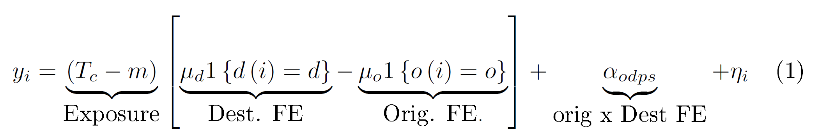
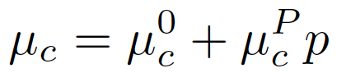
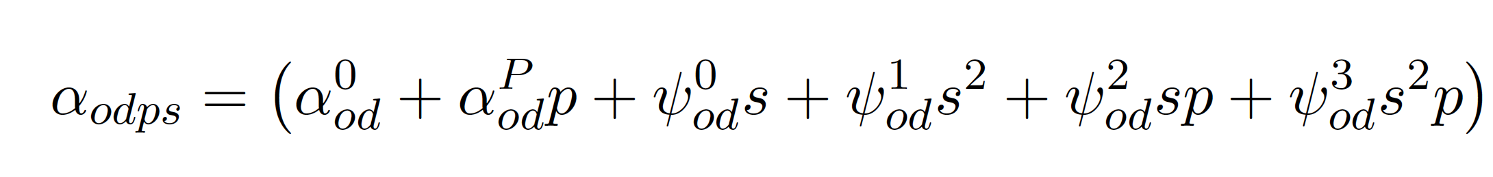

Estimating County Fixed Effects
Estimate place effects μ = (μ₁,…,μ_{N}) using fixed effects for origin and destination interacted with exposure time:
Place effects are allowed to vary linearly with parent income rank:
Include origin-by-destination fixed effects to isolate variation in exposure

Slide 5
Causal Effect Estimates vs. Permanent Resident Outcomes
Income Rank at Age 26 for Children with Parents at 25th Percentile
0.5
Seattle
Washington DC
Minneapolis
Cleveland
San Diego
Causal Effect of One Year of Exposure on Mean Rank
Phoenix
Newark
Boston
0.0
Philadelphia
San Francisco
Atlanta
Miami
Houston
Sacramento
Baltimore
Dallas
Pittsburgh
Detroit
Bridgeport
New York
Los Angeles
Chicago
-0.5
38
40
42
44
46
48
Mean Rank of Children of Permanent Residents at p=25

Slide 6
Causal Effect Estimates vs. Permanent Resident Outcomes
Income Rank at Age 26 for Children with Parents at 25th Percentile
0.5
Seattle
Washington DC
Minneapolis
Cleveland
San Diego
Causal Effect of One Year of Exposure on Mean Rank
Phoenix
Newark
Boston
0.0
Philadelphia
San Francisco
Atlanta
Miami
Houston
Sacramento
Baltimore
Dallas
Pittsburgh
Detroit
Bridgeport
New York
Los Angeles
Chicago
-0.5
38
40
42
44
46
48
Mean Rank of Children of Permanent Residents at p=25

Slide 7
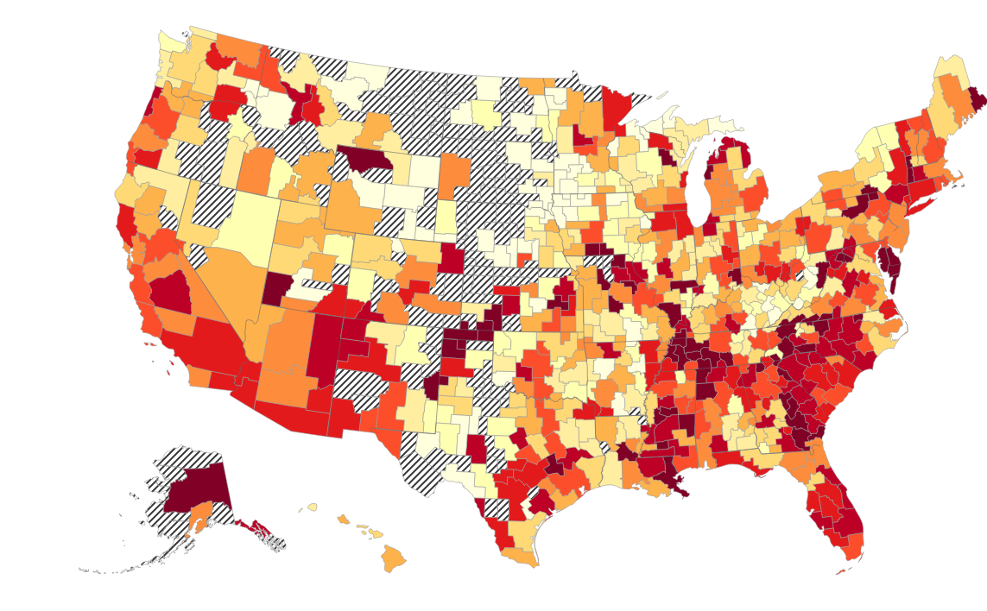
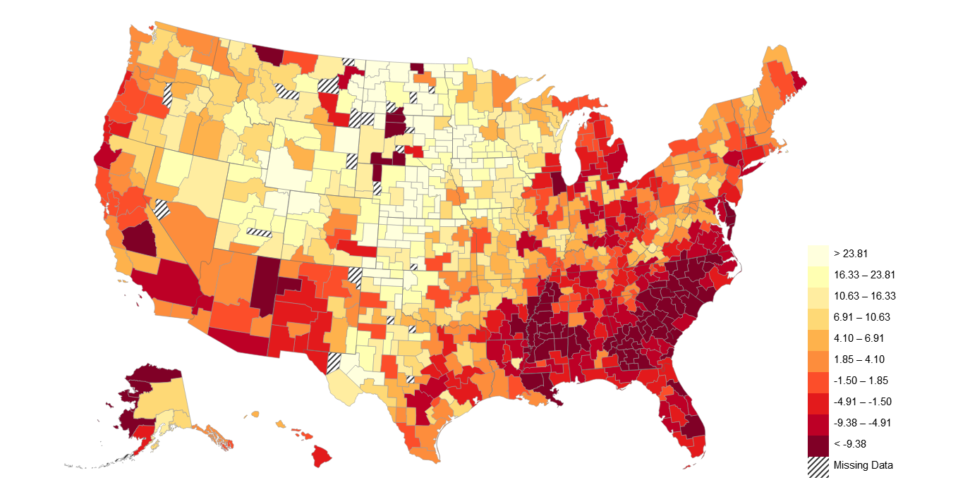
CZ Fixed Effect Estimates for Child’s Income Rank at Age 26
For Children with Parents at 25th Percentile of Income Distribution
> 0.90
0.50 – 0.90
0.32 -0.50
0.16 – 0.32
0.06 – 0.16
-0.00 – 0.06
-0.10 - -0.00
-0.22 - -0.10
-0.39 - -0.22
< -0.39
Insufficient Data
Note: Estimates represent annual exposure effects on child’s rank in income distribution at age 26

Slide 8
Three Objectives
Use fixed effect estimates for three purposes:
Quantify the size of place effects: how much do places matter?
Construct forecasts that can be used to guide families seeking to “move to opportunity”
Characterize which types of areas produce better outcomes to provide guidance for place-based policies

Slide 9
Objective 1: Magnitude of Place Effects
Estimate signal variance of place effects
  To interpret units, note that 1 pctile ~= 3% change in earnings
For children with parents at 25th percentile: 1 SD better county from birth → 10% earnings gain
For children with parents at 75th percentile: 1 SD better county from birth → 6% earnings gain
Correlation of place effects for p25 and p75 across counties is +0.3
    Places that are better for the poor are not worse for the rich

Slide 10
Objective 2: Forecasts of Best and Worst Areas
What are the best and worst places to grow up?
Construct forecasts that minimize mean-squared-error of predicted impact for a family moving to a new area
Raw fixed effect estimates have high MSE because of sampling error
Reduce MSE by combining fixed effects (unbiased, but imprecise) with permanent resident outcomes (biased, but precise)

Slide 11
Optimal Forecasts Combining Fixed Effects and Permanent Resident Outcomes
0.4
0.2
Seattle
Washington DC
Causal Effect of One Year of Exposure on Mean Rank
Philadelphia
0.0
Newark
Providence
Detroit
Albuquerque
New York
Los Angeles
-0.2
Chicago
Raleigh
-0.4
38
40
42
44
46
48
Mean Rank of Children of Permanent Residents at p=25

Slide 12
Optimal Forecasts Combining Fixed Effects and Permanent Resident Outcomes
0.4
0.2
Seattle
Washington DC
Causal effect point estimates are noisy
Causal Effect of One Year of Exposure on Mean Rank
Philadelphia
0.0
Newark
Providence
Detroit
Albuquerque
New York
Los Angeles
-0.2
Chicago
Raleigh
-0.4
38
40
42
44
46
48
Mean Rank of Children of Permanent Residents at p=25

Slide 13
Optimal Forecasts Combining Fixed Effects and Permanent Resident Outcomes
0.4
0.2
Seattle
Use forecasts based on
permanent residents
Washington DC
Causal Effect of One Year of Exposure on Mean Rank
Philadelphia
0.0
Newark
Providence
Detroit
Albuquerque
New York
Los Angeles
-0.2
Chicago
Raleigh
-0.4
38
40
42
44
46
48
Mean Rank of Children of Permanent Residents at p=25

Slide 14
Optimal Forecasts Combining Fixed Effects and Permanent Resident Outcomes
0.4
Optimal forecast is weighted avg. of fixed effect estimate and permanent resident outcome, with weight proportional to precision of fixed effect
0.2
Seattle
Washington DC
Causal Effect of One Year of Exposure on Mean Rank
Philadelphia
0.0
Newark
Providence
Detroit
Albuquerque
New York
Los Angeles
-0.2
Chicago
Raleigh
-0.4
38
40
42
44
46
48
Mean Rank of Children of Permanent Residents at p=25

Slide 15
Optimal Forecasts Combining Fixed Effects and Permanent Resident Outcomes
0.4
Predictions are forecast unbiased: 1pp higher predictions → 1pp higher causal effect on average
0.2
Seattle
Washington DC
Causal Effect of One Year of Exposure on Mean Rank
Philadelphia
0.0
Newark
Providence
Detroit
Albuquerque
New York
Los Angeles
-0.2
Chicago
Raleigh
-0.4
38
40
42
44
46
48
Mean Rank of Children of Permanent Residents at p=25

Slide 16
Predicted Exposure Effects on Child’s Income Rank at Age 26 by CZ
For Children with Parents at 25th Percentile of Income Distribution
Change in rank
percentiles
> 0.38
0.26 – 0.38
0.17 – 0.26
0.11 – 0.17
0.07 – 0.11
0.03 – 0.07
-0.02 – 0.03
-0.08 - -0.02
-0.15 - -0.08
< -0.15
Insufficient Data
Note: Estimates represent change in rank from spending one more year of childhood in CZ

Slide 17
Predicted Exposure Effects on Child’s Income Level at Age 26 by CZ
For Children with Parents at 25th Percentile of Income Distribution
Pct. Impact on
Earnings
> 23.8%
16.3 - 23.8
10.6 - 16.3
6.9 - 10.6
4.1 - 6.9
1.9 - 4.1
-1.5 - 1.9
-4.9 - -1.5
-9.4 - -4.9
< -9.4%
Insufficient Data
Note: Estimates represent % change in earnings from growing up from birth
(i.e. 20 years of childhood exposure) in CZ

Slide 18
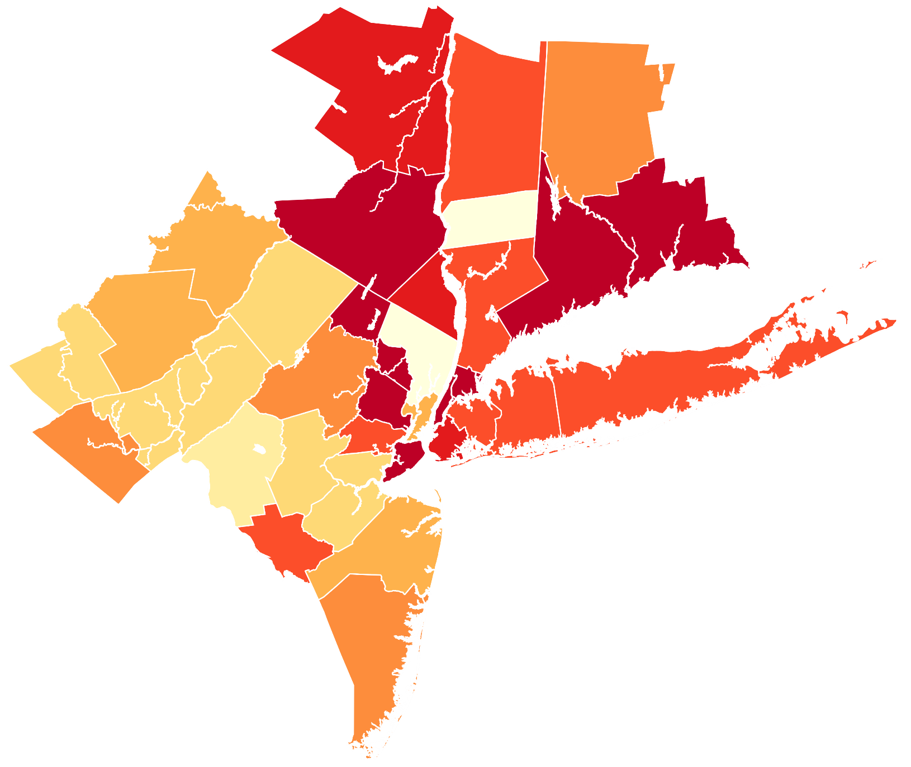
Exposure Effects on Income in the New York CSA
For Children with Parents at 25th Percentile of Income Distribution
Ulster
New Haven
Pct. Impact on
Earnings
> 19.1
13.3 - 19.1
9.3 - 13.3
6.2 - 9.3
3.7 - 6.2
1.5 - 3.7
-1.1 - 1.5
-4.4 - -1.1
-9.0 - -4.4
< -9.0%
Bergen
Bronx
Monroe
Suffolk
Queens
Brooklyn
Hudson
Ocean
Causal Exposure Effects:
Bronx NY: - 10.89%
Bergen NJ: + 13.77%

Slide 19
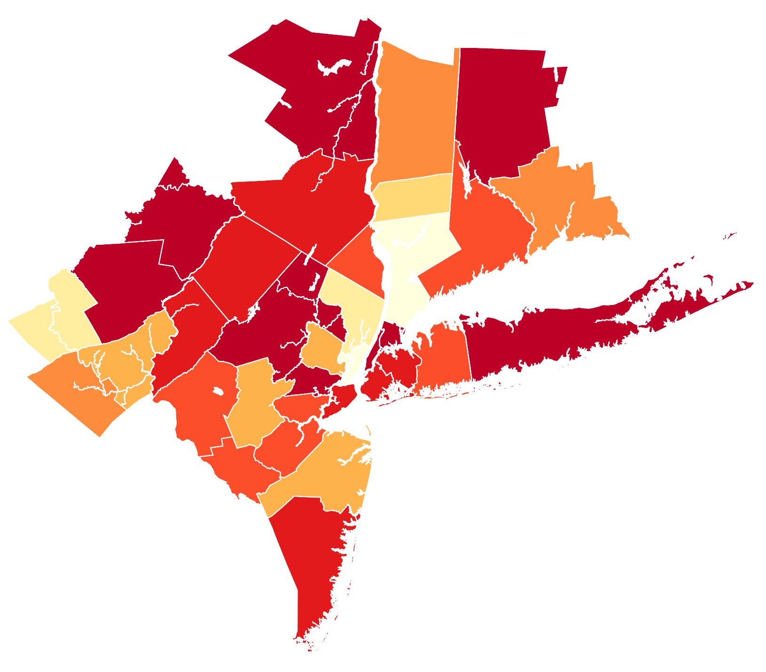
Exposure Effects on Income in the New York CSA
For Children with Parents at 75th Percentile of Income Distribution
Ulster
New Haven
New Haven
Pct. Impact on
Earnings
> 8.2%
6.5 - 8.2
5.0 - 6.5
3.8 - 5.0
2.6 - 3.8
1.6 - 2.6
0.5 - 1.6
-0.8 - 0.5
-2.5 - -0.8
< -2.5%
Bergen
Bronx
Monroe
Suffolk
Queens
Brooklyn
Hudson
Causal Exposure Effects:
Bronx NY: - 8.33%
Bergen NJ: + 6.29%

Slide 20
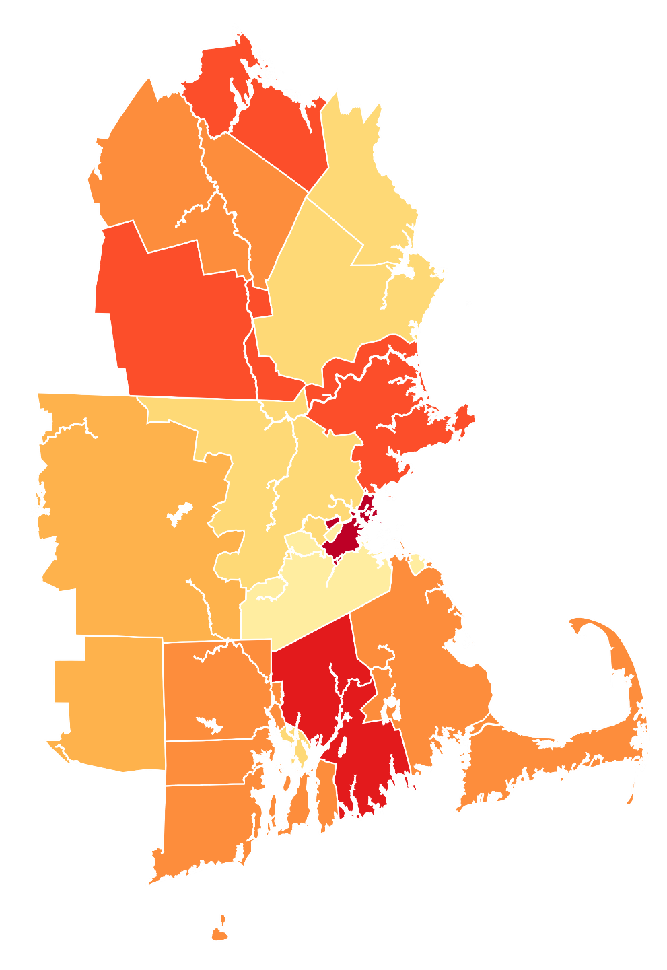
Exposure Effects on Income in the Boston CSA
For Children with Parents at 25th Percentile of Income Distribution
Belknap
Merrimack
Pct. Impact on
Earnings
> 19.1
13.3 - 19.1
9.3 - 13.3
6.2 - 9.3
3.7 - 6.2
1.5 - 3.7
-1.1 - 1.5
-4.4 - -1.1
-9.0 - -4.4
< -9.0%
Essex
Middlesex
Worcester
Suffolk
Norfolk
Plymouth
Providence
Barnstable
Causal Exposure Effects:
Suffolk MA: - 6.11 %
Middlesex MA: + 7.71 %
Newport

Slide 21
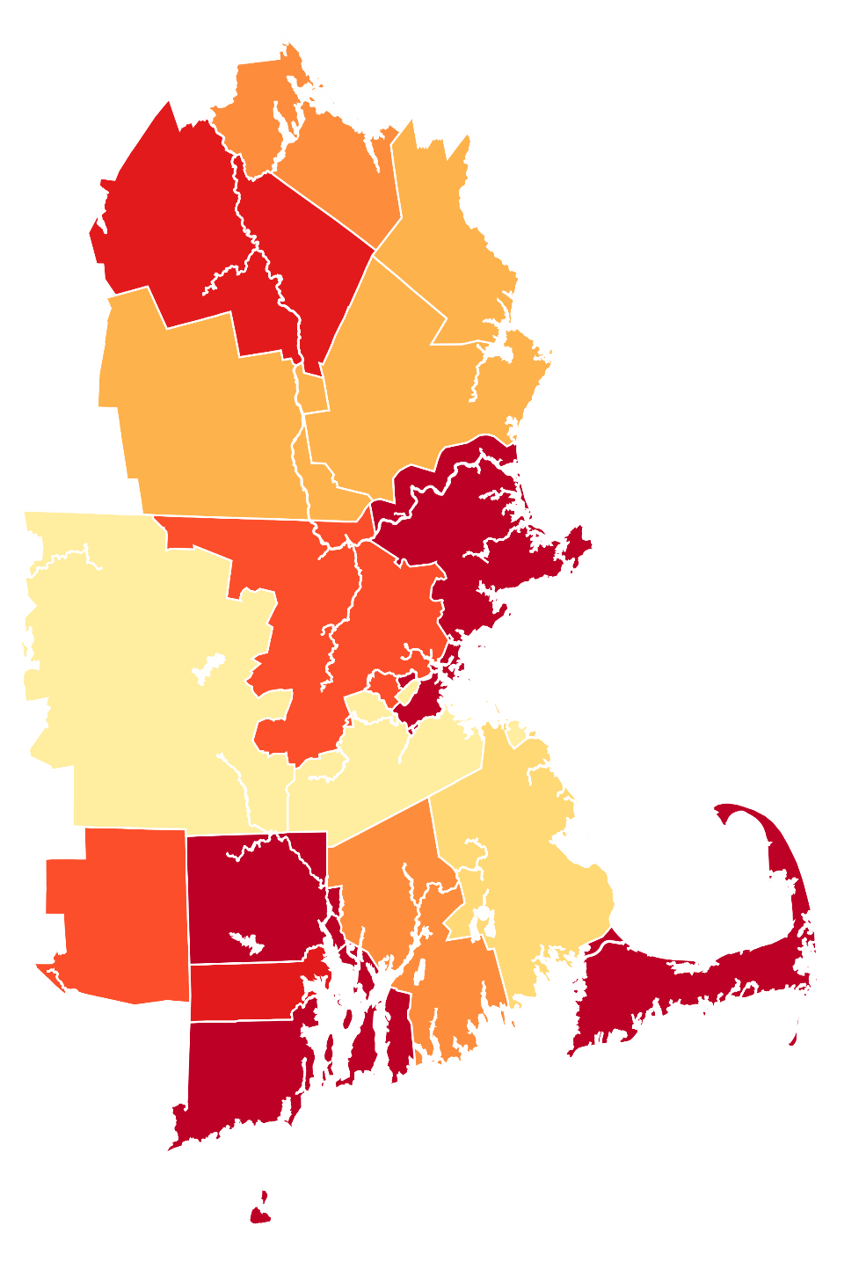
Exposure Effects on Income in the Boston CSA
For Children with Parents at 75th Percentile of Income Distribution
Belknap
Merrimack
Pct. Impact on
Earnings
> 8.2%
6.5 - 8.2
5.0 - 6.5
3.8 - 5.0
2.6 - 3.8
1.6 - 2.6
0.5 - 1.6
-0.8 - 0.5
-2.5 - -0.8
< -2.5%
Essex
Middlesex
Worcester
Suffolk
Norfolk
Plymouth
Providence
Causal Exposure Effects:
Suffolk MA: - 3.64 %
Middlesex MA: + 0.54 %
Newport

Slide 22
Annual Exposure Effects on Income for Children in Low-Income Families (p25)
Top 10 and Bottom 10 Among the 100 Largest Counties in the U.S.
Top 10 Counties |  |  |  |  | Bottom 10 Counties
Rank | County |  | Impact from Birth (%) |  | Rank | County | Impact from Birth (%)
1 | Dupage, IL |  | 16.00 |  | 91 | Wayne, MI | -11.39
2 | Fairfax, VA |  | 14.98 |  | 92 | Orange, FL | -12.10
3 | Snohomish, WA |  | 14.02 |  | 93 | Cook, IL | -12.79
4 | Bergen, NJ |  | 13.77 |  | 94 | Palm Beach, FL | -13.01
5 | Bucks, PA |  | 12.39 |  | 95 | Marion, IN | -13.09
6 | Norfolk, MA |  | 11.47 |  | 96 | Shelby, TN | -13.15
7 | Montgomery, PA |  | 9.74 |  | 97 | Fresno, CA | -13.50
8 | Montgomery, MD |  | 9.47 |  | 98 | Hillsborough, FL | -13.82
9 | King, WA |  | 9.33 |  | 99 | Baltimore City, MD | -13.98
10 | Middlesex, NJ |  | 9.13 |  | 100 | Mecklenburg, NC | -14.46
Exposure effects represent % change in adult earnings from growing up from birth (i.e. 20 years of exposure) in county

Slide 23
Annual Exposure Effects on Income for Children in High-Income Families (p75)
Top 10 and Bottom 10 Among the 100 Largest Counties in the U.S.
Top 10 Counties |  |  |  |  | Bottom 10 Counties
Rank | County |  | Impact from Birth (%) |  | Rank | County | Impact from Birth (%)
1 | Fairfax, VA |  | 10.96 |  | 91 | Hillsborough, FL | -7.95
2 | Westchester, NY |  | 6.88 |  | 92 | Bronx, NY | -8.33
3 | Contra Costa, CA |  | 6.67 |  | 93 | Broward, FL | -9.20
4 | Hamilton, OH |  | 6.32 |  | 94 | Dist. of Columbia, DC | -9.68
5 | Bergen, NJ |  | 6.29 |  | 95 | Orange, CA | -9.79
6 | Gwinnett, GA |  | 6.26 |  | 96 | San Bernardino, CA | -10.14
7 | Norfolk, MA |  | 6.23 |  | 97 | Riverside, CA | -10.26
8 | Worcester, MA |  | 5.38 |  | 98 | Los Angeles, CA | -10.49
9 | Franklin, OH |  | 4.72 |  | 99 | New York, NY | -11.36
10 | Kent, MI |  | 4.61 |  | 100 | Palm Beach, FL | -13.00
Exposure effects represent % change in adult earnings from growing up from birth (i.e. 20 years of exposure) in county

Slide 24
Annual Exposure Effects on Income for Children in Low-Income Families (p25)
Male Children
Top 10 Counties |  |  |  |  | Bottom 10 Counties
Rank | County |  | Impact from Birth (%) |  | Rank | County | Impact from Birth (%)
1 | Bucks, PA |  | 16.82 |  | 91 | Milwaukee, WI | -14.80
2 | Bergen, NJ |  | 16.62 |  | 92 | New Haven, CT | -14.96
3 | Contra Costa, CA |  | 14.47 |  | 93 | Bronx, NY | -15.21
4 | Snohomish, WA |  | 13.92 |  | 94 | Hillsborough, FL | -16.30
5 | Norfolk, MA |  | 12.45 |  | 95 | Palm Beach, FL | -16.49
6 | Dupage, IL |  | 12.17 |  | 96 | Fresno, CA | -16.80
7 | King, WA |  | 11.15 |  | 97 | Riverside, CA | -16.97
8 | Ventura, CA |  | 10.90 |  | 98 | Wayne, MI | -17.43
9 | Hudson, NJ |  | 10.41 |  | 99 | Pima, AZ | -23.03
10 | Fairfax, VA |  | 9.21 |  | 100 | Baltimore City, MD | -27.86
Exposure effects represent % change in adult earnings from growing up from birth (i.e. 20 years of exposure) in county

Slide 25
Annual Exposure Effects on Income for Children in Low-Income Families (p25)
Female Children
Top 10 Counties |  |  |  |  | Bottom 10 Counties
Rank | County |  | Impact from Birth (%) |  | Rank | County | Impact from Birth (%)
1 | Dupage, IL |  | 18.18 |  | 91 | Hillsborough, FL | -10.18
2 | Fairfax, VA |  | 15.10 |  | 92 | Fulton, GA | -11.52
3 | Snohomish, WA |  | 14.65 |  | 93 | Suffolk, MA | -11.54
4 | Montgomery, MD |  | 13.64 |  | 94 | Orange, FL | -12.02
5 | Montgomery, PA |  | 11.58 |  | 95 | Essex, NJ | -12.75
6 | King, WA |  | 11.39 |  | 96 | Cook, IL | -12.83
7 | Bergen, NJ |  | 11.20 |  | 97 | Franklin, OH | -12.88
8 | Salt Lake, UT |  | 10.22 |  | 98 | Mecklenburg, NC | -14.73
9 | Contra Costa, CA |  | 9.42 |  | 99 | New York, NY | -14.94
10 | Middlesex, NJ |  | 9.38 |  | 100 | Marion, IN | -15.50
Exposure effects represent % change in adult earnings from growing up from birth (i.e. 20 years of exposure) in county

Slide 26
Annual Exposure Effects on Income for Children in Low-Income Families (p25)
Gender Average vs. Pooled Specification
Top 10 Counties |  |  |  |  |  |  | Bottom 10 Counties
Rank | County |  | GenderAvg (%) |  | Pooled (%) |  | Rank | County | Gender Avg (%) | Pooled (%)
1 | Dupage, IL |  | 15.12 |  | 16.00 |  | 91 | Pima, AZ | -12.16 | -8.93
2 | Snohomish, WA |  | 14.35 |  | 14.02 |  | 92 | Bronx, NY | -12.30 | -10.89
3 | Bergen, NJ |  | 14.12 |  | 13.77 |  | 93 | Milwaukee, WI | -12.32 | -9.92
4 | Bucks, PA |  | 13.29 |  | 12.39 |  | 94 | Wayne, MI | -12.52 | -11.39
5 | Contra Costa, CA |  | 12.14 |  | 8.83 |  | 95 | Fresno, CA | -12.94 | -13.50
6 | Fairfax, VA |  | 12.09 |  | 14.98 |  | 96 | Cook, IL | -13.35 | -12.79
7 | King, WA |  | 11.33 |  | 9.33 |  | 97 | Orange, FL | -13.46 | -12.10
8 | Norfolk, MA |  | 10.81 |  | 11.47 |  | 98 | Hillsborough, FL | -13.47 | -13.82
9 | Montgomery, MD |  | 10.49 |  | 9.47 |  | 99 | Mecklenburg, NC | -13.81 | -14.46
10 | Middlesex, NJ |  | 8.61 |  | 9.13 |  | 100 | Baltimore City, MD | -17.27 | -13.98
Exposure effects represent % change in adult earnings from growing up from birth (i.e. 20 years of exposure) in county

Slide 27
Objective 3: Characteristics of Good Areas
Are correlations documented in prior studies driven by causal effects?
  Ex: children who grow up in “ghettos” with concentrated poverty have worse outcomes [Massey and Denton 1993, Cutler and Glaeser 1997]
  Is growing up in a segregated area actually bad for a child or do people who live in segregated areas have worse unobservables?”
Correlate fixed effect estimates with observable characteristics of areas

Slide 28
Step 4: Characteristics of Good Areas
Decompose observed rank for stayers (y_{pc}) into causal and sorting components by multiplying annual exposure effect μ_{pc} by 20:
  Causal component = 20μ_{pc}
  Sorting component = y_{pc} – 20μ_{pc}
Re-scale y_{pc}, causal, and sorting components to percentage change in earnings (1 percentile -> 3.1% increase in earnings at p25)
Regress y_{pc}, causal, and sorting components on covariates
  Standardize covariates so units represent impact of 1 SD change in covariate on percentage impact on earnings

Slide 29
Predictors of Causal Effects For Children at the CZ Level (p25)
Theil Index of
Racial Segregation
Permanent Residents
-8.0
-6.0
-4.0
-2.0
0
2.0
4.0
6.0
8.0
Percentage Impact of 1 SD Change in Covariate

Slide 30
Predictors of Causal Effects For Children at the CZ Level (p25)
Selection
Causal
Corr. with
Causal Effect
Theil Index of
-0.51
Racial Segregation
Permanent Residents
-8.0
-6.0
-4.0
-2.0
0
2.0
4.0
6.0
8.0
Percentage Impact of 1 SD Change in Covariate

Slide 31
Predictors of Causal Effects For Children at the CZ Level (p25)
Selection
Causal
Corr. with
Causal Effect
Theil Index of
-0.51
Racial Segregation
Frac w/Commute
Permanent Residents
0.88
<15 mins.
Gini
-0.76
Coef.
Top 1%
-0.49
Income Share
Test Scores
0.51
Cond. on Income
School Expend.
-0.02
Per Capita
Num. of Colleges
0.60
Per Capita
Social Capital
0.70
Index
Frac. Single
-0.57
Moms
Frac. Foreign
-0.45
Born
Frac. Black
-0.51
Residents
-8.0
-6.0
-4.0
-2.0
0
2.0
4.0
6.0
8.0
Percentage Impact of 1 SD Change in Covariate

Slide 32
Predictors of Causal Effects For Children at the CZ Level (p25)
Selection
Causal
Corr. with
Causal Effect
Theil Index of
-0.51
Racial Segregation
Frac w/Commute
Permanent Residents
0.88
<15 mins.
Gini
-0.76
Coef.
Top 1%
-0.49
Income Share
Test Scores
0.51
Cond. on Income
School Expend.
-0.02
Per Capita
Num. of Colleges
0.60
Per Capita
Social Capital
0.70
Index
Immigrants live in
worse areas but are positively selected (e.g., New York)
Frac. Single
-0.57
Moms
Frac. Foreign
-0.45
Born
Frac. Black
-0.51
Residents
-8.0
-6.0
-4.0
-2.0
0
2.0
4.0
6.0
8.0
Percentage Impact of 1 SD Change in Covariate

Slide 33
Predictors of Causal Effects For Children at the CZ Level (p25)
Selection
Causal
Corr. with
Causal Effect
Theil Index of
-0.51
Racial Segregation
Frac w/Commute
Permanent Residents
0.88
<15 mins.
Gini
-0.76
Coef.
Top 1%
-0.49
Income Share
Test Scores
0.51
Cond. on Income
School Expend.
-0.02
Per Capita
Num. of Colleges
0.60
Per Capita
Social Capital
0.70
Index
Frac. Single
1/5 of black-white earnings gap explained by differences in the counties where black and white children grow up
Moms
-0.57
Frac. Foreign
-0.45
Born
Frac. Black
-0.51
Residents
-8.0
-6.0
-4.0
-2.0
0
2.0
4.0
6.0
8.0
Percentage Impact of 1 SD Change in Covariate

Slide 34
Predictors of Exposure Effects For Children at the County within CZ Level (p25)
Selection
Causal
Corr. with
Causal Effect
Theil Index of
-0.37
Racial Segregation
Frac w/Commute
Permanent Residents
0.02
<15 mins.
Gini
-0.41
Coef.
Top 1%
-0.23
Income Share
Test Scores
0.36
Cond. on Income
School Expend.
-0.07
Per Capita
Num. of Colleges
-0.19
Per Capita
Social Capital
0.15
Index
Frac. Single
-0.38
Moms
Frac. Foreign
-0.03
Born
Frac. Black
-0.32
Residents
-8.0
-6.0
-4.0
-2.0
0
2.0
4.0
6.0
8.0
Percentage Impact of 1 SD Change in Covariate

Slide 35
Predictors of Exposure Effects For Children at the County within CZ Level (p75)
Selection
Causal
Corr. with
Causal Effect
Theil Index of
0.14
Racial Segregation
Frac w/Commute
Permanent Residents
0.08
<15 mins.
Gini
-0.06
Coef.
Top 1%
-0.01
Income Share
Test Scores
0.03
Cond. on Income
School Expend.
0.05
Per Capita
Num. of Colleges
-0.43
Per Capita
Social Capital
0.00
Index
Frac. Single
-0.07
Moms
Frac. Foreign
0.19
Born
Frac. Black
0.14
Residents
-8.0
-6.0
-4.0
-2.0
0
2.0
4.0
6.0
8.0
Percentage Impact of 1 SD Change in Covariate

Slide 36
House Prices
Does it cost more to live in a county that improves children’s outcomes?
Correlation between causal exposure effect and median rent is negative (-0.4) across CZs
    Rural areas produce better outcomes
But, evidence of positive correlation across counties within CZs
  Moving to a county that causes a 1% increase in child’s earnings per year of exposure on average has $176.8 (s.e. 65.50) higher median rent

Slide 37
Opportunity vs. House Prices
But, rents explain less than 2% of variation in county causal effects
  Implies that there are many “opportunity bargains”

Slide 38
Forecasted Causal Effects vs. Median Rents by County
in the New York CSA
15
Putnam
Bergen
Hunterdon
10
Sussex
Carbon
Warren
Middlesex
Somerset
Northampton
5
Pike
Monroe
Hudson
Monmouth
Forecasted Causal Effects (% impact, from birth)
Litchfield
Morris
Lehigh
Ocean
0
Westchester
Dutchess
Union
Suffolk
Mercer
Queens
Nassau
Rockland
Ulster
-5
Kings
New Haven
Richmond
Fairfield
Orange
Passaic
-10
Essex
Bronx
Manhattan
600
800
1000
1200
1400
Median Rent in 2000 (in 2012 $)

Slide 39
House Prices
Why are causal effects on children not fully capitalized in house prices?
  Other disamenities (e.g. longer commute)
  Causal effects not fully observed
Suggestive evidence of #2: only the observable components of the causal effects are priced
Define observable component as projection of place effect onto observables: poverty rate, commute time, single parent share, test scores, and Gini
Define unobservable component as residual from this regression, shrunk to adjust for measurement error
Regress median rent on observable and unobservable components
  Roughly one-third of the variance is “observable” and two-thirds is not

Slide 40
Median Rent vs. Observable Component of Place Effect Across Counties
CZs with Populations Above 590,000
1000
900
Median Rent
Slope: $430.2
(27.3)
800
700
-0.4
-0.2
0
0.2
0.4
Observed Place Effect (Forecast Regressed on Observables)

Slide 41
Median Rent vs. Unobserved Component of Place Effect Across Counties
CZs with Populations Above 590,000
950
900
850
Median Rent
Slope: $46.2
800
(42.7)
750
700
-0.2
0
0.2
0.4
Unobserved Place Effect (Residual from Forecast Regressed on Observables)

Slide 42
House Prices
Main lesson: substantial scope to move to areas that generate greater upward mobility for children without paying much more
  Especially true in cities with low levels of segregation
In segregated cities, places that generate good outcomes without having typical characteristics (better schools, lower poverty rates) provide bargains
  Ex: Hudson County, NJ vs. Bronx in New York metro area
Encouraging for housing-voucher policies that seek to help low-income families move to better areas

Slide 43
Conclusion
Findings provide support for place-focused approaches to improving economic opportunity
  Substantial scope to help low-income families move to better area without paying higher rents
    Outcome-based forecasting approach developed here provides a practical method to identify such areas
  Places that have high upward mobility have a common set of characteristics, such as less segregation and better schools
    Suggests that their successes may be replicable in areas that currently offer lower levels of opportunity

Slide 44

Download County-Level Data on Social Mobility in the U.S.
www.equality-of-opportunity.org/data

