Slide 1
Who Becomes an Inventor in America? The Importance of Exposure to Innovation
Alex Bell, Harvard Raj Chetty, Stanford
Xavier Jaravel, London School of Economics
Neviana Petkova, Office of Tax Analysis
John Van Reenen, MIT
December 2017
The opinions expressed in this paper are those of the authors alone and do not necessarily reflect the views of the Internal Revenue Service or the U.S. Treasury Department.

Slide 2
Motivation: Determinants of Innovation
Innovation is widely viewed as the engine of economic growth [Romer 1990, Aghion and Howitt 1992]
Many policies used to spur innovation, ranging from tax cuts to investments in STEM education
One approach to understanding effectiveness of such policies: study the determinants of who becomes an inventor
What types of people become inventors today?
What do their experiences teach us about who becomes a successful inventor?
Notes:
2

Slide 3
This Paper
We study the determinants of innovation using de-identified data on 1.2 million inventors from patent records linked to tax records
Track inventors’ lives from birth to adulthood to identify factors that determine who invents and policies that may be effective in increasing innovation
Notes:
3

Slide 4
This Paper
Main result: there are large gaps in innovation rates by parental income, gender, and race that are partly caused by differences in exposure to innovation
Substantial potential to increase innovation by bringing “lost Einsteins” into the pipeline through targeted efforts to increase exposure
In contrast, changes in financial incentives have less scope to increase innovation because high-impact inventors already earn high returns
Findings contribute to nascent literature studying “supply of inventors” using administrative data from European countries [Toivanen & Vaananen 2012, 2015; Jung and Ejermo 2014; Depalo and Di Addario 2015; Bender et al. 2015; Aghion, Akcigit, Hyytinen, & Toivanen 2017]
Notes:
4

Slide 5
The Lifecycle of Inventors
Organize analysis around the chronology of an inventor’s life
Birth
Parents
Gender
Ability
Childhood
Mentors
Neighborhood
College
Career
Earnings
Employers
Age Profile
Notes:
5

Slide 6
Patent Data
Patents granted between 1996-2014 from USPTO (Google XML files): 1.7 million patents
Published applications between 2001-12 from Strumsky (2014): 1.6 million applications
Notes:
6

Slide 7
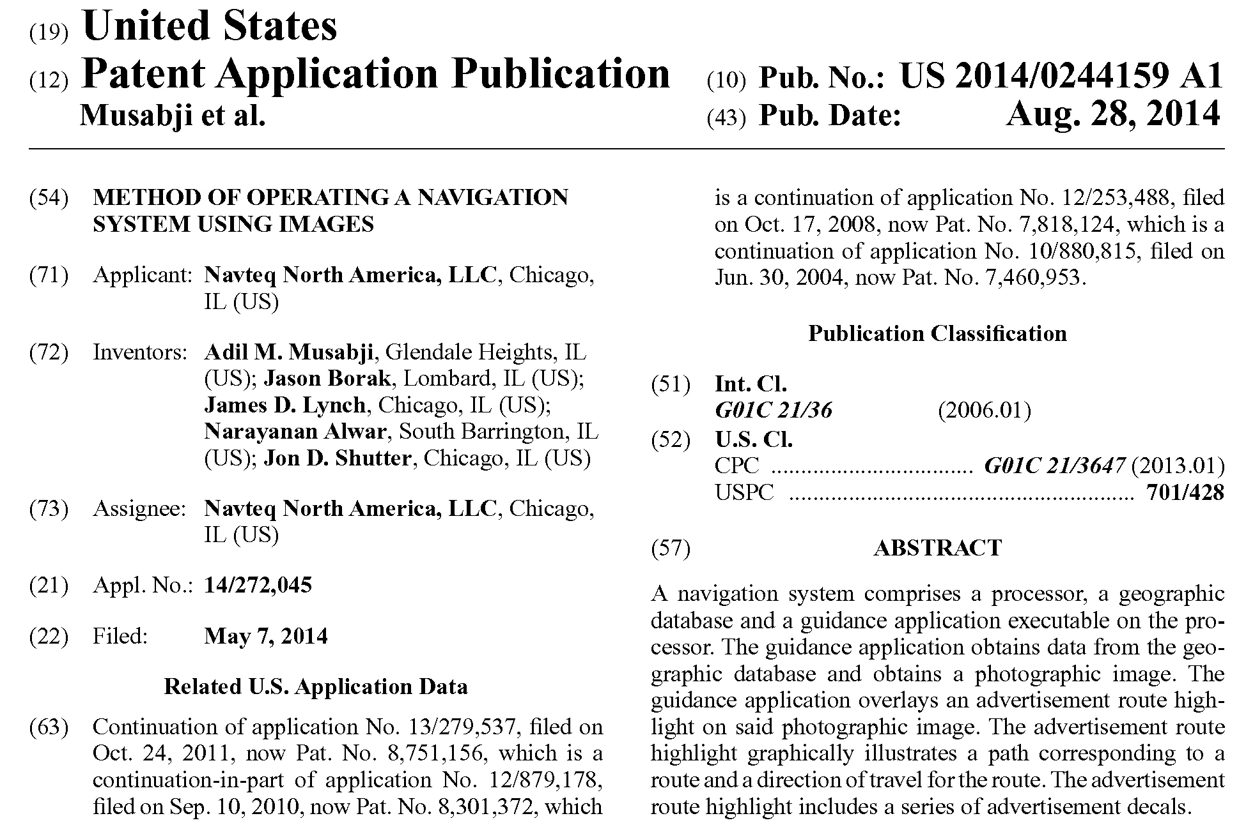

Slide 8
Income Tax Data
Panel dataset covering U.S. population
Covers every person in the U.S. who appears on any tax form from 1996-2012
Includes non-filers through information returns (W-2’s, 1099’s, etc.)
Notes:
8

Slide 9
Linked Patent-Tax Data
Patent data were linked to tax data by inventor name, city, and state at time of patent application
86% of people in patent files linked to tax data
1,200,689 unique inventors in linked patent-tax data
Notes:
9

Slide 10
The Lifecycle of Inventors
Birth
Parents
Gender
Ability
Notes:
10

Slide 11
Parent Characteristics
Link parents to children based on dependent claiming [Chetty, Hendren, Kline, Saez 2014]
We can identify parents only for children born in or after 1980
Forces us to study young inventors: patents before age 32 (in 2012)
Still a substantial sample: 34,973 inventors in our sample born between 1980-1984
13% of (eventually granted) patents applied for in 2000 were from individuals aged under age 32
Evaluate robustness of patterns using Statistics of Income 0.1% sample, which allows us to look at patenting up to age 40
Notes:
11

Slide 12
Patent Rates vs. Parent Income Percentile
8
6
No. of Inventors per Thousand Children
4
2
0
0
20
40
60
80
100
Parent Household Income Percentile
Notes: Sample of children is 1980-84 birth cohorts. Parent Income is mean household income from 1996-2000.
Notes:
Fig 1a

Slide 13
Patent Rates vs. Parent Income Percentile
8
6
No. of Inventors per Thousand Children
4
2
Patent rate for below
median parent income:
0.84 per 1,000
0
0
20
40
60
80
100
Parent Household Income Percentile
Notes: Sample of children is 1980-84 birth cohorts. Parent Income is mean household income from 1996-2000.
Notes:
Fig 1a

Slide 14
Patent Rates vs. Parent Income Percentile
8
Patent rate for top 1% parent income:
8.3 per 1,000
6
No. of Inventors per Thousand Children
4
2
Patent rate for below
median parent income:
0.84 per 1,000
0
0
20
40
60
80
100
Parent Household Income Percentile
Notes: Sample of children is 1980-84 birth cohorts. Parent Income is mean household income from 1996-2000.
Notes:
Fig 1a

Slide 15
Highly-Cited Inventors vs. Parent Income Percentile
0.4
0.3
0.2
Highly-Cited (Top 5%) Inventors per Thousand
0.1
0
0
20
40
60
80
100
Parent Household Income Percentile

Slide 16
Patent Rates Between Ages 30-40 vs. Parent Income Percentile
25
20
15
Inventors Between Ages 30-40 per Thousand
10
5
0
0
20
40
60
80
100
Parent Household Income Percentile
Notes: Sample of children is birth cohorts 1971-72 from the Statistics of Income 0.1% Random Sample.

Slide 17
Why Do Patent Rates Vary with Parent Income?
Correlation between parent income and children growing up to be inventors could be driven by three mechanisms:
Endowments: Children from high-income families may have greater ability to innovate
Preferences: lower income children prefer other occupations (e.g., because of higher risk aversion due to financial constraints)
Constraints: lower income children have comparable talent and preferences but face higher barriers to entry or lack exposure
Notes:
17

Slide 18
Why Do Patent Rates Vary with Parent Income?
First step to distinguish between these explanations: measure ability using data on test scores for all children in NYC public schools [Chetty, Friedman, Rockoff 2014]
Math/reading scores from grades 3-8 on statewide standardized tests from 1989-2009
Use data for 430,000 children in 1979-85 birth cohorts for this analysis
Notes:
18

Slide 19
Patent Rates vs. 3rd Grade Math Test Scores in NYC Public Schools
5
90th Percentile
4
3
Inventors per Thousand
2
1
0
-2
-1
0
1
2
3rd Grade Math Test Score (Standardized)
Notes:
Fig4 (Without breaking down by parent income) – 1979-85 Birth Cohorts
Top 5%: 4.57 Inventors per Thousand
Below p80: 0.41 Inventors per Thousand
Below Median: 0.33 Inventors per Thousand

Slide 20
Distribution of Math Test Scores in 3rd Grade for Children of Low vs. High Income Parents
0.5
Fraction with Score in Top 10%
Parents below p80: 7%
Parents above p80: 23%
0.4
0.3
Density
0.2
0.1
0
-3
-2
-1
0
1
2
3
Grade 3 Math Scores (Standardized)
Parent Income Below 80th Percentile
Parent Income Above 80th Percentile
Notes:
Fig A3a

Slide 21
Patenting Gap Explained by Test Scores
What fraction of the gap in patenting by parent income is explained by test scores?
Calculate this non-parametrically using a simple reweighting approach [Dinardo, Fortin, Lemieux 1996]
Estimate patent rate for low-income kids if they were to have the same 3rd grade math scores as high income kids
Notes:
21

Slide 22
What Fraction of the Gap in Patenting by Parent Income is Explained by Differences in Test Scores?
 | Patent Rate (per 1000 Individuals) |  |  | Gap Relative to Above p80 Group
Above 80th Pctile. | 1.93
Below 80th Pctile. | 0.52 |  |  | 1.41
Below 80th Pctile. (Reweighting Scores) | 0.95 |  |  | 0.97
 |  |  |  | (= 1.93 – 0.95)
% of gap accounted for by 3rd grade scores |  |  |  | 31.2% (s.e. = 6.8%)

Slide 23
Patent Rates vs. 3rd Grade Test Scores by Parental Income
8
90th Percentile
6
Inventors per Thousand
4
2
0
-2
-1
0
1
2
3rd Grade Math Test Score (Standardized)
Parent Income Below 80th Percentile
Parent Income Above 80th Percentile
Notes:
Fig4a
Top 10% - High-Income: 5.08 vs. Low-income: 2.59 Inventors per Thousand
Below p90 - High-Income: 1.04 vs. Low-income: 0.43 Inventors per Thousand

Slide 24
Patenting Gap Explained by Test Scores
Now repeat preceding analysis using test scores at later ages
What fraction of innovation gap between low- and high-income children can be explained by test scores in 4th grade, 5th grade, etc.?
Notes:
24

Slide 25
Gap in Patent Rates by Parental Income Explained by Test Scores in Grades 3-8
50
45
Percent of Gap Explained by Math Test Scores
40
35
Slope: 3.20% per grade
(0.55)
30
3
4
5
6
7
8
Grade
Notes:
Fig 5 – 1979-85 Birth Cohorts (NYC Public School Sample)
Unweighted regression. SE in parentheses.

Slide 26
Expanding Gaps over Childhood
Gap in innovation explained by test scores grows over time, consistent with low SES children falling behind over time [Fryer and Levitt 2006, Fryer 2014]
Suggests that innovation may be driven by differences in childhood environment
However, not conclusive because latent genetic ability may be better manifested in tests at later ages
To evaluate whether environment matters, analyze importance of environmental exposure directly in next section
Notes:
26

Slide 27
Racial Gaps in Patenting
Next, replicate this analysis to evaluate gaps by race
Is there misallocation of talent by race in innovation? [Cook and Kongcharoen 2010]
Notes:
27

Slide 28
Patent Rates by Race and Ethnicity
4
3
Inventors per Thousand
2
Raw rate
3.3
1
1.6
0.5
0
0.2
White
Black
Hispanic
Asian
Notes:
Fig 2
Share of Students By Race: Asian 9.6%, Hispanic 33.7%, Black 36.0 %, White 19.5%

Slide 29
Patent Rates by Race and Ethnicity
4
3
Reweighted to match parental incomes of whites
Inventors per Thousand
2
4.2
Raw rate
3.3
1
1.6
1.6
1.0
0.5
0.3
0
0.2
White
Black
Hispanic
Asian
Notes:
Fig 2
Share of Students By Race: Asian 9.6%, Hispanic 33.7%, Black 36.0 %, White 19.5%

Slide 30
Patent Rates by Race and Ethnicity
4
3
Reweighted to match parental incomes of whites
Inventors per Thousand
2
4.2
Raw rate
Reweighted to match 3rd grade test scores of whites
3.3
3.1
1
1.6
1.6
1.6
1.0
0.5
0.6
0
0.2
0.3
0.3
White
Black
Hispanic
Asian
Notes:
Fig 2
Share of Students By Race: Asian 9.6%, Hispanic 33.7%, Black 36.0 %, White 19.5%

Slide 31
Patent Rates vs. 3rd Grade Math Test Scores by Race and Ethnicity
8
90th Percentile
6
Inventors per Thousand
4
2
0
-2
-1
0
1
2
3rd Grade Math Test Score (Standardized)
White
Black
Hispanic
Asian
Notes:
Fig 4b

Slide 32
Gender Gaps in Patenting
Finally, characterize gaps in innovation by gender
Is there misallocation of talent by gender?
How has this changed over time? [Thursby and Thursby 2005, Ding, Murray, Stewart 2006, Jung and Ejermo 2014]
Notes:
32

Slide 33
Percentage of Female Inventors by Birth Cohort
50
Average change per year: 0.27%
40
(0.01%)
→ 118 years to reach 50% female share
30
Percentage of Inventors who are Female
20
10
0
1940
1950
1960
1970
1980
Year of Birth
Notes:
Fig 3 – Unweighted OLS regression

Slide 34
Distribution of Math Test Scores in 3rd Grade for Boys vs. Girls
0.4
Math scores in 3rd grade explain less than 3% of the gender gap in innovation
0.3
Density
0.2
0.1
0
-3
-2
-1
0
1
2
3
Grade 3 Math Scores (Standardized)
Boys
Girls
Notes:
Fig A3b

Slide 35
Patent Rates vs. 3rd Grade Math Test Scores by Gender
8
90th Percentile
6
Inventors per Thousand
4
2
0
-2
-1
0
1
2
3rd Grade Math Test Score (Standardized)
Female
Male

Slide 36
The Lifecycle of Inventors
Birth
Parents
Gender
Ability
Childhood
Mentors
Neighborhood
College
Notes:
36

Slide 37
Effects of Childhood Environment
Begin by characterizing importance of exposure to innovation during childhood for propensity to innovate
Are children who are exposed to innovation through parents, friends, or neighbors more likely to patent?
First analyze relationship between children’s and parents’ patent rates
Notes:
37

Slide 38
Patent Rates for Children of Inventors vs. Non-Inventors
18.0
2.0
Parents not Inventors
Parents Inventors
No. of Children
16,238,825
157,058

Slide 39
Exposure vs. Genetics
Correlation between child and parent’s propensity to patent could be driven by genetics or by environment
To distinguish the two, analyze propensity to patent by narrow technology class
Intuition: genetic ability to innovate is unlikely to vary significantly across similar technology classes
Define “similarity” of two technology classes based on the fraction of inventors who hold patents in both classes [Bloom et al. 2013]
Other measures yield similar results
Notes:
39

Slide 40
Illustration of Technology Classes and Distance
Category: Computers + Communications
Subcategory: Communications
Technology Class | Distance Rank
Pulse or digital communications | 0
Demodulators | 1
Modulators | 2
Coded data generation or conversion | 3
Electrical computers: arithmetic processing and calculating | 4
Oscillators | 5
Multiplex communications | 6
Telecommunications | 7
Amplifiers | 8
Motion video signal processing for recording or reproducing | 9
Directive radio wave systems and devices (e.g., radar, radio navigation) | 10
Notes:
40
Pulse or digital communications (375)
Demodulators (329)
Modulators (332)

Slide 41
Income of Inventors by Characteristics at Birth
1
0.8
0.6
Inventors per Thousand
0.4
0.2
0
0
20
40
60
80
100
Distance from Father's Technology Class
Notes:
Fig 6: Children whose fathers are inventors (1980-84), dropping children who were listed as co-inventors with there fathers
For Distance 0: Magnitude = 0.94
For Distance 1-100: Magnitude = 0.06

Slide 42
Industry
Now turn to a broader source of exposure: parent’s “colleagues”
Do children whose parents work in more innovative industries have higher patent rates?
Focus on children whose parents are not inventors themselves to eliminate direct effect of parent inventing
Notes:
42

Slide 43
Effect of Class-Level Patent Rates in Father’s Industry on
Children’s Patent Rates by Technological Distance
0.08
0.06
Regression Coefficient on Class-Level Patent Rate
0.04
0.02
0
0
1-10
11-20
21-30
31-40
41-50
51-60
61-70
71-80
81-90
91-100
Distance Between Technology Classes
Notes:
Fig A4a

Slide 44
Children’s Patent Rates vs. Patent Rates in Father’s Industry: Regression Estimates
Dependent variable: | (1) Frac. Inventors |  | (2) Frac. Inventing in Category |  | (3) Frac. Inventing in Sub-Category | (4) Frac. Inventing in Class |  | (5) Frac. Inventing in Class
Frac. Inventors in Father’s Industry | 0.250*** (0.028)
Frac. in Category in Father’s Ind. |  |  | 0.163*** (0.018)
Frac. in S-Category in Father’s Ind. |  |  |  |  | 0.155*** (0.017)
Frac. in Class in Father’s Ind. |  |  |  |  |  | 0.078*** (0.013) |  | 0.0598*** (0.0125)
Frac. in same S-Cat but other Class |  |  |  |  |  |  |  | 0.0044*** (0.0008)
Frac. in same Cat. but other S-Cat. |  |  |  |  |  |  |  | 0.0001 (0.0004)
Frac. in other Cat. |  |  |  |  |  |  |  | 0.0002*** (0.0000)
Observations | 345 |  | 2,415 |  | 12,765 | 153,525 |  | 153,525
Notes: Std errors clustered by industry. Col. 2 includes Category FE; col. 3 includes sub-category FE; cols. 4-5 include class FE. Sample: 10.2 million children whose parents are not inventors.
Notes:
Col 1
N: 345
Mean of Dep: .0023402
SD of Indep: .0023675
Col 2
N: 2415
Mean of Dep: .0003343
SD of Indep: .0006537
Col 3
N:12765
Mean of Dep: .0000632
SD of Indep: .0002057
Col 4
N: 154,525
Mean of Dep: 5.26e-06
SD of Indep: .0000303
Col 5
N: 153,525
Mean of Dep: 5.26e-06
SD of Indep:
Class: .0000303
Same S-Cat but other Class: .0002355
Same Cat but other S-Cat: .0004045
Other Cat: .0020658
Table 7: (This graph excludes children with parents who invent)

Slide 45
Neighborhoods
Next, analyze influence of neighborhoods
Tabulate patent rates by commuting zone (aggregation of counties analogous to metro area) where child grows up
Differs from literature on clusters of innovation (e.g., Porter and Stern 2001), because this is not necessarily where they live as adults
Notes:
45

Slide 46
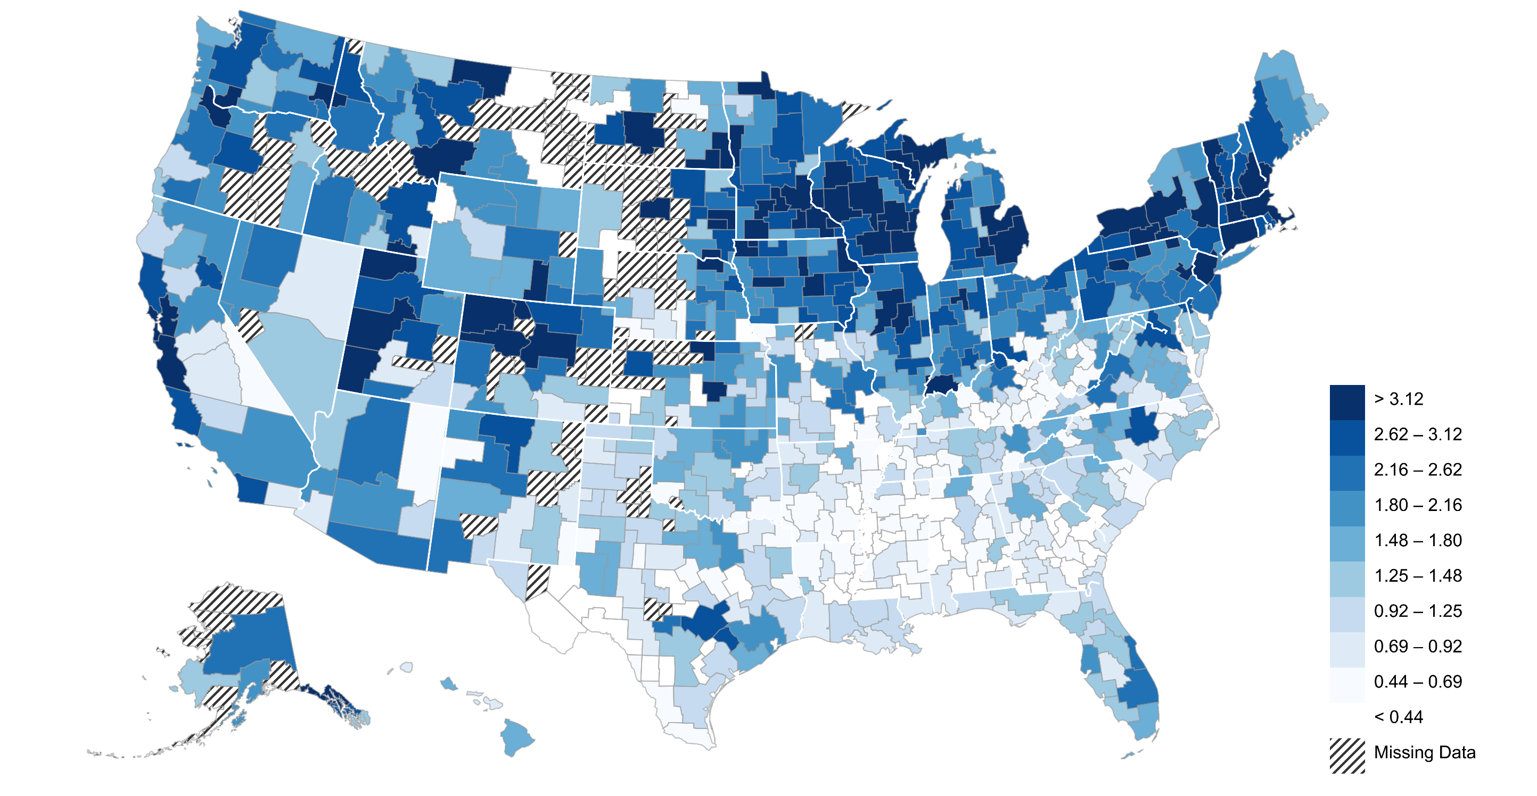
The Origins of Inventors: Patent Rates by Childhood Commuting Zone
Inventors per 1000 Children
Insufficient Data
Notes:
Fig7a (omits CZ’s with fewer than 1,000 kids)

Slide 47
CZs with the Highest and Lowest Patent Rates among the 100 Largest CZs
Top 10
Bottom 10
San Jose, CA
Birmingham, AL
Madison, WI
Virginia Beach, VA
Minneapolis, MN
El Paso, TX
San Francisco, CA
Fresno, CA
Detroit, MI
Modesto, CA
Boston, MA
Little Rock, AR
Allentown, PA
Fayetteville, NC
Milwaukee, WI
Lakeland, FL
Manchester, NH
Mobile, AL
Newark, NJ
Brownsville, TX
0
1
2
3
4
5
6
0
1
2
3
4
5
6
Inventors per 1000 Children
Inventors per 1000 Children
Notes:
Fig7b

Slide 48
Patent Rates of Children who Grow up in a CZ vs. Patent Rates of Adults in that CZ
6
San Jose
5
Madison
Minneapolis
4
3
Newark
Num. of Inventors per 1000 Children
Portland
2
Houston
1
Brownsville
0
0
0.2
0.4
0.6
0.8
Annual Patent Rate per Thousand Working Age Adults in CZ
Notes:
Fig 7

Slide 49
Neighborhoods
Children raised in areas with more inventors are more likely to be inventors themselves
Could again be driven by genetics or exposure effects
Once again, study patterns within technological class
Do children who grow up in Silicon Valley tend to become computing innovators?
Do children who grow up in Minnesota (with large medical device manufacturers) become medical innovators?
Notes:
49

Slide 50
Effect of Class-Level Patent Rates in Childhood CZ on
Children’s Patent Rates by Technological Distance
1.2
1
0.8
Regression Coefficient on Class-Level Patent Rate
0.6
0.4
0.2
0
0
1-10
11-20
21-30
31-40
41-50
51-60
61-70
71-80
81-90
91-100
Distance Between Technology Classes
Notes:
Fig A4b

Slide 51
Children’s Patent Rates vs. Patent Rates in Neighborhood: Regression Estimates
 | (1) | (2) | (3) | (4) | (5) | (6) | (7) | (8)
Dep. Variable: Fraction Inventing in | Any Category | Any Category | Patent Category | Patent Category | Patent Category | Patent Sub-Category | Patent Class | Patent Class
Exposure (Childhood CZ): Invention rate | 2.932*** (0.417)-- | 2.578*** (0.531) -
Invention rate in same category |  |  | 1.759*** (0.404) -- | 1.114*** (0.341)f | 1.722*** (0.406)--
Invention rate in same sub-category |  |  |  |  |  | 1.526*** (0.375)
Invention rate in same technology class |  |  |  |  |  |  | 1.108*** (0.181)-- | 1.050*** (0.173) --
Invention rate in same sub-category, but different technology class |  |  |  |  |  |  |  | -0.0003-- (0.0063)
Invention rate in same category, but different sub-category |  |  |  |  |  |  |  | -0.0015-- (0.0028)
Invention rate rate in different category in Childhood CZ |  |  |  |  |  |  |  | 0.0054*** (0.0006)--
Notes: Std errors clustered by CZ. Cols. 3-5 include Category FE; col. 6 includes sub-category FE; cols. 7-8 include class FE. Sample: children whose parents are not inventors. Col. 2 and 4 based on movers only.

Slide 52
Variation by Gender across Neighborhoods
Areas differ not just in overall rate of innovation but also in composition of inventors
Focus here on variation in fraction of inventors who are female by CZ where child grew up
Notes:
52

Slide 53
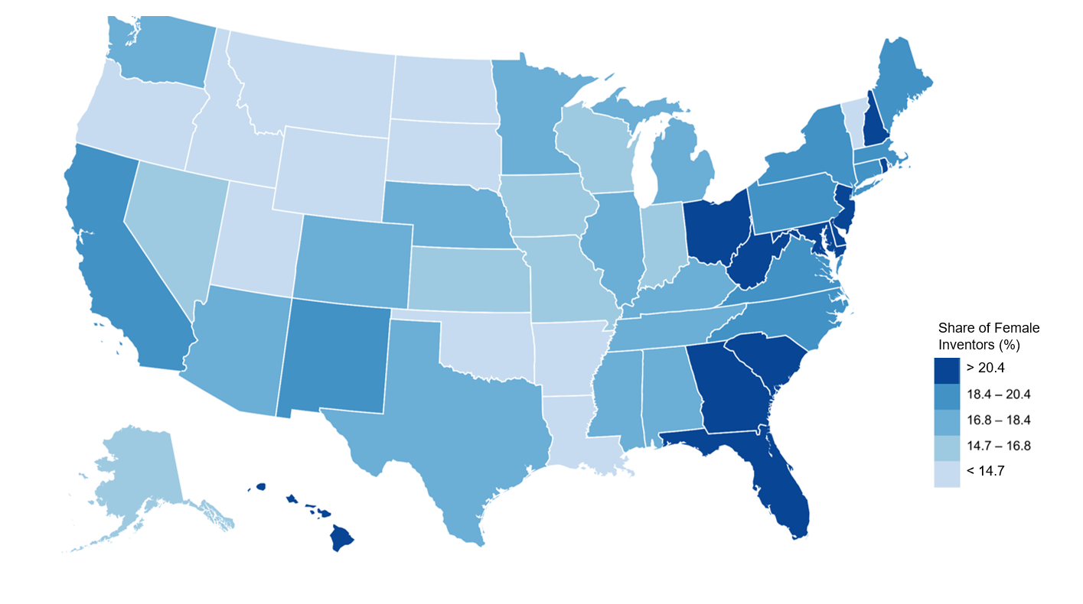
Geographical Variation in Gender Gaps in Patent Rates
Percent of Inventors who are Female by State where Child Grew Up
Notes:
Fig 9a

Slide 54
Highest and Lowest Female Inventor Shares by CZ where Child Grew Up
(100 Largest CZs)
Top 10
Bottom 10
Modesto, CA
Eugene, OR
Honolulu, HI
Salt Lake City, UT
Toms River, NJ
Grand Rapids, MI
Lakeland, FL
Fayetteville, NC
Jacksonville, FL
Erie, PA
Greenville, SC
Bakersfield, CA
Cape Coral, FL
Fresno, CA
Brownsville, TX
Oklahoma City, OK
Charlotte, NC
Little Rock, AR
Dayton, OH
Santa Rosa, CA
0
10
20
30
40
50
0
10
20
30
40
50
Female Inventor Share (%)
Female Inventor Share (%)
Notes:
Fig 9b

Slide 55
Percentage of Female Inventors and Gender Stereotypes
30
RI
HI
25
SC
NH
NJ
FL
GA
Percentage of Inventors who are Female
OH
MD
WV
20
MA
NM
DE
CT
NY
NC
CA
ME
AZ
VA
PA
NE
AL
IL
KY
MI
CO
WA
MN
TX
TN
MS
WI
IN
15
MO
IA
AK
KS
WY
NV
ND
OR
OK
LA
UT
VT
MT
AR
SD
ID
10
1.5
2.0
2.5
3.0
Gender Stereotype Adherence Index on 8th Grade Tests (Pope and Sydnor 2010)
Notes:
Fig A5

Slide 56
Children’s Patent Rates vs. Patent Rates by Gender in Neighborhood
Dependent variable: | (1) | (2) | (3) | (4) | (5)
 | Fraction Inventing in CZ | Fraction of Women Inventing | Fraction of Men Inventing | Fraction of Women Inventing in Patent Category | Fraction of Men Inventing in Patent Category
Exposure: Invention Rate in Childhood CZ | 0.986***
 | (0.145)
Invention Rate of Women in Childhood CZ |  | 2.408* | -0.356 | 2.232*** | -2.157*
 |  | (1.265) | (4.398) | (0.607) | (1.300)
Invention Rate of Men in Childhood CZ |  | 0.174 | 1.784*** | 0.102 | 1.693***
 |  | (0.154) | (0.625) | (0.062) | (0.295)
Fixed Effects | None | None | None | Category | Category
Unit of Observation | Childhood CZ | Childhood CZ | Childhood CZ | Childhood CZ by Category | Childhood CZ by Category
Number of Cells | 741 | 741 | 741 | 5,188 | 5,188
p-value from F-test for Equality of Coefficients |  | 0.113 | 0.667 | 0.001 | 0.015
Notes: Std. errors clustered by CZ. Sample of children whose parents are not inventors.
* denotes p<0.1, *** denotes p<0.01

Slide 57
College Attendance and Innovation
Finally, examine college as a pathway to innovation
What fraction of variation in innovation is accounted for by college that a child attends?
How much variation is left to be explained by labor market choices after college?
Notes:
57

Slide 58
Colleges with the Highest Share of Inventors per Student
Massachusetts Institute of Technology
Carnegie Mellon University
Rensselaer Polytechnic Institute
Stanford University
Case Western Reserve University
Michigan Technological University
Clarkson University
Georgia Institute of Technology
Rochester Institute of Technology
Rice University
0
20
40
60
80
100
120
Inventors per 1000 Students
Notes:
Figure 10a

Slide 59
Patent Rates vs. Parent Income in the 10 Most Innovative Colleges
90
80
71 per 1,000 students with parents in the top 1% become inventors
70
60
40 per 1,000 students with below median parent income become inventors
50
Inventors per 1000 Students
40
30
20
10
0
0
20
40
60
80
100
Parents' Percentile Rank in National Income Distribution
Notes:
Figure 10b

Slide 60
The Lifecycle of Inventors
Birth
Parents
Gender
Ability
Childhood
Mentors
Neighborhood
College
Career
Earnings
Dynamics
Notes:
60

Slide 61
Income Distribution of Inventors
Characterize careers of inventors to shed light on how financial incentives may affect individuals’ decisions to pursue innovation
First analyze cross-sectional distribution of mean income between ages 40-50 and covariance with scientific impact of patents
Then characterize earnings dynamics over lifecycle
Notes:
61

Slide 62
Distribution of Inventors’ Mean Individual Income Between Ages 40-50
0.006
p50 = $114k
p95 = $497
p99 = $1.6m
0.004
Density
0.002
0
0
500
1000
1500
Mean Annual Individual Income ($1000), Ages 40-50
Notes:
Fig A6
p25 = $69,731
p75 = $175,109

Slide 63
Inventors’ Incomes vs. Patent Citations
1200
1000
800
Mean Annual Income Between Ages 40-50 ($1000)
Slope : 1.468
(0.084)
600
400
200
0
200
400
600
Number of Citations
Notes:
Fig 11

Slide 64
Earnings Dynamics
Now turn to earnings dynamics
General pattern: increase in earnings largely precedes patent application, consistent with Depalo and Addario (2014)
Private return to innovation appears to be earned largely before patent application itself
Change in income from grant of patent is small relative to earnings change prior to application
Begin by examining age profile of innovation as background
Notes:
64

Slide 65
Age Distribution of Individuals who Patent in 2000
Conditional on grant by 2012
0.04
0.03
Density
0.02
0.01
0
20
30
40
50
60
70
Age
Notes:
Fig 12a

Slide 66
Median Income of Inventors by Age
120
100
80
Median Income ($1000)
60
40
20
20
30
40
50
60
Age
Patent App. at Age 30
Notes:
Fig 13a

Slide 67
Median Income of Inventors by Age
120
100
80
Median Income ($1000)
60
40
20
20
30
40
50
60
Age
Patent App. at Age 30
Patent App. at Age 40
Notes:
Fig 13a

Slide 68
Median Income of Inventors by Age
120
100
80
Median Income ($1000)
60
40
20
20
30
40
50
60
Age
Patent App. at Age 30
Patent App. at Age 40
Patent App. at Age 50
Notes:
Fig 13a
Number of obs: note that this is not balanced, so below is a list of # of obs for people who patented at this age, but the # obs for dots around it are in age_rpat_age_med_collapse. The sample we pull from is basically all inventors (a small yob<1984 restriction at top brings down to about 1.1m).
30: 26,401
40: 36,733
50: 27,408

Slide 69
Event Study of Income Distributions Around Patent Application
1800
200
1600
150
1400
Median or Mean Income ($1000)
99th Percentile of Income Distribution ($1000)
1200
100
1000
50
800
-10
-5
0
5
10
Year Relative to Patent Application
Median Income
Mean Income
99th Percentile
Notes:
Fig 13b
Number of obs: 19,570,332
Number of individuals: 1,151,196
This seems to be all inventors with yob<=1984

Slide 70
Event Study of Income Distributions Around Patent Application
140
120
Median Income ($1000)
100
80
60
-10
-5
0
5
10
Year Relative to Patent Application
Ungranted Patents
Granted Patents
Highly-Cited (Top 5%) Patents
Notes:
Fig 13c
Change from -1 to +1:
Ungranted Patents: 1400 Dollars
Granted Patents: 2500 Dollars
Highly Cited Granted Patents: 7.9 Thousand Dollars
Change from -10 to 0:
Ungranted Patents: 37.6 Thousand Dollars
Granted Patents: 38.8 Thousand Dollars
Highly Cited Granted Patents: 60.4 Thousand Dollars

Slide 71
Implications for Models of Innovation
Three key facts about returns to innovation:
Returns are extremely skewed: small chance of a very large payoff
Private financial returns are highly correlated with scientific impact: highly-cited inventors earn more than $1 million on average
Returns are often obtained late in an inventor’s career → payoffs may be uncertain when individuals make initial career choice
We show below that these facts imply that changes in tax rates will have small effects on rates of innovation in a standard expected utility model
Notes:
71

Slide 72
Income and Citations by Characteristics at Birth
Finally, examine how income and citations vary with characteristics at birth
Sheds further light on mechanisms that drive differences in innovation rates across subgroups
Models of barriers to entry predict that inventors from under-represented groups will have higher ability on average [Hsieh et al. 2013]
Top inventors (“Einsteins”) make it through pipeline regardless of their parent’s income, race, gender
Notes:
72

Slide 73
Income of Inventors by Characteristics at Birth
400
300
Mean Income in 2012 ($1000)
200
241
261
100
224
193
122
143
0
Par Inc.
Par Inc.
Non-Minority
Minority
Male
Female
Above p80
Below p80
Notes:
Fig 14a
1st set of bars – IGE sample (1980-84) 35,000 inventors
2nd set of bars – NYC sample (1979-85) 450 inventors
3rd set of bars – Full sample 1.2M inventors

Slide 74
Fraction with Highly-Cited Patents by Characteristics at Birth
10
8
6
Pct. of Inventors in Top 5% of Citation Distribution
4
5.3
5.7
5.2
5.4
2
4.8
2.6
0
Par Inc.
Par Inc.
Non-Minority
Minority
Male
Female
Above p80
Below p80
Notes:
Fig 14a
1st set of bars – IGE sample (1980-84) 35,000 inventors
2nd set of bars – NYC sample (1979-85) 450 inventors
3rd set of bars – Full sample 1.2M inventors

Slide 75
Implications for Models of Innovation
Data are inconsistent with simple barriers to entry models
But are consistent with exposure effects model
Regardless of the explanation, key implication is that we are not just losing inventors of marginal ability
There are many “lost Einsteins” in under-represented groups
Implies that costs of misallocation of talent might be even larger than predicted by existing models such as Hsieh et al. (2013)
Notes:
75

Slide 76
How Many Lost Einsteins?
White men from high-income (top-quintile) families comprise approximately 10% of US population
Innovation rate for this group is about 4 times higher than in population as a whole
→ If women, minorities, and low-income children invented at same rate as high-income white men, would have four times as many inventors
Notes:
76

Slide 77
Career Choice Model
Analyze implications of findings for policies to increase innovation using a stylized model of career choice
Two sectors: non-innovation (fixed salary) and innovation, which has payoffs that vary with ability and stochastic shock (Pareto distributions)
Individuals choose careers by maximizing expected utility
Decisions depend upon financial payoffs to innovation, tax rates/barriers to entry, and exposure (binary variable)
Notes:
77

Slide 78
Career Choice Model: Results
Key result: changes in financial incentives have less potential to increase quality-weighted innovation than changes in exposure, for three reasons:
[Exposure dampening] Taxes only affect those exposed to innovation
[Forecastable returns] With highly skewed abilities, marginal inventor influenced by tax change has little impact on aggregate innovation [Jaimovich and Rebelo 2016]
[Stochastic returns] With highly uncertain returns, changes in top tax rates do not affect marginal utility in “good” state significantly
Calibrate distributions of ability and stochastic shocks to match empirical distribution of earnings to assess magnitudes of tax elasticities in practice
Notes:
78

Slide 79
Predicted Impacts of Tax Rates on Innovation
Forecastable Returns
100
80
60
% Relative to Baseline
40
20
Quality-Weighted Aggregate Innovation (ϕ)
Number of Inventors (φ)
0
0
10
20
30
40
50
60
70
80
90
Tax Rate on Inventors' Earnings (%)
Notes:
79

Slide 80
Predicted Impacts of Tax Rates on Innovation
Stochastic Returns
100
80
60
% Relative to Baseline
Quality-Weighted Aggregate Innovation (ϕ), CRRA = 1
40
Number of Inventors (φ), CRRA = 1
Quality-Weighted Aggregate Innovation (ϕ), CRRA = 0
Number of Inventors (φ), CRRA = 0
20
0
0
10
20
30
40
50
60
70
80
90
Tax Rate on Inventors' Earnings (%)
Notes:
80

Slide 81
Impacts of Taxes with Stochastic Returns: Intuition
Suppose an inventor makes $0 if his invention is unsuccessful and $10 million if invention succeeds
Suppose he would make a fixed salary of $200K in an alternative career
Consider an increase in income tax rate from 30 to 40%
If innovation fails, this has no impact on payoff (zero)
In innovation succeeds, net-of-tax payoff falls from $6m to $5m
Fraction of individuals deterred from going into innovation sector will be small in a standard expected utility model
With diminishing marginal utility, value of extra $1m conditional on earning $5m is low
Notes:
81

Slide 82
Tax Incentives for Innovation: Results
Key result: when returns to innovation are calibrated to match empirical distribution, top tax elasticities are small regardless of other parameters
Caveats
This is not an empirical result: no direct evidence that tax elasticities are small
Taxes may affect innovation through other channels, such as behavior of firms, other salaried workers, or through GE effects
Notes:
82

Slide 83
Conclusions
Exposure to innovation is critical in determining who becomes an inventor
Many “lost Einsteins” among children from low-income families, minorities, and women because of a lack of exposure
If these groups invented at the same rate as white men from high-income families, innovation rate would quadruple
Notes:
83

Slide 84
Conclusions
Results do not provide specific guidance on policies to increase exposure
Could include mentorship programs, internships, changes in networks
But they do provide guidance on how these programs should be targeted
Should be targeted toward women, minorities, and children from low-income families who excel in math/science at early ages
Should also be tailored by background: women more likely to be influenced by female inventors
Key question: what programs are effective in increasing exposure?
We have posted online data tables with statistics on patent rates (www.equality-of-opportunity.org/data) to facilitate such analyses
Notes:
84

Slide 85
Appendix Figures

Slide 86
Patent Rates vs. Parent Income
Alternative Measures of Innovation
8
6
Inventors
Applicants
Inventors/Applicants/Grantees per Thousand
Grantees
4
2
0
0
20
40
60
80
100
Parent Household Income Percentile
Notes:
Fig A1b

Slide 87
Patent Rates vs. Parent Income
New York City School Sample
5
4
3
Inventors per Thousand
2
1
0
0
20
40
60
80
100
Parent Household Income Percentile
Notes:
Fig A1b

Slide 88
Other Upper-Tail Outcomes
Probability of patenting is an increasing, convex function of parent income percentile
Same is true of other upper tail outcomes, e.g. probability of having income in top 1% of distribution
Why focus on patenting instead of simply having high income?
Innovation has larger positive externalities than other activities that generate large private returns
Focusing on innovation yields more precise predictions that help us identify mechanisms
Notes:
88

Slide 89
Fraction of Children in Top 1% of The Income Distribution vs. Parent Income
10
9.2% of children born in the top 1% stay there
8
6
Percentage of Children with Income in Top 1%
4
2
0.3% of children with below median parent income reach the top 1%
0
0
20
40
60
80
100
Parent Household Income Percentile

Slide 90
Fraction of Children in Top 5% of The Income Distribution vs. Parent Income
25
20
17.5% of children born in the top 5% stay there
15
Percentage of Children with Income in Top 5%
10
2.1% of children with below median parent income reach the top 5%
5
0
0
20
40
60
80
100
Parent Household Income Percentile
Notes:
Fig A2

Slide 91
Age Distribution of Inventors
At what stage of career do innovations occur? [e.g., Galenson and Weinberg 2001, Jones 2010]
When are the highest-impact discoveries made?
Notes:
91

Slide 92
Age Distribution of Individuals who Patent in 2000
Conditional on grant by 2012
0.04
0.03
Density
0.02
0.01
0
20
30
40
50
60
70
Age
Notes:
Fig 12a

Slide 93
Fraction of Workers who Patent in 2000, by Age
Conditional on grant by 2012
2.5
2
1.5
Workers who Patent in 2000 (per 10,000)
1
0.5
Age 40 : 2.31
Age 60 : 1.55
Decline: 33%
0
20
30
40
50
60
Age
Notes:
Fig 12b

Slide 94
Fraction of Workers with Highly-Cited Patents, by Age
Conditional on grant by 2012
0.15
0.10
Workers with Highly Cited Patents in 2000 (per 10,000)
0.05
Age 40 : 0.13
Age 60 : 0.04
Decline: 66%
0
20
30
40
50
60
Age
Notes:
Fig 12b

