Slide 1
Lost Einsteins Innovation and Opportunity in America
Alex Bell
Raj Chetty
Xavier Jaravel
Neviana Petkova
John van Reenen
The opinions expressed in this paper are those of the authors alone and do not necessarily reflect the views of the Internal Revenue Service or the U.S. Treasury Department.

Slide 2
How Can We Increase Innovation and Growth in America?
Innovation is widely viewed as the engine of economic growth
How can we increase the rate of innovation?
Policy approaches range from STEM education to tax incentives
Effectiveness of these policies is debated, partly because of a lack of data on who innovates in America

Slide 3
We Use Big Data to Study Who Becomes an Inventor in America
Patent Data
1.2 million inventors
Tax Records
Parents, College, Earnings
School District Data
Test scores
Source: Bell, Chetty, Jaravel, Petkova, van Reenen 2017

Slide 4
We track inventors from birth to adulthood to understand the factors that determine who invents
Career
Childhood
Birth

Slide 5
Begin by analyzing inventors’ characteristics at birth
Career
Childhood
Birth

Slide 6
Patent Rates vs. Parent Income
8
6
No. of Inventors per Thousand Children
4
2
0
0
20
40
60
80
100
Parent Household Income Percentile

Slide 7
Patent Rates vs. Parent Income
8
6
No. of Inventors per Thousand Children
4
2
Patent rate for below
median parent income:
0.84 per 1,000
0
0
20
40
60
80
100
Parent Household Income Percentile

Slide 8
Patent Rates vs. Parent Income
Patent rate for top 1% parent income:
8.3 per 1,000
8
6
No. of Inventors per Thousand Children
4
2
Patent rate for below
median parent income:
0.84 per 1,000
0
0
20
40
60
80
100
Parent Household Income Percentile

Slide 9
Lost Einsteins? Highly-Cited Patents vs. Parent Income
0.4
0.3
Highly-Cited (Top 5%) Inventors per Thousand
0.2
0.1
0
0
20
40
60
80
100
Parent Household Income Percentile

Slide 10
Why do patent rates vary with parent income?
Three potential explanations
Ability
Preferences
1
Children from high-income families have greater ability to innovate
Preferences
Lower income children prefer other occupations (e.g., to avoid risk)
2
Constraints
Lower income children have comparable talent and preferences but lack resources or exposure
3

Slide 11
Patent Rates vs. 3rd Grade Math Test Scores
90th percentile
5
4
3
Inventors per 1000
Children
2
1
0
-2
-1
0
1
2
3rd Grade Math Test Score (Standardized)

Slide 12
Patent Rates vs. 3rd Grade Math Test Scores
90th percentile
8
Parent Income Above 80th Percentile
6
Inventors per 1000
Children
4
Parent Income Below 80th Percentile
2
0
-2
-1
0
1
2
3rd Grade Math Test Score (Standardized)

Slide 13
Patent Rates vs. 3rd Grade Math Test Scores
90th percentile
8
Parent Income Above 80th Percentile
High-scoring children are much more likely to become inventors if they are from high-income families
6
Inventors per 1000
Children
4
Parent Income Below 80th Percentile
2
0
-2
-1
0
1
2
3rd Grade Math Test Score (Standardized)

Slide 14
The Gap in Patent Rates Explained by Test Scores
Grows as Children Progress Through School
50
45
Percent of Gap Explained by Math Test Scores
40
35
30
3
4
5
6
7
8
Grade

Slide 15
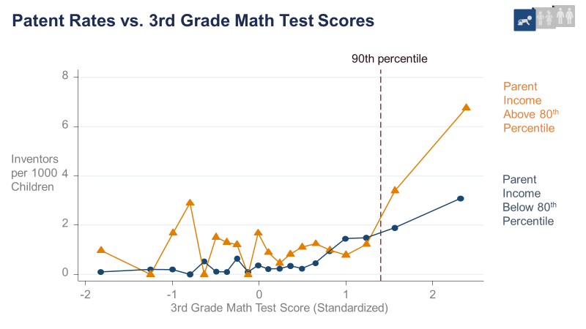
Gaps in Innovation by Race and Gender
We find analogous gaps by race…
… and gender

Slide 16
Patent Rates vs. 3rd Grade Test Scores by Race & Ethnicity
8
90th Percentile
White
6
Black
Asian
Hispanic
Inventors per
Thousand
4
2
0
-2
-1
0
1
2
3rd Grade Math Test Score (Standardized)

Slide 17
Percentage of Female Inventors by Year of Birth
50
Average change per year: 0.27%
118 years to reach 50% female share
40
30
% Female Inventors
20
10
0
1940
1950
1960
1970
1980
Year of Birth

Slide 18
Patent Rates vs. 3rd Grade Math Test Scores by Gender
8
90th Percentile
6
Female
Male
Inventors per
Thousand
4
2
0
-2
-1
0
1
2
3rd Grade Math Test Score (Standardized)

Slide 19
Effects of Childhood Environment on Innovation
Career
Childhood
Birth

Slide 20
Impacts of Exposure to Innovation
Study impacts of childhood environment by focusing on effect of exposure to innovation during childhood through family and neighbors
Start by analyzing relationship between children’s and their own parents’ patent rates

Slide 21
Patent Rates for Children of Inventors vs. Non-Inventors
18.0
Parents Inventors
2.0
Parents not Inventors

Slide 22
Exposure or Genetics?
Correlation between child and parent’s propensity to patent could be driven by genetics or by exposure (environment)
Isolate causal effect of exposure by analyzing propensity to patent by narrow technology class
Intuition: genetic ability to innovate is unlikely to vary significantly across similar technology classes
Define “similarity” of two technology classes based on the fraction of inventors who hold patents in both classes

Slide 23
Distance Between Technology Classes
Category: Computers + Communications
Subcategory: Communications
Technology Class
Distance Rank
Pulse or digital communications
0
Demodulators
1
Modulators
2
Coded data generation or conversion
3
Electrical computers: arithmetic processing and calculating
4
Oscillators
5
Multiplex communications
6
Telecommunications
7
Amplifiers
8
Motion video signal processing for recording or reproducing
9
Directive radio wave systems and devices (e.g., radar, radio navigation)
10

Slide 24
Innovation Rates by Technology Class
1
0.8
0.6
Inventors per
1000 Children
0.4
0.2
0
0
20
40
60
80
100
Distance from Father's Technology Class

Slide 25
Exposure Effects Across Neighborhoods
Parents are not an easily replicable source of exposure to innovation
Next, analyze a broader source of influence: neighbors
Examine patent rates by commuting zone (aggregation of counties analogous to metro area) where child grows up

Slide 26
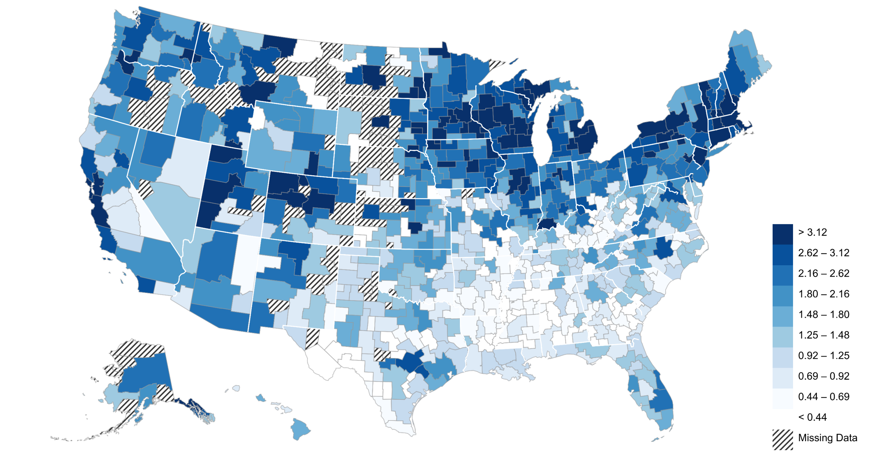
The Origins of Inventors in America Patent Rates by Childhood Commuting Zone
Minneapolis
4.9
Madison
4.3
Detroit
3.8
San Francisco
3.8
Inventors per 1000 Children
San Jose
5.4
>3.1
<0.4
1.5
Insufficient Data

Slide 27
Patent Rates of Children who Grow up in a CZ vs.
Patent Rates of Adults in that CZ
6
San Jose
5
Madison
Minneapolis
4
Inventors
per 1000
Children
Newark
3
Portland
2
Houston
1
Brownsville
0
0
0.2
0.4
0.6
0.8
Annual Patent Rate per Thousand Working Age Adults in CZ

Slide 28
Differences Across Areas are Driven by Exposure Effects
Neighborhood exposure effects are technology-class specific
Consider two people currently living in Boston, one from Silicon Valley and one from Minneapolis (a medical device hub)

Slide 29
Differences Across Areas are Driven by Exposure Effects
Neighborhood exposure effects are technology-class specific
Consider two people currently living in Boston, one from Silicon Valley and one from Minneapolis (a medical device hub)
The one from Silicon Valley is most likely to patent in computers
The one from Minneapolis is most likely to patent in medical devices

Slide 30
Differences Across Areas are Driven by Exposure Effects
Neighborhood exposure effects are technology-class specific
Consider two people currently living in Boston, one from Silicon Valley and one from Minneapolis (a medical device hub)
Moreover, these patterns are gender-specific

Slide 31
Gender-Specific Innovation Exposure Effects
Change in Number of Inventors per 1000 Children
1.5
1.1
0.1
-0.2
Effect of Male Inventors on
Boys’ Innovation Rates
Effect of Female
Inventors on
Boys’ Innovation Rates
Effect of Male
Inventors on
Girls’ Innovation Rates
Effect of Female
Inventors on
Girls’ Innovation Rates

Slide 32
Gender-Specific Innovation Exposure Effects
Change in Number of Inventors per 1000 Children
1.5
1.1
If girls were as exposed to female inventors as boys are to male inventors, the gender gap in innovation would fall by half.
0.1
-0.2
Effect of Male Inventors on
Boys’ Innovation Rates
Effect of Female
Inventors on
Boys’ Innovation Rates
Effect of Male
Inventors on
Girls’ Innovation Rates
Effect of Female
Inventors on
Girls’ Innovation Rates

Slide 33
Differences Across Areas are Driven by Exposure Effects
Findings are consistent with other evidence that neighborhood environment in childhood matters greatly for long-term success
But differences across areas in production of inventors are unlikely to be due to broad differences in school quality or resources
Technology-class and gender-specific patterns are more likely due to direct exposure effects (mentoring, role models)

Slide 34
Finally, characterize inventors’ careers to understand how financial incentives affect individuals’ decisions to pursue innovation
Career
Childhood
Birth

Slide 35
Distribution of Inventors’ Income Ages 40-50
p50 = $114k
p95 = $497k
p99 = $1.6m
Density
0
500
1000
1500
Mean Annual Income ($1000), Ages 40-50

Slide 36
Inventors’ Incomes vs. Patent Citations
1200
$1.04m
1000
800
Mean
Annual Income, Ages 40-50
600
400
$377k
$260k
$196k
$209k
$207k
200
0
Bottom 20%
20-40
40-60
60-80
80-99
Top 1%
Inventor's Citation Impact (Percentile)

Slide 37
Changes in financial incentives have limited
potential to increase innovation
Changes in financial incentives are unlikely to influence star inventors, who earn more than $1 million per year
And they can affect only the relatively few people who have exposure to innovation
Notes:
37

Slide 38
Lost Einsteins: The Importance of Exposure to Innovation
If women, minorities, and children from low-income families invent at the same as high-income white men, the innovation rate in America would quadruple
4x
Notes:
38

Slide 39
How can we recover the Lost Einsteins?
1
3
Identify female, minority, and low-income children who excel in math and science at early ages
Evaluate Impacts of Interventions
2
Increase exposure to innovation through tailored mentoring, internships, and expanding opportunity
Data presented here are available at EOP website
Notes:
39

Slide 40
The Fading American Dream
Percent of Children Earning More than Their Parents, by Year of Birth
100
90
Pct. of Children
Earning more than
their Parents
80
70
60
50
1940
1950
1960
1970
1980
Child's Year of Birth
Source: Chetty, Grusky, Hell, Hendren, Manduca, Narang (Science 2017)

