Slide 1
Where is the Land of Opportunity?
The Geography of Intergenerational Mobility in the U.S.
Raj Chetty, Harvard
Nathaniel Hendren, Harvard
Patrick Kline, UC-Berkeley
Emmanuel Saez, UC-Berkeley
The opinions expressed in this paper are those of the authors alone and do not necessarily reflect the views of the Internal Revenue Service or the U.S. Treasury Department. This work is a component of a larger project examining the effects of eliminating tax expenditures on the budget deficit and economic activity. Results reported here are contained in the SOI Working Paper “The Economic Impacts of Tax Expenditures: Evidence from Spatial Variation across the U.S.,” approved under IRS contract TIRNO-12-P-00374.

Slide 2

Introduction
United States traditionally hailed as “land of opportunity”
  Chances of succeeding do not depend heavily on parent’s income
Vast literature has investigated whether this is true empirically
[Hauser et al. 1975, Behrman and Taubman 1985, Becker and Tomes 1986, Solon 1992, Zimmerman 1992, Mulligan 1997, Solon 1999, Mazumder 2005]
Results debated partly due to limitations in data [Black and Devereux 2011]
  Ex: Mazumder (2005) uses SIPP-SSA sample with 3,000 obs. and imputed earnings for up to 60% of parents
Notes:
2

Slide 3
This Paper
We study intergenerational mobility in the U.S. using administrative data on 40 million children
We show that the question of whether the U.S. is the “land of opportunity” does not have a clear answer
  Substantial variation in intergenerational mobility within the U.S.
  Some lands of opportunity and some lands of persistent inequality
Notes:
3

Slide 4
Outline
    National Statistics
    Geographical Variation in Intergenerational Mobility
    Correlates of Spatial Differences in Mobility

Slide 5
Data
Data source: IRS Databank [Chetty, Friedman, Hilger, Saez, Yagan 2011]
  Selected de-identified data from 1996-2012 income tax returns
  Includes non-filers via information forms (e.g. W-2’s)
Notes:
5

Slide 6
Sample Definition
Primary sample: Current U.S. citizens in 1980-81 birth cohorts
  6.3 million children, age 30-32 in 2012
Expanded sample: 1980-1991 birth cohorts for robustness checks
  40 million children, age 20-32 in 2012
Notes:
6

Slide 7
Linking Children to Parents
Parent(s) defined as first person(s) who claim child as a dependent
  Most children are linked to parents based on tax returns in 1996
We link approximately 95% of children to parents
Notes:
7

Slide 8
Income Definitions
Parent Income: mean pre-tax household income (AGI+SSDI) between 1996-2000
Child Income: mean pre-tax household income between 2010-2012
For non-filers, use W-2 wage earnings + SSDI + UI income
  If no 1040 and no W-2, code income as 0
These household level definitions capture total resources in the household
  Spatial patterns very similar using individual income but IGE magnitudes lower, especially for daughters [Chadwick and Solon 2002]
Notes:
8

Slide 9
Part 1
National Statistics

Slide 10
Mean Child Household Income at Age 30 vs. Parent Household Income
100
80
60
Mean Child Household Income ($1000s)
40
Slope [Par Inc < P90] = 0.335
20
(0.0007)
Slope [P90 < Par Inc < P99] = 0.076
(0.0019)
0
0
100
200
300
400
Parent Household Income ($1000s)

Slide 11
Mean Log Child Income vs. Log Parent Income (Excluding 0’s)
11
10.5
Mean Log Child Income
10
IGE = 0.344
(0.0004)
9.5
8
10
12
14
Log Parent Income

Slide 12
Mean Log Child Income vs. Log Parent Income (Excluding 0’s)
11
10.5
Mean Log Child Income
10
IGE = 0.344
(0.0004)
IGE [Par Inc P10-P90] = 0.452
(0.0007)
9.5
8
10
12
14
Log Parent Income

Slide 13
Fraction of Children with Zero Income vs. Log Parent Income
20
15
Percentage of Children with Zero Income
10
5
0
8
10
12
14
Log Parent Income

Slide 14
Mean Log Child Income vs. Log Parent Income
Income of Non-Working Children Coded as $1
11
10
Log Child Income
9
IGE = 0.618
(0.0009)
8
8
10
12
14
Log Parent Income
Including 0’s
Excluding 0’s

Slide 15
Rank-Rank Specification
To handle zeros and non-linearity, we use a rank-rank specification (similar to Dahl and DeLeire 2008)
  Rank children based on their incomes relative to other children same in birth cohort
  Rank parents of these children based on their incomes relative to other parents in this sample
Notes:
15

Slide 16
Mean Child Percentile Rank vs. Parent Percentile Rank
70
60
50
Mean Child Income Rank
40
30
Rank-Rank Slope (U.S) = 0.341
(0.0003)
20
0
10
20
30
40
50
60
70
80
90
100
Parent Income Rank

Slide 17
Lifecycle Bias: Intergenerational Income Correlation
by Age at Which Child’s Income is Measured
0.4
0.3
Rank-Rank Slope
0.2
0.1
0
22
25
28
31
Age at which Child’s Income is Measured

Slide 18
Lifecycle Bias: Intergenerational Income Correlation
by Age at Which Child’s Income is Measured
0.4
0.3
Rank-Rank Slope
0.2
0.1
0
22
25
28
31
34
37
40
Age at which Child’s Income is Measured
Population
SOI 0.1% Random Sample

Slide 19
Attenuation Bias: Rank-Rank Slopes
by Number of Years Used to Measure Parent Income
0.4
0.3
Rank-Rank Slope
0.2
0.1
0
1
4
7
10
13
16
Years Used to Compute Mean Parent Income

Slide 20
Part 2
Geographical Variation

Slide 21
Intergenerational Mobility in the United States vs. Denmark
70
60
50
Mean Child Income Rank
40
30
Rank-Rank Slope (U.S) = 0.341
Rank-Rank Slope (Denmark) = 0.180
20
0
10
20
30
40
50
60
70
80
90
100
Parent Income Rank
Denmark [Boserup, Kreiner, Kopczuk 2013]
United States

Slide 22
Geographical Variation within the U.S.
We study variation in intergenerational mobility at the level of Commuting Zones (CZ’s)
  CZ’s are aggregations of counties based on commuting patterns in 1990 census [Tolbert and Sizer 1996, Autor and Dorn 2012]
  Similar to metro areas but cover rural areas as well
Notes:
22

Slide 23
The Boston Commuting Zone
Essex
Middlesex
Worcester
Suffolk
Boston
Norfolk
Plymouth
Barnstable

Slide 24
Geographical Definitions
Divide children into locations based on where they grew up
  CZ from which parents filed tax return when they first claimed the child as a dependent
  Permanently assign child to this CZ, no matter where she lives now
For 1980 cohort, this is typically location when child is age 16
  Verify using younger cohorts that measuring location at earlier ages yields very similar results
Notes:
24

Slide 25
Defining Income Ranks
In every CZ, we measure parent and child incomes using ranks in the national income distribution
  This allows us to identify both relative and absolute mobility
Important because more relative mobility is not necessarily desirable from a normative perspective
Notes:
25

Slide 26
Intergenerational Mobility in Salt Lake City
70
60
50
Child Rank in National Income Distribution
40
30
20
0
20
40
60
80
100
Parent Rank in National Income Distribution

Slide 27
Intergenerational Mobility in Salt Lake City
70
60
50
Child Rank in National Income Distribution
40
30
Relative Mobility
What are the outcomes of children of low vs. high income parents?
20
0
20
40
60
80
100
Parent Rank in National Income Distribution

Slide 28
Intergenerational Mobility in Salt Lake City
70
60
50
Child Rank in National Income Distribution
Y₁₀₀ – Y₀ = 100 × (Rank-Rank Slope)
40
30
Salt Lake City: Y₁₀₀ – Y₀ = 26.4
20
0
20
40
60
80
100
Parent Rank in National Income Distribution

Slide 29
Intergenerational Mobility in Salt Lake City vs. Charlotte
70
60
50
Child Rank in National Income Distribution
40
30
Salt Lake City: Y₁₀₀ – Y₀ = 26.4
Charlotte: Y₁₀₀ – Y₀ = 39.7
20
0
20
40
60
80
100
Parent Rank in National Income Distribution
Salt Lake City
Charlotte

Slide 30
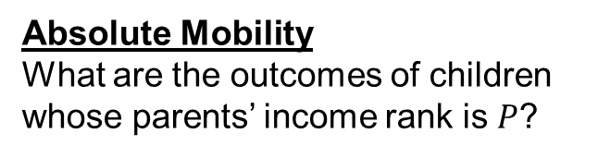
Intergenerational Mobility in Salt Lake City
70
60
50
Child Rank in National Income Distribution
40
30
Absolute Mobility
What are the outcomes of children whose parents’ income rank is $P$?
20
0
20
40
60
80
100
Parent Rank in National Income Distribution

Slide 31
Intergenerational Mobility in Salt Lake City
70
60
50
Child Rank in National Income Distribution
40
30
Y₀ = E[Child Rank | Parent Rank P = 0]
20
0
20
40
60
80
100
Parent Rank in National Income Distribution

Slide 32
Intergenerational Mobility in Salt Lake City
70
60
50
Child Rank in National Income Distribution
40
Y_{P} =Y₀ + (Rank-Rank Slope) × $P$
30
Expected outcomes for all children can be summarized using slope + intercept in CZ
20
0
20
40
60
80
100
Parent Rank in National Income Distribution

Slide 33
Intergenerational Mobility in Salt Lake City
70
60
50
Child Rank in National Income Distribution
40
Y₂₅ = E[Child Rank | Parent Rank < 50]
30
Focus on mean outcomes of children from families below median: “Absolute Upward Mobility”
20
0
20
40
60
80
100
Parent Rank in National Income Distribution

Slide 34

Intergenerational Mobility in Salt Lake City
70
60
50
Child Rank in National Income Distribution
40
30
Salt Lake City $Y$₂₅ = 46.2 = $31,100
20
0
20
40
60
80
100
Parent Rank in National Income Distribution

Slide 35

Intergenerational Mobility in Salt Lake City vs. Charlotte
70
60
50
Child Rank in National Income Distribution
40
30
Salt Lake City $Y$₂₅ = 46.2 = $31,100
Charlotte $Y$₂₅ = 35.8 = $22,900
20
0
20
40
60
80
100
Parent Rank in National Income Distribution
Salt Lake City
Charlotte

Slide 36
Intergenerational Mobility in San Francisco vs. Chicago
70
60
50
Child Rank in National Income Distribution
40
30
San Francisco: Y₁₀₀ – Y₀= 25.0, Y₂₅ = 44.4
Chicago: Y₁₀₀ – Y₀ = 39.3, Y₂₅ = 39.4
20
0
20
40
60
80
100
Parent Rank in National Income Distribution
San Francisco
Chicago

Slide 37
Mobility Estimates by CZ
In each CZ, regress child national rank on parent national rank in micro data:
  Rank_{child} = α + βRank_{parent}
  Relative mobility = 100 x β
  Absolute upward mobility = α + 25 x β
Notes:
37

Slide 38
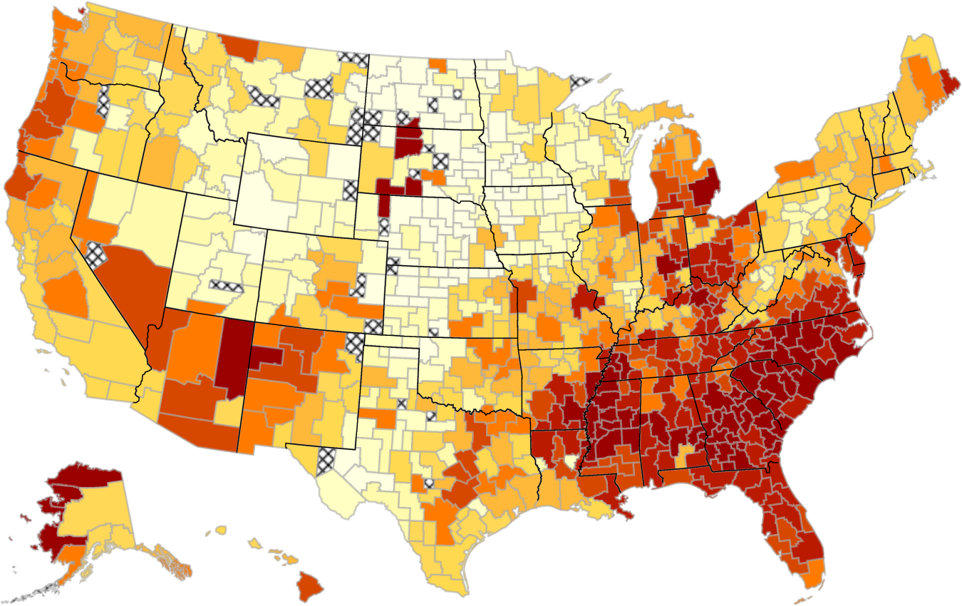
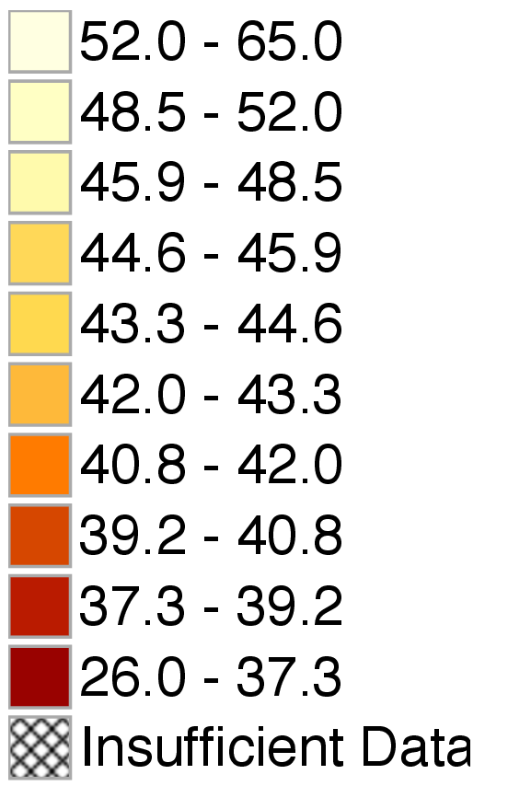
The Geography of Upward Mobility in the United States
Mean Child Percentile Rank for Parents at 25th Percentile (Y₂₅)
Note: Lighter Color = More Absolute Upward Mobility

Slide 39
Highest Absolute Mobility In The 50 Largest CZs
Upward Mobility | CZ Name | Y₂₅ | Y₁₀₀ – Y₀ | P(Child in Q5|
Rank |  |  |  | Parent in Q1)
1 | Salt Lake City, UT | 46.2 | 0.264 | 10.83%
2 | Pittsburgh, PA | 45.2 | 0.359 | 9.51%
3 | San Jose, CA | 44.7 | 0.235 | 12.93%
4 | Boston, MA | 44.6 | 0.322 | 10.49%
5 | San Francisco, CA | 44.4 | 0.250 | 12.15%
6 | San Diego, CA | 44.3 | 0.237 | 10.44%
7 | Manchester, NH | 44.2 | 0.296 | 10.02%
8 | Minneapolis, MN | 44.2 | 0.338 | 8.52%
9 | Newark, NJ | 44.1 | 0.350 | 10.24%
10 | New York, NY | 43.8 | 0.330 | 10.50%

Slide 40
Lowest Absolute Mobility In The 50 Largest CZs
Upward Mobility | CZ Name | Y₂₅ | Y₁₀₀ – Y₀ | P(Child in Q5|
Rank |  |  |  | Parent in Q1)
41 | Nashville, TN | 38.2 | 0.357 | 5.73%
42 | New Orleans, LA | 38.2 | 0.397 | 5.12%
43 | Cincinnati, OH | 37.9 | 0.429 | 5.12%
44 | Columbus, OH | 37.7 | 0.406 | 4.91%
45 | Jacksonville, FL | 37.5 | 0.361 | 4.92%
46 | Detroit, MI | 37.3 | 0.358 | 5.46%
47 | Indianapolis, IN | 37.2 | 0.398 | 4.90%
48 | Raleigh, NC | 36.9 | 0.389 | 5.00%
49 | Atlanta, GA | 36.0 | 0.366 | 4.53%
50 | Charlotte, NC | 35.8 | 0.397 | 4.38%

Slide 41
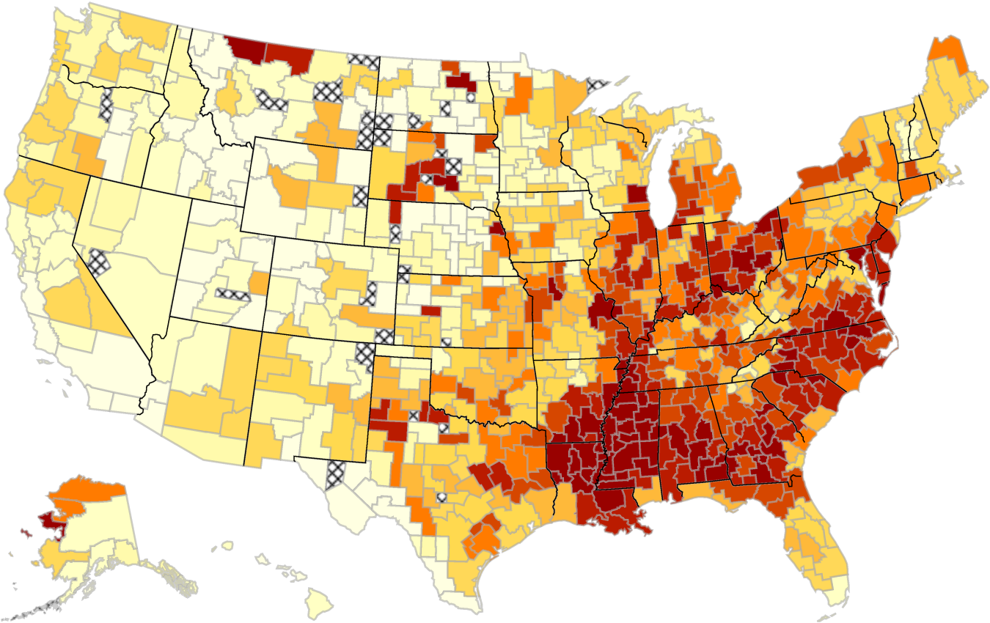
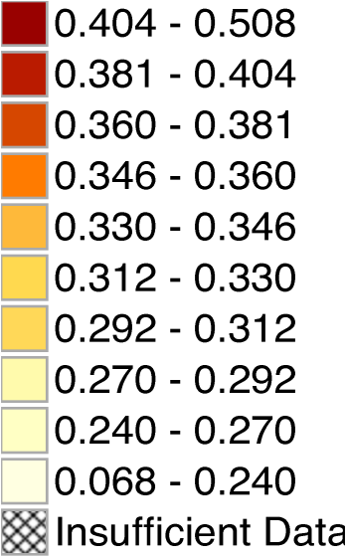
Relative Mobility Across Areas in the U.S.
Rank-Rank Slopes (Y₁₀₀ – Y₀) by Commuting Zone
Corr. with baseline $\overline{y}$₂₅ = -0.68 (unweighted), -0.61 (pop-weighted)

Slide 42
Mean Relationship between Absolute and Relative Mobility
0.2
0
-0.2
Coef. from Regression of Child Rank on Relative Mobility
-0.4
-0.6
Mean Pivot Point = 85.1th Percentile
-0.8
0
20
40
60
80
100
Parent Rank in National Income Distribution

Slide 43
Mean Relationship between Absolute and Relative Mobility
70
Average Pivot Point: P = 85.1
60
50
Child Rank in National Income Distribution
40
30
On average across CZ’s, more relative mobility → higher absolute mobility for families below P = 85
20
0
20
40
60
80
100
Parent Rank in National Income Distribution

Slide 44
Mean Relationship between Absolute and Relative Mobility
70
Average Pivot Point: P = 85.1
60
50
Child Rank in National Income Distribution
40
30
Outcomes vary less across areas for high income families
20
0
20
40
60
80
100
Parent Rank in National Income Distribution

Slide 45
Stability of Intergenerational Mobility Measures Across Areas
 |  |  | Correlation with Baseline Specification
Alternative Measures |  |  | Y₂₅ |  |  | Y₁₀₀ – Y₀
Cohort 83-5 |  |  | 0.96 |  |  | 0.96
Cohort 86-88 |  |  | 0.82 |  |  | 0.88
Cost-of-Living Adjusted |  |  | 0.86 |  |  | 0.99
Indiv. Inc. Male Children |  |  | 0.96 |  |  | 0.95
Parent Income 2011/12 |  |  | 0.94 |  |  | 0.98
Local Ranks Relative Mobility |  |  |  |  |  | 0.96
College Attendance (18-21) |  |  | 0.53 |  |  | 0.72
Teen Birth Rate (Females) |  |  | -0.64 |  |  | -0.68

Slide 46
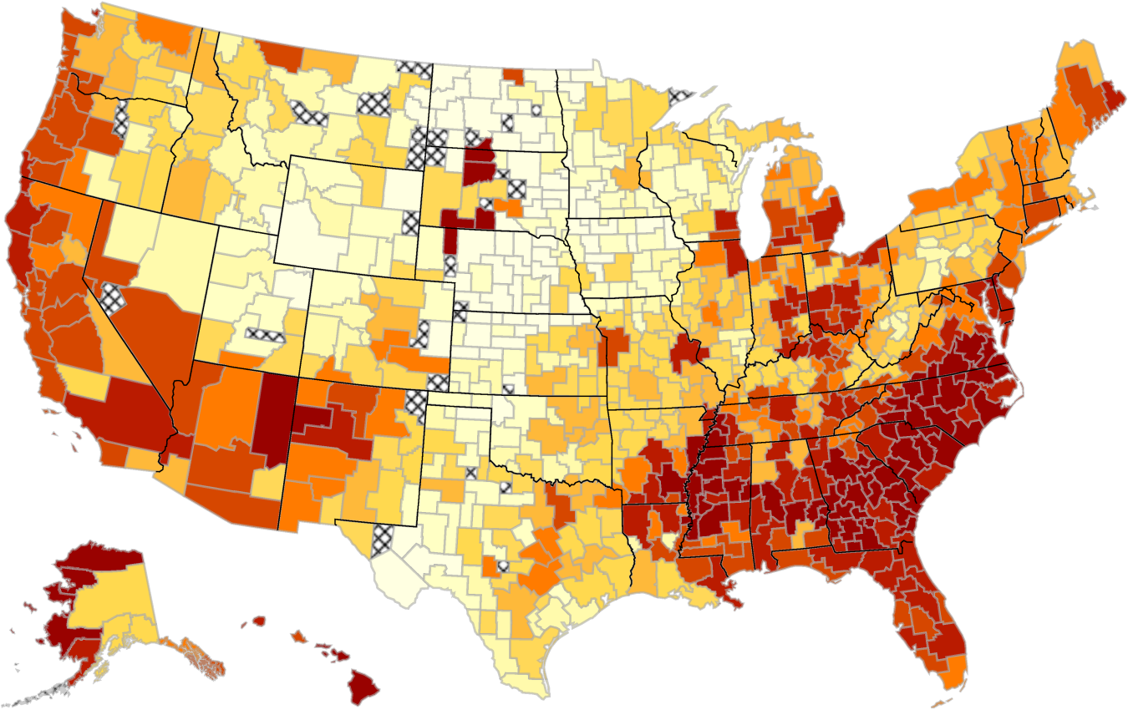
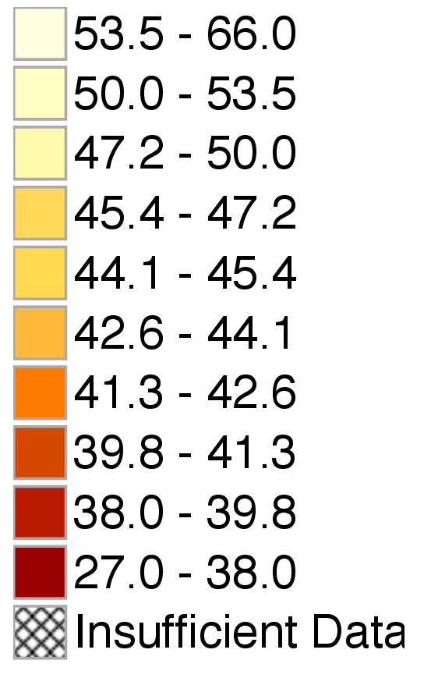
Upward Mobility (Y₂₅) Adjusted for Differences in Cost of Living
Parent and Child Income Deflated by Cost of Living Based on ACCRA data
Corr. with baseline $\overline{y}$₂₅ = 0.98 (unweighted), 0.86 (pop-weighted)

Slide 47
Part 3
Correlates of Intergenerational Mobility

Slide 48
Correlates of Intergenerational Mobility
Correlate differences in mobility with observable factors
  Focus on hypotheses proposed in sociology and economics literature and public debate
  Goal: stylized facts to guide search for causal mechanisms
First clues into potential mechanisms: timing
  Spatial variation in inequality emerges at very early ages
  Well before children start working

Slide 49
College Attendance Rates vs. Parent Income Rank in the U.S.
100
80
Percent Attending College at Ages 18-21
60
Slope = 0.675
(0.0005)
40
20
0
10
20
30
40
50
60
70
80
90
100
Parent Income Rank

Slide 50
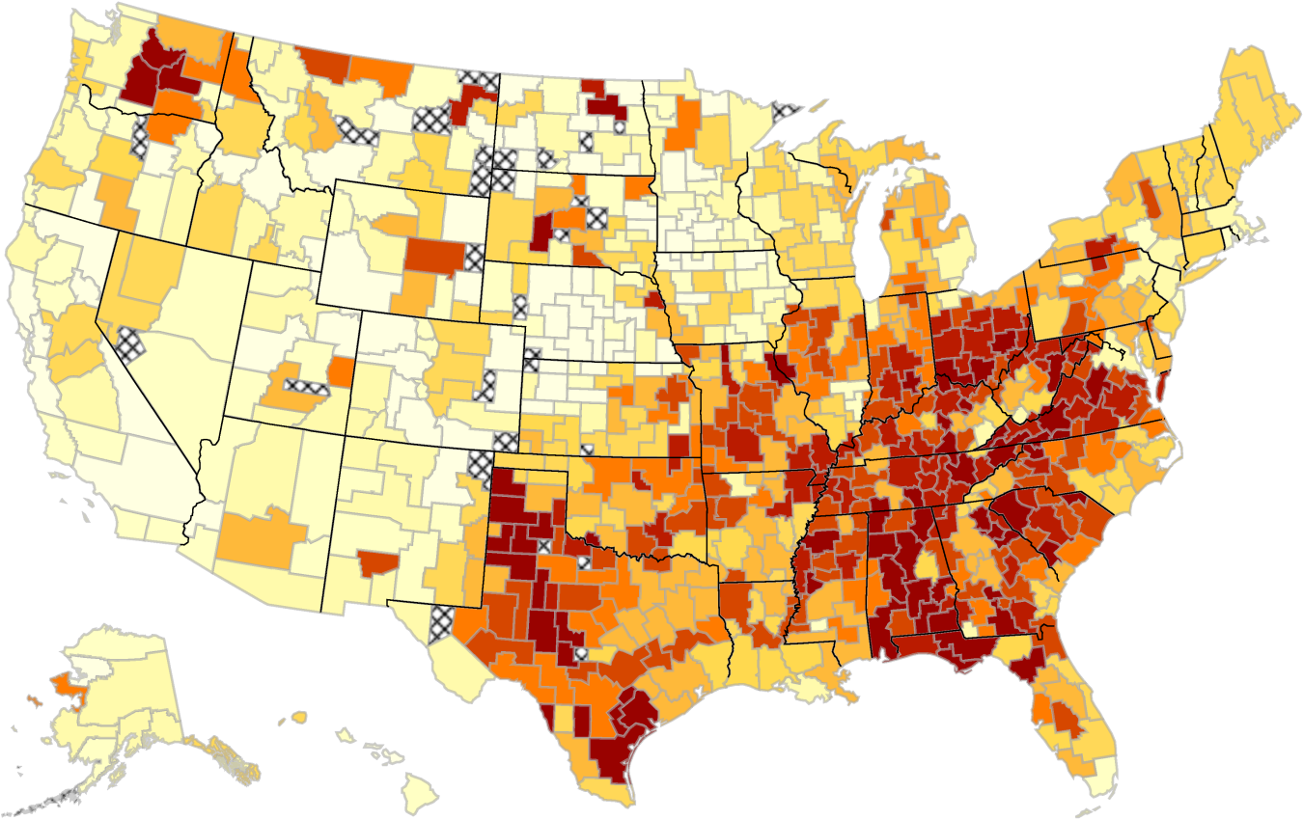
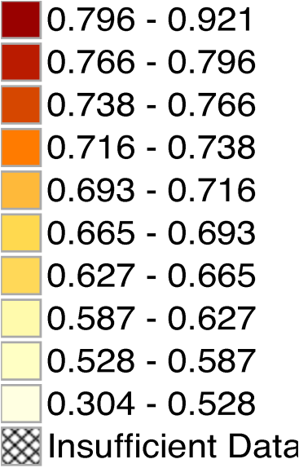
College-Income Gradients by Area
Slopes from Regression of College Attendance (Age 18-21) on Parent Inc. Rank
Corr. with baseline $\overline{y}$₁₀₀- $\overline{y}$₀ = 0.68 (unweighted), 0.72 (pop-weighted)

Slide 51
Teenage Birth Rates for Females vs. Parent Income Rank in the U.S.
30
20
Teenage Birth Rate (%)
Slope = -0.300
(0.0005)
10
0
0
10
20
30
40
50
60
70
80
90
100
Parent Income Rank

Slide 52
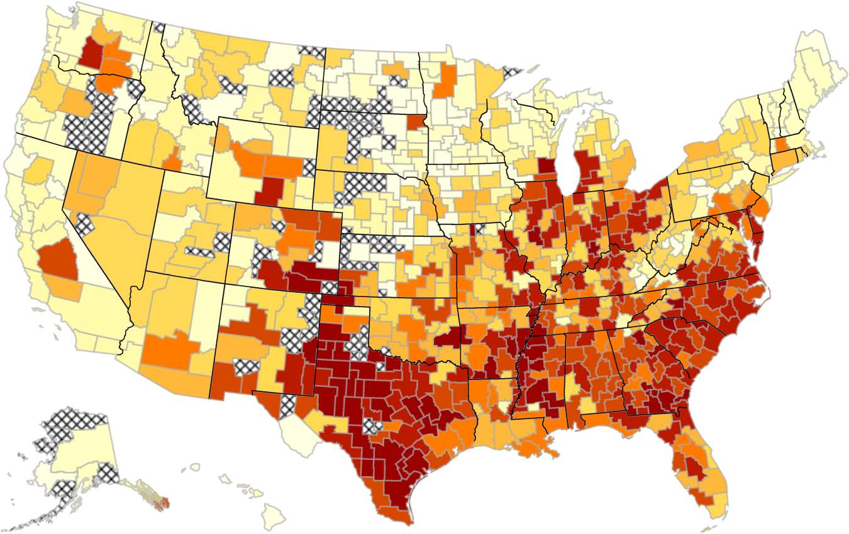
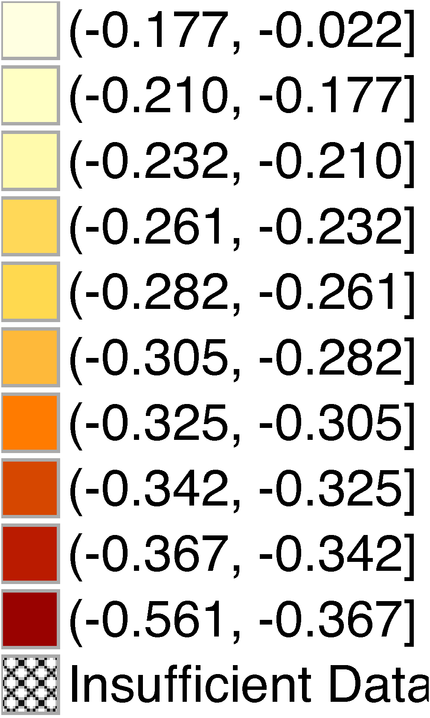
Teenage Birth Gradients by Area
Slopes from Regression of Teenage Birth on Parent Inc. Rank
Corr. with baseline $\overline{y}$₁₀₀-$\overline{ y}$₀ = -0.58 (unweighted), -0.68 (pop-weighted)

Slide 53
Correlates of Intergenerational Mobility
Early emergence of gradients points to factors that affect children when growing up (or anticipatory responses to later factors)
  E.g. schools or family characteristics [e.g., Mulligan 1999]
Start by exploring racial differences
  Most obvious pattern from map: upward mobility lower in areas with larger African-American population

Slide 54

Absolute Upward Mobility vs. Fraction Black in CZ
55
Correlation = -0.580
(0.066)
50
45
Upward Mobility $(\overline{y}$₂₅ )
40
35
0.02
0.14
1
7.39
54.60
% Black (log scale)

Slide 55
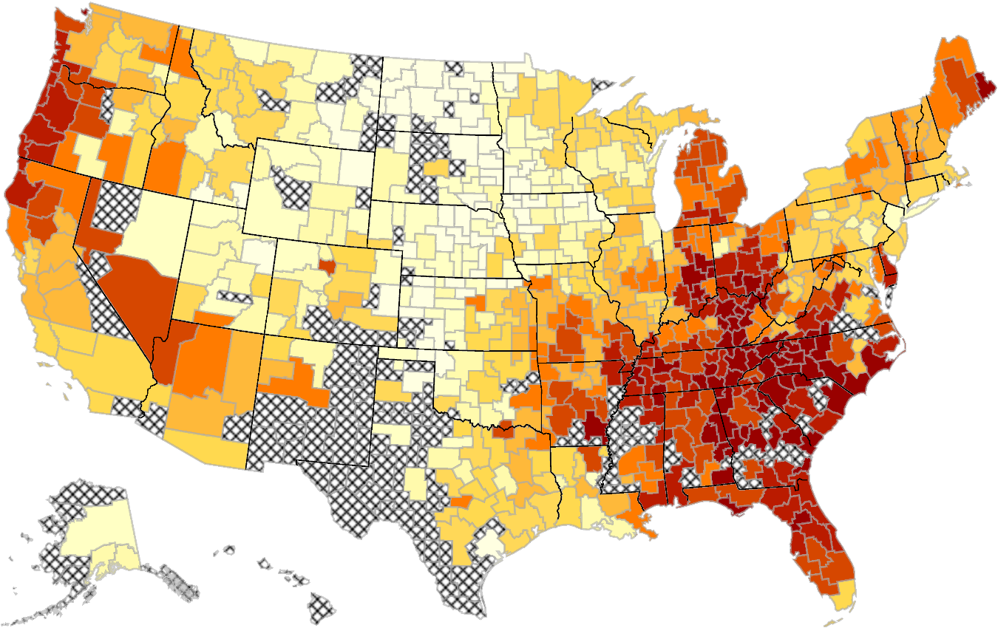
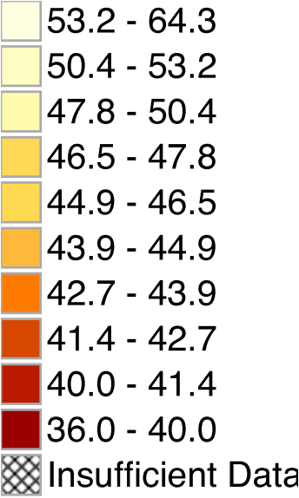
Upward Mobility (Y₂₅) for ZIP-5’s with ≥ 80% White Residents
Corr. with baseline $\overline{y}$₂₅ = 0.91 (unweighted), 0.73 (pop-weighted)

Slide 56
White Upward Mobility vs. Overall Upward Mobility
at Varying ZIP-5 Race Thresholds
1
0.8
0.6
Coef. from Reg. of Upward Mobility Ests. On Baseline Ests.
0.4
0.2
0
0.70
0.75
0.80
0.85
0.90
0.95
1.00
Fraction of White Individuals in Restricted Sample
Prediction with No Spatial
Heterogeneity Cond. on Race
Empirical Estimates

Slide 57
Race and Upward Income Mobility
Racial shares matter at community level for both blacks and whites
One potential mechanism: racial and income segregation
  Historical legacy of greater segregation in areas with larger African-American population
  Racial segregation is associated with greater income segregation
  Such segregation could affect both low-income blacks and whites [Wilson 1987, Massey and Denton 1988, Cutler and Glaeser 1997, Graham and Sharkey 2013]

Slide 58
Absolute Upward Mobility vs. Racial Segregation
55
50
Correlation = -0.361
(0.068)
45
Upward Mobility $(\overline{y}$₂₅ )
40
35
0.01
0.02
0.05
0.14
0.37
Theil Index of Racial Segregation in 2000 (log scale)

Slide 59
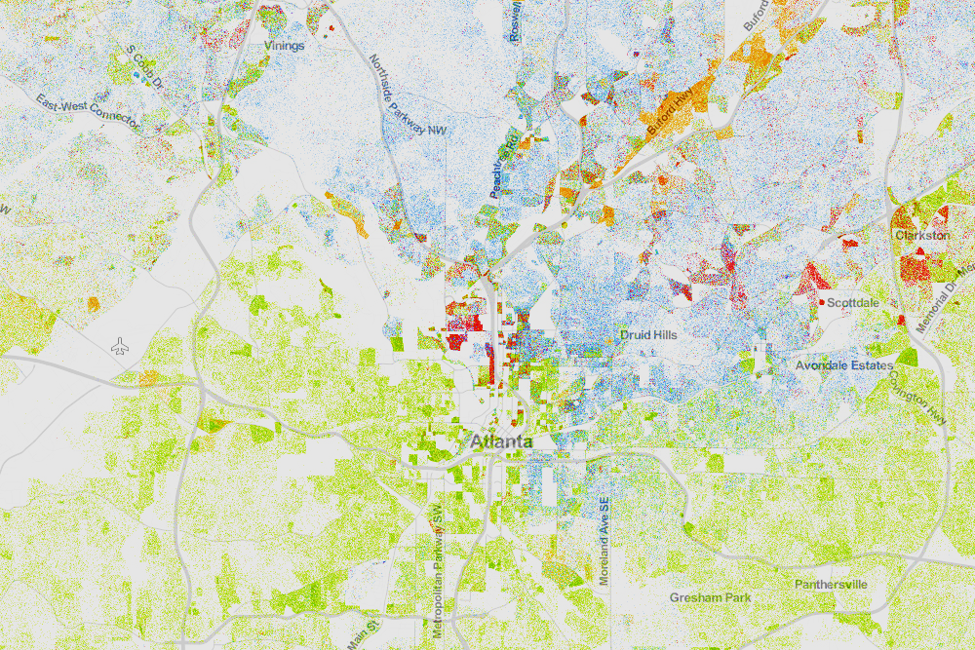
Racial Segregation in Atlanta
Whites (blue), Blacks (green), Asians (red), Hispanics (orange)
Source: Cable (2013) based on Census 2010 data

Slide 60
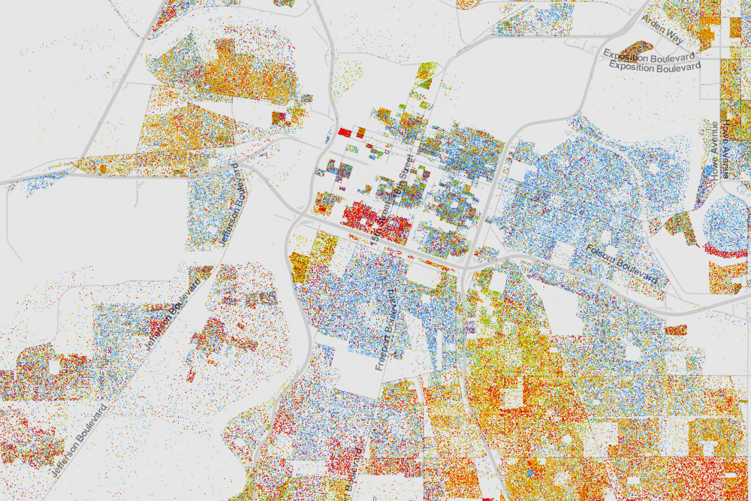
Racial Segregation in Sacramento
Whites (blue), Blacks (green), Asians (red), Hispanics (orange)
Source: Cable (2013) based on Census 2010 data

Slide 61
Absolute Upward Mobility vs. Income Segregation
55
50
Correlation = -0.393
(0.065)
45
Upward Mobility $(\overline{y}$₂₅ )
40
35
0.002
0.007
0.018
0.050
0.135
Rank-Order Index of Income Segregation (log scale)

Slide 62
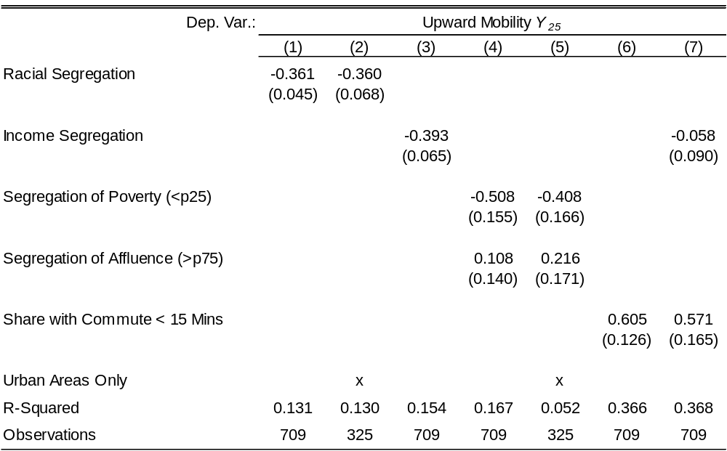
Intergenerational Mobility and Segregation

Slide 63
Spatial Correlates of Upward Mobility
SEG
Racial Segregation (-)
Segregation of Poverty (-)
Frac. < 15 Mins to Work (+)
0
0.2
0.4
0.6
0.8
1.0
Correlation

Slide 64
Income Distribution and Upward Income Mobility
Next, investigate properties of local income distribution: mean income levels and inequality
  Many economic channels for link between static income distribution and intergenerational mobility [e.g. Becker and Tomes 1979, Han and Mulligan 2001, Solon 2004]
  Inequality is negatively correlated with intergenerational mobility across countries [e.g. Corak 2013]

Slide 65

Absolute Upward Mobility vs. Mean Household Income in CZ
55
50
45
Upward Mobility $(\overline{y}$₂₅ )
40
Correlation = 0.050
(0.071)
35
22.0
26.9
32.9
40.1
49.0
Mean Income per Working Age Adult ($1000s, log scale)

Slide 66
Upward Mobility vs. Inequality in CZ
The “Great Gatsby” Curve Within the U.S.
55
50
Correlation = -0.578
(0.093)
45
Upward Mobility $(\overline{y}$₂₅ )
40
35
0.3
0.4
0.5
0.6
Gini Coef. for Parent Family Income (1996-2000)

Slide 67
Upward Mobility vs. Top 1% Income Share in CZ
55
50
Correlation = -0.190
(0.072)
45
Upward Mobility $(\overline{y}$₂₅ )
40
35
0.05
0.08
0.14
0.22
Top 1% Income Share Based on Parent Family Income (1996-2000, log scale)

Slide 68
Upward Mobility vs. Bottom 99% Gini Coefficient
55
50
Correlation = -0.647
(0.092)
45
Upward Mobility $(\overline{y}$₂₅ )
40
35
0.20
0.25
0.30
0.35
0.40
Gini Coefficient for the Bottom 99% Based on Parents 1996-2000

Slide 69
Spatial Correlates of Upward Mobility
SEG
Racial Segregation (-)
Segregation of Poverty (-)
Frac. < 15 Mins to Work (+)
INC
Mean Household Income (+)
Gini Coef. (-)
Top 1% Inc. Share (-)
0
0.2
0.4
0.6
0.8
1.0
Correlation

Slide 70
Absolute Mobility and Inequality: The Great Gatbsy Curve
 | Variation Across CZs Within U.S. |  |  |  |  | Variation Across Countries
 | Upward | Upward | Upward |  |  | Log-Log | Log-Log | Log-Log
 | Mobility | Mobility | Mobility |  |  | Elasticity | Elasticity | Elasticity
 | Y₂₅ | Y₂₅ | Y₂₅ |  |  | 1985 | 1985 | 2005
 | (1) | (2) | (3) |  |  | (4) | (5) | (6)
Gini coefficient | -0.578 |  |  |  |  | 0.72
 | (0.093) |  |  |  |  | (0.22)
Gini bottom 99% |  | -0.634 | -0.624 |  |  |  | 0.62 | 0.78
 |  | (0.090) | (0.113) |  |  |  | (0.27) | (0.27)
Top 1% income share |  | -0.123 | 0.029 |  |  |  | 0.30 | -0.11
 |  | (0.035) | (0.039) |  |  |  | (0.32) | (0.28)
CZ intersects MSA |  |  | X
R-Squared | 0.334 | 0.433 | 0.380 |  |  | 0.52 | 0.54 | 0.53
Number of observations | 709 | 709 | 325 |  |  | 13 | 13 | 12

Slide 71
Spatial Correlates of Upward Mobility
SEG
Racial Segregation (-)
Segregation of Poverty (-)
Frac. < 15 Mins to Work (+)
INC
Mean Household Income (+)
Gini Coef. (-)
Top 1% Inc. Share (-)
TAX
Local Tax Rate (+)
State EITC Exposure (+)
Tax Progressivity (+)
0
0.2
0.4
0.6
0.8
1.0
Correlation

Slide 72
Spatial Correlates of Upward Mobility
SEG
Racial Segregation (-)
Segregation of Poverty (-)
Frac. < 15 Mins to Work (+)
INC
Mean Household Income (+)
Gini Coef. (-)
Top 1% Inc. Share (-)
TAX
Local Tax Rate (+)
State EITC Exposure (+)
Tax Progressivity (+)
K-12
Student-Teacher Ratio (-)
Test Scores (Inc Adjusted) (+)
High School Dropout (-)
0
0.2
0.4
0.6
0.8
1.0
Correlation

Slide 73
Spatial Correlates of Upward Mobility
SEG
Racial Segregation (-)
Segregation of Poverty (-)
Frac. < 15 Mins to Work (+)
INC
Mean Household Income (+)
Gini Coef. (-)
Top 1% Inc. Share (-)
TAX
Local Tax Rate (+)
State EITC Exposure (+)
Tax Progressivity (+)
K-12
Student-Teacher Ratio (-)
Test Scores (Inc Adjusted) (+)
High School Dropout (-)
COLL
Colleges per Capita (+)
College Tuition (-)
Coll Grad Rate (Inc Adjusted) (+)
0
0.2
0.4
0.6
0.8
1.0
Correlation

Slide 74
Spatial Correlates of Upward Mobility
SEG
Racial Segregation (-)
Segregation of Poverty (-)
Frac. < 15 Mins to Work (+)
INC
Mean Household Income (+)
Gini Coef. (-)
Top 1% Inc. Share (-)
TAX
Local Tax Rate (+)
State EITC Exposure (+)
Tax Progressivity (+)
K-12
Student-Teacher Ratio (-)
Test Scores (Inc Adjusted) (+)
High School Dropout (-)
COLL
Colleges per Capita (+)
College Tuition (-)
Coll Grad Rate (Inc Adjusted) (+)
LAB
Manufacturing Share (-)
Chinese Import Growth (-)
Teenage LFP Rate (+)
0
0.2
0.4
0.6
0.8
1.0
Correlation

Slide 75
Spatial Correlates of Upward Mobility
SEG
Racial Segregation (-)
Segregation of Poverty (-)
Frac. < 15 Mins to Work (+)
INC
Mean Household Income (+)
Gini Coef. (-)
Top 1% Inc. Share (-)
TAX
Local Tax Rate (+)
State EITC Exposure (+)
Tax Progressivity (+)
K-12
Student-Teacher Ratio (-)
Test Scores (Inc Adjusted) (+)
High School Dropout (-)
COLL
Colleges per Capita (+)
College Tuition (-)
Coll Grad Rate (Inc Adjusted) (+)
LAB
Manufacturing Share (-)
Chinese Import Growth (-)
Teenage LFP Rate (+)
MIG
Migration Inflow (-)
Migration Outflow (-)
Share Foreign Born (-)
0
0.2
0.4
0.6
0.8
1.0
Correlation

Slide 76
Spatial Correlates of Upward Mobility
SEG
Racial Segregation (-)
Segregation of Poverty (-)
Frac. < 15 Mins to Work (+)
INC
Mean Household Income (+)
Gini Coef. (-)
Top 1% Inc. Share (-)
TAX
Local Tax Rate (+)
State EITC Exposure (+)
Tax Progressivity (+)
K-12
Student-Teacher Ratio (-)
Test Scores (Inc Adjusted) (+)
High School Dropout (-)
COLL
Colleges per Capita (+)
College Tuition (-)
Coll Grad Rate (Inc Adjusted) (+)
LAB
Manufacturing Share (-)
Chinese Import Growth (-)
Teenage LFP Rate (+)
MIG
Migration Inflow (-)
Migration Outflow (-)
Share Foreign Born (-)
SOC
Social Capital Index (+)
Frac. Religious (+)
Violent Crime Rate (-)
0
0.2
0.4
0.6
0.8
1.0
Correlation

Slide 77
Spatial Correlates of Upward Mobility
SEG
Racial Segregation (-)
Segregation of Poverty (-)
Frac. < 15 Mins to Work (+)
INC
Mean Household Income (+)
Gini Coef. (-)
Top 1% Inc. Share (-)
TAX
Local Tax Rate (+)
State EITC Exposure (+)
Tax Progressivity (+)
K-12
Student-Teacher Ratio (-)
Test Scores (Inc Adjusted) (+)
High School Dropout (-)
COLL
Colleges per Capita (+)
College Tuition (-)
Coll Grad Rate (Inc Adjusted) (+)
LAB
Manufacturing Share (-)
Chinese Import Growth (-)
Teenage LFP Rate (+)
MIG
Migration Inflow (-)
Migration Outflow (-)
Share Foreign Born (-)
SOC
Social Capital Index (+)
Frac. Religious (+)
Violent Crime Rate (-)
FAM
Frac. Single Moms (-)
Divorce Rate (-)
Frac. Married (+)
0
0.2
0.4
0.6
0.8
1.0
Correlation

Slide 78
Upward Mobility and Fraction of Single Mothers in CZ
55
50
Correlation = -0.764
(0.074)
45
Upward Mobility $(\overline{y}$₂₅ )
40
35
10
15
20
25
30
35
Fraction of Children Raised by Single Mothers

Slide 79
Upward Mobility and Fraction of Single Mothers in CZ
Married Parents Only
55
50
Correlation = -0.662
(0.087)
45
Upward Mobility $(\overline{y}$₂₅ )
40
35
10
15
20
25
30
35
Fraction of Children Raised by Single Mothers

Slide 80
Spatial Correlates of Upward Mobility
SEG
Racial Segregation (-)
Segregation of Poverty (-)
Frac. < 15 Mins to Work (+)
INC
Mean Household Income (+)
Gini Coef. (-)
Top 1% Inc. Share (-)
TAX
Local Tax Rate (+)
State EITC Exposure (+)
Tax Progressivity (+)
K-12
Student-Teacher Ratio (-)
Test Scores (Inc Adjusted) (+)
High School Dropout (-)
COLL
Colleges per Capita (+)
College Tuition (-)
Coll Grad Rate (Inc Adjusted) (+)
LAB
Manufacturing Share (-)
Chinese Import Growth (-)
Teenage LFP Rate (+)
MIG
Migration Inflow (-)
Migration Outflow (-)
Share Foreign Born (-)
SOC
Social Capital Index (+)
Frac. Religious (+)
Violent Crime Rate (-)
FAM
Frac. Single Moms (-)
Divorce Rate (-)
Frac. Married (+)
0
0.2
0.4
0.6
0.8
1.0
Correlation

Slide 81
Comparison of Alternative Hypotheses
Dep. Var.: | Upward Mobility (Y₂₅)
 | (1) | (2) | (3) | (4)
Racial Segregation | -0.085 | -0.112 | -0.165
 | (0.029) | (0.020) | (0.034)
Gini Bottom 99% | -0.050 | -0.019 | -0.313
 | (0.063) | (0.039) | (0.064)
High School Dropout Rate | -0.157 | -0.142 | -0.286
 | (0.061) | (0.030) | (0.067)
Social Capital Index | 0.284 | 0.109 | 0.296
 | (0.056) | (0.053) | (0.065)
Fraction Single Mothers | -0.484 | -0.438 |  | -0.808
 | (0.070) | (0.072) |  | (0.085)
Fraction Black |  |  |  | 0.056
 |  |  |  | (0.073)
State FEs |  | X
R-squared | 0.705 | 0.848 | 0.605 | 0.584
Observations | 709 | 709 | 709 | 709

Slide 82
Conclusion
Substantial variation in upward and relative mobility across the U.S.
  Implies CZ-level neighborhood effects are 60% as large as parent-child income correlation
  Intergenerational mobility is shaped by environment and may therefore be manipulable (not pure genetics)

Slide 83
Future Research
Key questions for future work:
  Is the variation due to differences in people (sorting) or places?
    Currently studying this question by analyzing individuals who move across areas [Chetty and Hendren 2014]
  If place effects, what policies cause improvements in mobility?
    To facilitate this work, we have posted statistics on mobility online at www.equality-of-opportunity.org

Slide 84
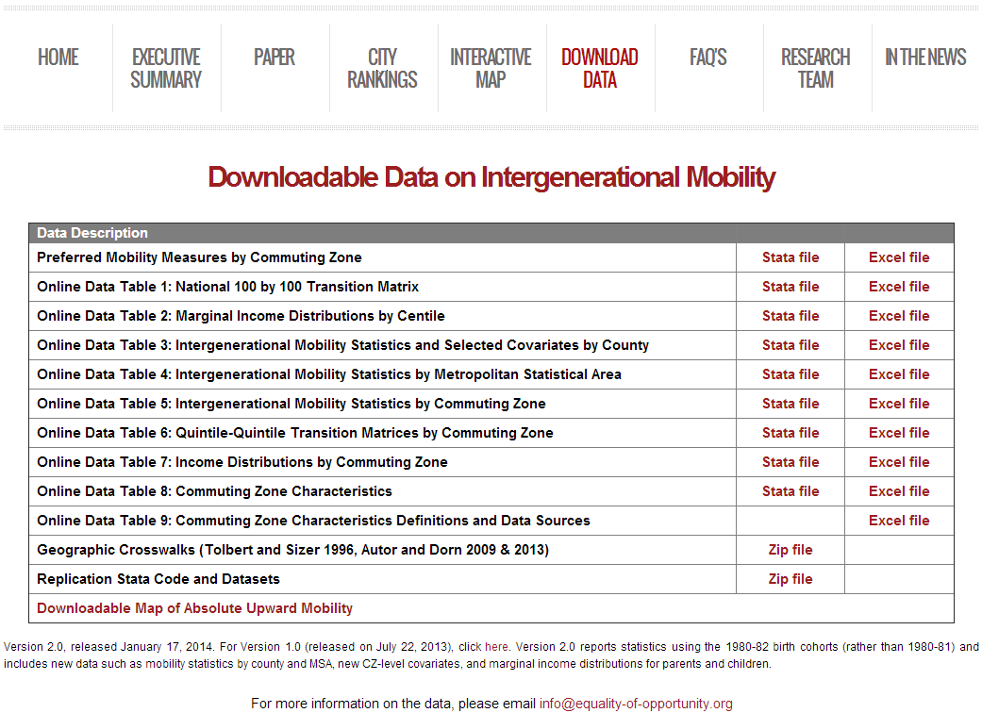
Download CZ-Level Data on Social Mobility
www.equality-of-opportunity.org/data

