Slide 1
Childhood Environment and Gender Gaps in Adulthood
Raj Chetty, Nathaniel Hendren, Frina Lin, Jeremy Majerovitz, and Benjamin Scuderi
Stanford University and Harvard University
January 2016
The opinions expressed in this paper are those of the authors alone and do not necessarily reflect the views of the Internal Revenue Service or the U.S. Treasury Department. This work is a component of a larger project examining the effects of eliminating tax expenditures on the budget deficit and economic activity. Results reported here are contained in the SOI Working Paper “The Economic Impacts of Tax Expenditures: Evidence from Spatial Variation across the U.S.,” approved under IRS contract TIRNO-12-P-00374.

Slide 2

Introduction
Differences between men and women in earnings, employment, and other outcomes in adulthood have been widely documented
[e.g., Darity and Mason 1998, Altonji and Blank 1999, Blau and Kahn 2000, Goldin, Katz, and Kuziemko 2006, Goldin 2014]
  Explanations for these gender gaps focus on labor market factors: e.g., occupational choice, fertility patterns, wage discrimination
Recent work has shown that effects of family background and environment on child development also vary by gender
[e.g., Entwisle, Alexander, and Olson 2007, Bertrand and Pan 2011, DiPrete and Jennings 2012, Autor et al. 2015, Mitnik et al. (2015)]
We connect these two literatures by examining the role of childhood environment on gender gaps in adulthood
Notes:
2

Slide 3
Overview
We document three facts using tax data for the 1980-82 birth cohorts
Boys who grow up in poor families are less likely to work than girls
Gender gaps vary substantially across areas where children grow up
  Studying families who move reveals that this variation is primarily due to causal effects of childhood environment [Chetty and Hendren 2015]
Spatial variation in gender gaps is highly correlated with proxies for neighborhood disadvantage
  Low-income boys who grow up in high-poverty, high-minority areas work less than girls
→ Gender gaps observed in adulthood have roots in childhood, perhaps
because poverty during childhood is particularly harmful for boys
Notes:
3

Slide 4
Outline
Data
National Statistics on Gender Gaps by Parental Income
Local Area Variation in Gender Gaps by Where Kids Grow Up
Mechanisms and Discussion
Notes:
4

Slide 5
Data
Data source: de-identified data from 1996-2012 population tax returns
[Chetty, Hendren, Kline, Saez 2014; Chetty and Hendren 2015]
Children linked to parents based on dependent claiming
Focus on children in 1980-1982 birth cohorts, who are age 30 when we examine outcomes in adulthood
  Approximately 10 million children
Notes:
5

Slide 6
Variable Definitions
Parent income: mean pre-tax household income between 1996-2000
      For non-filers, use W-2 wage earnings + SSDI + UI income
  Children’s outcomes:
    Employment: presence of a W-2 form
    Earnings: total wage earnings reported on W-2’s
      Robustness check: measure self-employment income using data from Schedule C (noting that SE income often misreported)
Notes:
6

Slide 7
National Statistics on Gender Gaps by Parent Income

Slide 8
Children’s Employment Rates at Age 30 by Gender and Parent Income Percentile
90
80
Percent Employed
70
Male-Female Difference
Parent p10: -2.1%
Parent p50: 3.8%
60
Parent p90: 3.1%
0
20
40
60
80
100
Parent Household Income Percentile
Male
Female

Slide 9
Children’s Employment Rates at Age 30 by Gender and Parent Income Percentile
Including Self-Employment (Non-Zero Schedule C Income)
90
80
Percent with Positive W-2 or Schedule C Income
70
Male-Female Difference
Parent p10: -4.3%
Parent p50: 2.2%
60
Parent p90: 2.0%
0
20
40
60
80
100
Parent Household Income Percentile
Male
Female

Slide 10
Children’s Employment Rates at Age 30 by Gender and Parent Income Percentile
Single Parent Households
90
80
Percent Employed
70
Male-Female Difference
60
Parent p10: -4.5%
Parent p50: -1.3%
Parent p90: -0.1%
0
20
40
60
80
100
Parent Household Income Percentile
Male
Female

Slide 11
Children’s Employment Rates at Age 30 by Gender and Parent Income Percentile
Married Parent Households
90
80
Percent Employed
70
Male-Female Difference
60
Parent p10: 3.2%
Parent p50: 5.4%
Parent p90: 3.3%
0
20
40
60
80
100
Parent Household Income Percentile
Male
Female

Slide 12
W-2 Wage Earnings at Age 30 by Gender and Parent Income Percentile
80000
60000
W-2 Earnings ($)
40000
Male-Female Difference
Parent p10: $5,544
Parent p50: $7,602
20000
Parent p90: $9,770
0
20
40
60
80
100
Parent Household Income Percentile
Male
Female

Slide 13
Interpreting Gender Gaps by Parent Income
Why is low parental income associated with particularly lower outcomes for boys relative to girls?
  In particular, why do we see a “reversal” in employment rates
One explanation: differential effects of childhood/family environment
  Ex: poor boys substitute toward crime while girls do not
Alternative explanation: other factors that are correlated with poverty and have differential effects by gender
  Ex: Blacks more likely to grow up in poor families and black men are significantly more likely to be incarcerated than white men
  Racial differences could be due to differences in childhood environment, but may also be due to factors such as discrimination in labor market
Notes:
13

Slide 14
Interpreting Gender Gaps by Parent Income
To isolate effects of childhood environment, analyze local area variation in gender gaps based on where kids grew up
Motivation: substantial variation in children’s outcomes across counties and commuting zones in the U.S.
  Analysis of families who move reveals that this spatial variation primarily reflects causal effects of childhood environment [Chetty and Hendren 2015]
  Childhood environment matters conditional on where kids live as adults
Building on this approach, examine how gender gaps vary based on where children grow up
Notes:
14

Slide 15
Local Area Variation in Gender Gaps by Where Kids Grow Up

Slide 16
Local Area Variation
Begin by estimating gender gap in employment rates for children by parent quintile in each commuting zone (labor market) and county
Classify children into areas based on where they grew up
  Where child was first claimed as a dependent by his/her parents
First analyze “permanent residents” – children whose parents never move between 1996-2012 (later discuss movers)
Notes:
16

Slide 17
Children’s Employment Rates at Age 30 by Gender and Parent Income Quintile
New York vs. Charlotte Commuting Zones
90
80
Percent Employed
70
60
1
2
3
4
5
Parent Household Income Quintile
Females, Charlotte
Females, NYC

Slide 18
Children’s Employment Rates at Age 30 by Gender and Parent Income Quintile
New York vs. Charlotte Commuting Zones
90
80
Percent Employed
70
60
1
2
3
4
5
Parent Household Income Quintile
Females, Charlotte
Females, NYC
Males, Charlotte
Males, NYC

Slide 19
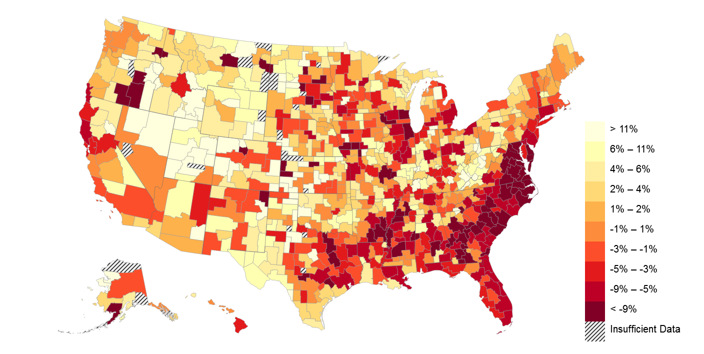
Gender Gaps (M-F) in Employment Rates at Age 30 by Commuting Zone
For Children with Parents in Bottom Quintile of National Income Distribution
Note: Darker colors depict places where boys have lower employment rates than girls

Slide 20
Gender Gaps (M-F) in Employment in the Bottom Parent Income Quintile
Top 10 and Bottom 10 CZs Among 100 Largest CZs
Top 10 CZs in Male-Female Diff. |  |  |  |  |  |  | Bottom 10 CZs in Male-Female Diff.
Rank | CZ |  | Gap | Male | Female |  | Rank | CZ | Gap | Male | Female
1 | Salt Lake City, UT |  | 9.8 | 78.9 | 69.1 |  | 91 | Milwaukee, WI | -9.2 | 65.0 | 74.2
2 | Bakersfield, CA |  | 7.3 | 76.8 | 69.5 |  | 92 | Dallas, TX | -9.4 | 64.7 | 74.1
3 | El Paso, TX |  | 7.2 | 81.8 | 74.6 |  | 93 | Washington DC | -9.7 | 66.6 | 76.3
4 | Brownsville, TX |  | 5.8 | 82.6 | 76.8 |  | 94 | St. Louis, MO | -11.0 | 65.0 | 76.0
5 | Erie, PA |  | 4.1 | 75.6 | 71.5 |  | 95 | Atlanta, GA | -11.1 | 59.3 | 70.4
6 | Eugene, OR |  | 4.0 | 69.0 | 65.0 |  | 96 | Virginia Beach, VA | -11.6 | 65.0 | 76.6
7 | Canton, OH |  | 3.7 | 69.0 | 65.3 |  | 97 | Charlotte, NC | -12.4 | 60.1 | 72.5
8 | Reading, PA |  | 3.2 | 73.7 | 70.5 |  | 98 | Raleigh, NC | -13.6 | 59.9 | 73.5
9 | Spokane, WA |  | 2.5 | 70.3 | 67.8 |  | 99 | Memphis, TN | -15.3 | 59.2 | 74.5
10 | Syracuse, NY |  | 2.4 | 74.2 | 71.8 |  | 100 | Richmond, VA | -16.0 | 62.3 | 78.3

Slide 21
Standard Deviation of Employment Rates Across CZs
By Gender and Parent Income Quintile
5
Male
4
3
Standard Deviation (%)
2
1
0
1st Quintile
2nd Quintile
3rd Quintile
4th Quintile
5th Quintile

Slide 22
Standard Deviation of Employment Rates Across CZs
By Gender and Parent Income Quintile
5
Male
Female
4
3
Standard Deviation (%)
2
1
0
1st Quintile
2nd Quintile
3rd Quintile
4th Quintile
5th Quintile

Slide 23
Causal Effects of Place on Gender Gap
Key lesson: where a child grows up matters most for poor boys
Importantly, most of the variance across areas is driven by causal effects of place (rather than sorting)
Chetty and Hendren (2015) identify causal effects of spending one more year growing up in each area by studying families who move
  Find gender-specific convergence in children’s outcomes
    When a family with a daughter and son moves to a place where boys do well, son does better in proportion to exposure time but daughter does not
  Variation based on where children grow up implies that gender gaps in adulthood are shaped partly by childhood environment
Notes:
23

Slide 24
Predictors of Spatial Variation in Gender Gaps
Natural next question: what are the characteristics of areas for which exposure during childhood produces lower employment rates for low income boys relative to girls in adulthood?
Correlate gender gap in employment rates for children with low-income parents with various CZ-level characteristics
Notes:
24

Slide 25
Correlates of Spatial Variation in Employment Gender Gap
Across CZs, Bottom Parent Income Quintile
Frac. Black Residents (-)
Racial Segregation (-)
Segregation of Poverty (-)
Frac. < 15 Mins to Work (+)
Mean Household Income (-)
Gini Coef. (-)
Top 1% Inc. Share (-)
Student-Teacher Ratio (-)
Test Scores (Inc Adjusted) (+)
High School Dropout (-)
MIG LAB COLL TAX FAM SOC K-12 INC SEG
Social Capital Index (+)
Frac. Religious (+)
Violent Crime Rate (-)
Frac. Single Moms (-)
Divorce Rate (-)
Frac. Married (+)
Local Tax Rate (+)
State EITC Exposure (-)
Tax Progressivity (+)
Colleges per Capita (+)
College Tuition (-)
Coll Grad Rate (Inc Adjusted) (-)
Manufacturing Share (-)
Chinese Import Growth (-)
Teenage LFP Rate (+)
Migration Inflow (-)
Migration Outflow (-)
Frac. Foreign Born (-)
0
0.2
0.4
0.6
0.8
1.0
Magnitude of Correlation

Slide 26
Correlates of Spatial Variation in Employment Gender Gap
Across CZs, Bottom Parent Income Quintile
Frac. Black Residents (-)
Racial Segregation (-)
Segregation of Poverty (-)
Frac. < 15 Mins to Work (+)
Mean Household Income (-)
Gini Coef. (-)
Top 1% Inc. Share (-)
Student-Teacher Ratio (-)
Test Scores (Inc Adjusted) (+)
High School Dropout (-)
MIG LAB COLL TAX FAM SOC K-12 INC SEG
Social Capital Index (+)
Frac. Religious (+)
Violent Crime Rate (-)
Frac. Single Moms (-)
Divorce Rate (-)
Frac. Married (+)
Local Tax Rate (+)
State EITC Exposure (-)
Tax Progressivity (+)
Colleges per Capita (+)
College Tuition (-)
Coll Grad Rate (Inc Adjusted) (-)
Manufacturing Share (-)
Chinese Import Growth (-)
Teenage LFP Rate (+)
Migration Inflow (-)
Migration Outflow (-)
Frac. Foreign Born (-)
0
0.2
0.4
0.6
0.8
1.0
Magnitude of Correlation

Slide 27
Regression Estimates of Gender Gaps in Employment with Key Correlates
For Children with Parents in the Bottom Quintile of National Income Distribution
 | Male-Female Employment Gap
 | (1) | (2)
Segregation of Poverty | -1.620 | -1.948
 | (0.323) | (0.197)
% Black | -3.552 | -3.335
 | (0.536) | (0.563)
% Single Mothers | 0.404 | 0.526
 | (0.666) | (0.413)
State FE |  | X
Notes: Standard errors clustered by state.
Significance levels: * p<0.05, ** p<0.01, *** p<0.001

Slide 28
Mechanisms
Why do areas with concentrated poverty produce lower employment rates for poor boys relative to girls?
One potential mechanism: growing up in poverty induces low-ability boys to select out of formal labor force
  Growing up in poverty reduces perceived return of formal work relative to crime/other activities → more men drop out of labor force
  Consistent with this explanation, more segregated areas have higher rates of crime (correlation = 0.27 across CZs)
Notes:
28

Slide 29
Conclusion
Gender gap in employment is now reversed for children who grow up in low-income families in the U.S.
  Men who grow up in poor families work less than women
Gender gaps vary substantially across areas, with lower employment rates for boys in high-poverty, high-minority neighborhoods
Findings suggest that childhood disadvantage may have particularly detrimental long-term effects on boys
More broadly, understanding of gender gaps in adulthood can be enriched by starting analysis from childhood
  Can increasing segregation and inequality in America explain recent declines in male labor force participation rates?
Notes:
29

Slide 30
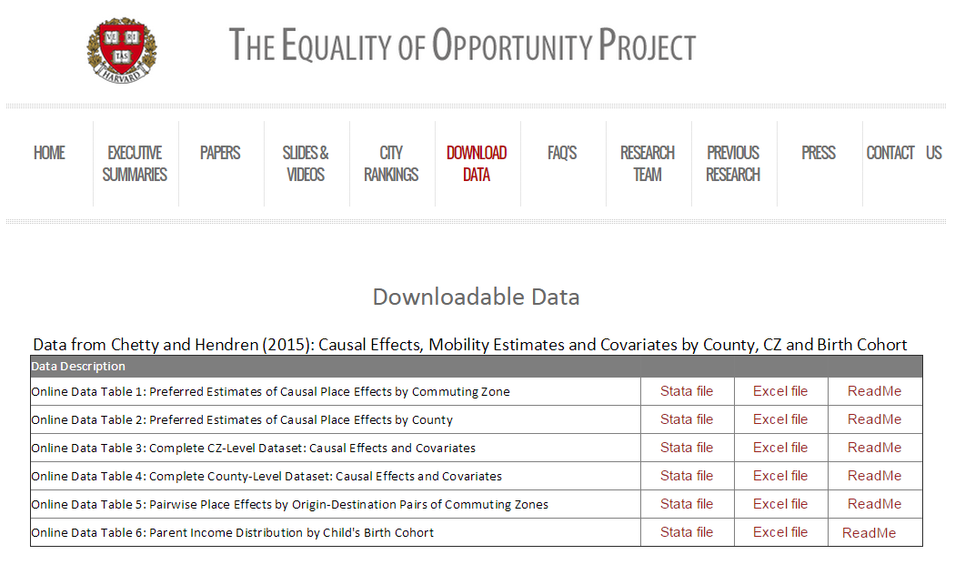
Download County-Level Data on Social Mobility in the U.S.
www.equality-of-opportunity.org/data

Slide 31
Appendix

Slide 32
Children’s Employment Rates at Age 30 by Gender and Parent Income Percentile
Including Non-employee Compensation (Non-Zero Form 1099 Box 7 Income)
90
80
Percent with Positive W-2 or 1099 Income
70
Male-Female Difference
Parent p10: -0.7%
Parent p50: 4.9%
60
Parent p90: 3.8%
0
20
40
60
80
100
Parent Household Income Percentile
Male
Female

Slide 33
Children’s Employment Rates at Age 30 by Gender and Parent Income Percentile
Sample Born after Jan 1, 1970 in the PSID
100
90
80
Percent Employed
70
60
50
1st Quintile
2nd Quintile
3rd Quintile
4th Quintile
5th Quintile
Male
Female

Slide 34
Children’s Employment Rates at Age 30 by Gender and Parent Income Percentile
Trends for Children with Parents in the Bottom Income Quintile in the PSID, 1950-1984
80
70
Percent Employed
60
50
40
1950
1960
1970
1980
Child Year of Birth
Male
Female

Slide 35
Mean Income Rank at Age 30 by Gender and Parent Income Percentile
70
60
Individual Income Percentile
50
40
Male-Female Difference
Parent p10: 2.1%
Parent p50: 7.2%
Parent p90: 6.0%
30
0
20
40
60
80
100
Parent Household Income Percentile
Male
Female

Slide 36
College Attendance by Gender and Parent Income Percentile
100
80
Percent who Attend College
60
40
Male-Female Difference
Parent p10: -16.1%
Parent p50: -13.5%
Parent p90: -4.7%
20
0
20
40
60
80
100
Parent Household Income Percentile
Male
Female

Slide 37
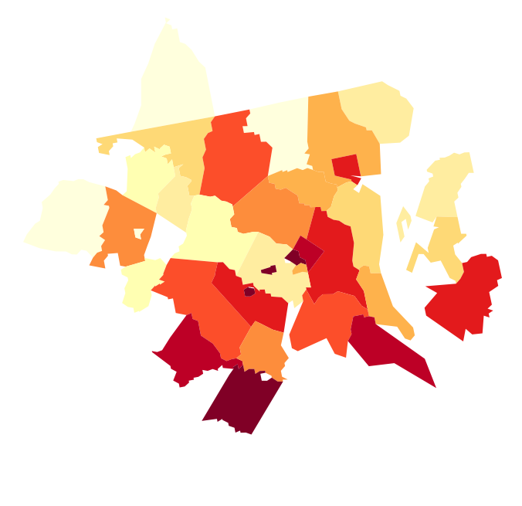
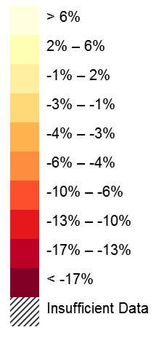
Gender Gap in Employment Rates: DC-Baltimore Combined Statistical Area
Children with Parents in Bottom Quintile of National Income Distribution
Franklin
Hartford
Carroll
Baltimore
Frederick
Mont-gomery
Hampshire
Loudoun
DC
Prince George’s
Dorchester
Fauquier
Charles
Note: Darker colors depict places where boys have lower employment rates than girls

Slide 38
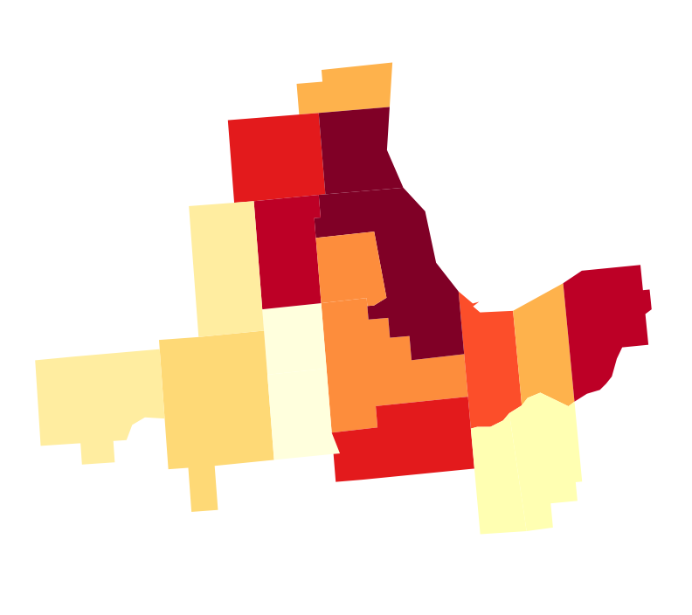
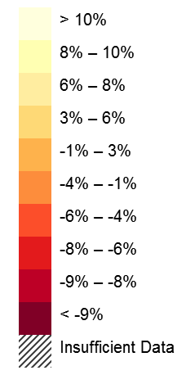
Gender Gap in Employment Rates: Chicago Combined Statistical Area
Children with Parents in Bottom Quintile of National Income Distribution
McHenry
DeKalb
Kane
Du
Page
Cook
LaPorte
Will
Lake
Porter
Bureau
La Salle
Grundy
Note: Darker colors depict places where boys have lower employment rates than girls

Slide 39
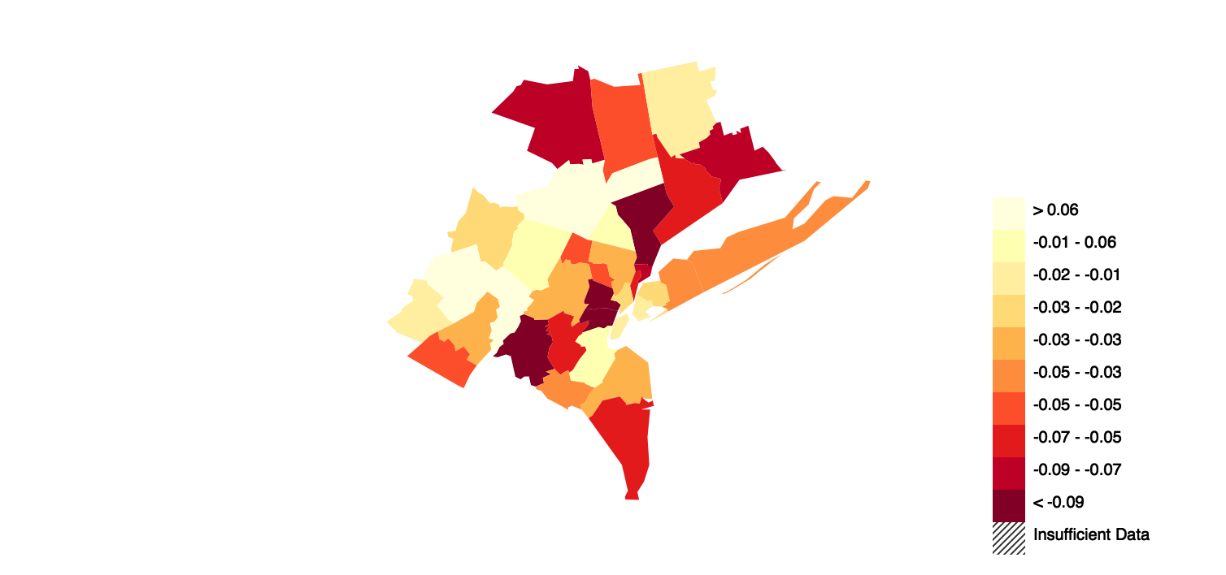
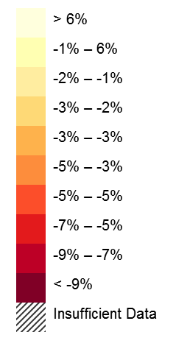
Gender Gap in Employment Rates: New York Combined Statistical Area
Children with Parents in Bottom Quintile of National Income Distribution
Ulster
New Haven
Bergen
Suffolk
Bronx
Monroe
Manhattan
Queens
Brooklyn
Hudson
Ocean
Note: Darker colors depict places where boys have lower employment rates than girls

Slide 40
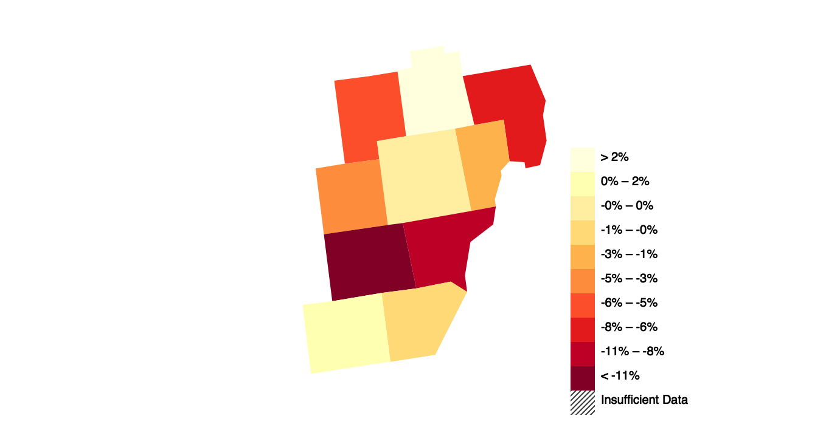
Gender Gap in Employment Rates: Detroit Combined Statistical Area
Children with Parents in Bottom Quintile of National Income Distribution
Genesee
Saint Clair
Oakland
Wayne
Washtenaw
Monroe
Note: Darker colors depict places where boys have lower employment rates than girls

Slide 41
Standard Deviation of Employment Rates Across CZs
By Gender and Parent Income Quintile for Single Parent Households
6
Male
Female
4
Standard Deviation (%)
2
0
1st Quintile
2nd Quintile
3rd Quintile
4th Quintile
5th Quintile

Slide 42
Standard Deviation of Employment Rates Across CZs
By Gender and Parent Income Quintile for Married Parent Households
6
Male
Female
4
Standard Deviation (%)
2
0
1st Quintile
2nd Quintile
3rd Quintile
4th Quintile
5th Quintile

Slide 43
Regression Estimates of Gender Gaps in Income Rank with Key Correlates
For Children with Parents in the Bottom Quintile of National Income Distribution
 | Male-Female Mean Income Rank Gap
 | (1) | (2)
Segregation of Poverty | -2.485 | -2.231
 | (0.246) | (0.186)
% Black | -1.311 | -1.820
 | (0.410) | (0.449)
% Single Mothers | -0.217 | 0.288
 | (0.516) | (0.391)
State FE |  | X
Notes: Standard errors clustered by state.
Significance levels: * p<0.05, ** p<0.01, *** p<0.001

Slide 44
Regression Estimates of Gender Gaps in the Causal Effect on Income Rank
For Children with Parents in the Bottom Quintile of National Income Distribution
 | Male-Female Income Rank Causal Effect Gap
 | (1) | (2)
Segregation of Poverty | -2.464 | -2.780
 | (0.576) | (0.556)
% Black | -0.452 | 1.389
 | (0.777) | (1.326)
% Single Mothers | 0.350 | -0.300
 | (0.743) | (0.866)
State FE |  | X
Notes: Standard errors clustered by state.
Significance levels: * p<0.05, ** p<0.01, *** p<0.001

